Slide 1
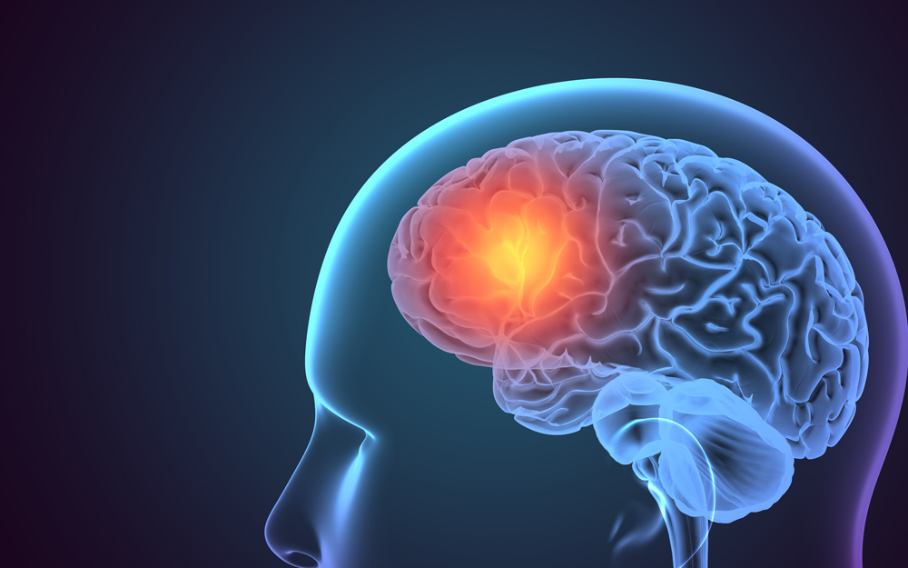
Anticoagulant Reversal in Traumatic Intracranial Hemorrhage
Waliya Qureshi, PGY1 Pharmacy Resident

Slide 2
Objectives
Review an article on Anticoagulant Reversal in Traumatic Intracranial Hemorrhage
Discuss possible exemptions to anticoagulation reversal by reviewing an article on Anticoagulant Reversal in Traumatic Intracranial Hemorrhage
Assess if patient JR was a candidate for anticoagulation reversal

Slide 3

Pre - Test
Which of the following statements is true regarding INR goal for mechanical aortic valve vs. mechanical mitral valve? Select all that apply
Mechanical mitral valve INR goal of 2 - 3
Mechanical aortic valve INR goal of 2.5 – 3.5 for high-risk patients
Mechanical aortic valve INR goal of 2 - 3 for low-risk patients
Mechanical mitral valve INR goal of 2.5 – 3.5
Notes:
B C D

Slide 4
Pre - Test
What are the indications for reversal? Select all that apply
Critical Bleeding Site
Hemodynamic Instability
C) INR > 4 but ≤10 and no bleeding
D) Overt Bleeding: Hgb decrease of > 2 g/dL within 24 hrs, or requiring at least 2u pRBC
E) Emergent Surgery / Procedure in the Prescence of an Oral Anticoagulant
Notes:
• Hold until INR below upper limit of therapeutic range
• Decrease weekly maintenance dose by 5% to 20%
• If patient considered to be at significant risk for bleeding, consider low-dose oral vitamin K
ABDE

Slide 5
Pre - Test
What is the mechanism of action of warfarin?
Direct, highly-selective thrombin inhibitor which reversibly binds to the active thrombin site of free and clot-associated thrombin. Inhibits fibrin formation, activation of coagulation factors 5, 8, and 13, protein C and platelet aggregation
Inhibits the activity of vitamin K epoxide reductase (VKOR), which is essential for the synthesis of certain clotting factors in the liver. By inhibiting VKOR, warfarin interferes with the production of these clotting factors, specifically factors 2, 7, 9, 10, protein C and S, which are necessary for blood clot formation
Inhibits Factor 10 which is responsible for converting prothrombin to thrombin, a crucial step in the formation of blood clots. By inhibiting Factor 10, it interferes with the coagulation process, reducing the formation of blood clots
Potentiates the action of antithrombin III and thereby inactivates thrombin and prevents the conversion of fibrinogen to fibrin
Notes:
factors 2 (half-life 42 to 72 hours), 7 (half-life 4 to 6 hours), 9, and 10 (half-life 27-48 hours) and protein C and S
As a result, warfarin slows down the clotting process, reducing the risk of blood clots forming in conditions such as atrial fibrillation, deep vein thrombosis, and pulmonary embolism.
Answer = B

Slide 6
Pre - Test
What of the following is NOT a complication of anticoagulation reversal?
Hypersensitivity Reactions
Deep vein thrombosis
Pulmonary embolism
They can all be complications
Notes:
D

Slide 7



Patient Case
HPI
JR is a 96yo F who presented with a mechanical fall 2 days prior with head strike. Originally stayed home but is now feeling more lethargic and sleepier
Was getting ready for church but felt dizzy which is when she called her son to take her to the hospital
AAOx3 and denies any other complaints – no back, neck, hip or pelvic pain
PMHx
Afib on warfarin
NSVT s/p pacemaker
Aortic stenosis with mechanical aortic valve (AVR) since 2002
HLD
HTN
Uterine cancer
TIA
CHF
CAD
Gout
Hypothyroidism
CC
Mechanical fall 2 days prior
Lethargy
Sleepiness
Dizziness

Slide 8
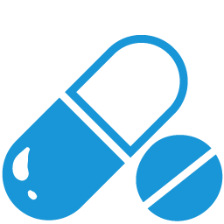
Patient Case
Home Medications
Allopurinol 100 mg daily
Amiodarone 100 mg daily
Amlodipine 5 mg daily
Atorvastatin 40 mg at bedtime
Aspirin 81 mg daily
Calcitriol 0.5 mcg every other day
Furosemide 40 mg daily
Latanoprost 0.005% ophthalmic solution
Levothyroxine 75 mcg daily
Metoprolol succinate 50 mg daily
Spironolactone 25 mg daily
Warfarin 2 mg daily

Slide 9


  Labs
BP: 138/56
HR: 62
RR: 18
SpO2 %: 99
Temperature: 97.7 F
  Imaging
CT head impression:
  Chronic subdural hemorrhage
  No mass effect or shift currently seen
Prothrombin: 35.4
INR: 3.5
Repeat CT head impression:
  Repeat CT head after 6 hours showed slight increase in acute component of SDH
  Tertiary Exam
Alert: Yes
GCS: 15
HEENT: small soft hematoma posterior skull, no lacerations
Neck: non-tender
Chest: non-tender, equal chest rise, non-labored
Abdomen: soft, non-tender, non-distended
Back: no deformities
Upper extremities: left shoulder limited range of motion
Lower extremities: full range of motion
CT C-spine:
  No fracture seen
Chest XR:
  Negative
XR Pelvis:
  No evidence of an acute fracture or dislocation

Slide 10
Review of Systems
Cardio:
Gastrointestinal:
Neuro:
Passed dysphagia screen – on a regular diet
Started on senna 2 tablets HS
  Awake and alert
  Q1h neuro checks
  Started on Keppra 500 mg q12h for 7 days
  Glasgow Coma Scale (GCS) 15
  Home meds started:
    Amlodipine
    Amiodarone
    Atorvastatin
    Furosemide
    Metoprolol
    Spironolactone
Genitourinary:
Allopurinol 100 mg daily for gout
Monitor and correct electrolytes
AKI – SCr 1.61
Pulmonary:
  Slightly elevated troponins – 0.051
  BP goal of 120-140
  EF 35%
  Room air
Infectious Disease:
Endocrine:
  Levothyroxine 75 mcg daily
  HbA1c 6%
  Positive Urinalysis
  E. Coli culture
  Ceftriaxone 1g daily

Slide 11
Review of Systems
Heme
  Received Vitamin K 10 mg IVPB x1 for warfarin reversal
  Did NOT receive Kcentra
  Hemoglobin 12.2
  INR: 3.5 - Follow-up daily INR
  Holding ASA and warfarin

Slide 12
Background

Slide 13
Falls are the primary cause of injury in individuals aged 65 and older, often resulting in traumatic brain injury (TBI), with intracranial hemorrhage (ICH) being a common subtype.
ICH encompasses various types of brain bleeding and is assessed using tools like the Glasgow Coma Scale (GCS) and Abbreviated Injury Scale (AIS) to gauge severity.
Managing anticoagulant use is crucial in TBI cases, necessitating rapid bleeding control.
While guidelines vary, there's uncertainty regarding anticoagulant reversal in minor ICH cases, with limited data suggesting that reversal may not significantly impact outcomes.
Nonetheless, such decisions are complex and require individualized consideration based on factors like patient health, bleeding risk, and guideline variability.
Additionally, while minor TBIs generally have favorable outcomes, they pose significant costs to the healthcare system, highlighting the need for better risk stratification and treatment optimization.

Slide 14
Is Reversal of Anticoagulants Necessary in Neurologically Intact Traumatic Intracranial Hemorrhage?

Slide 15
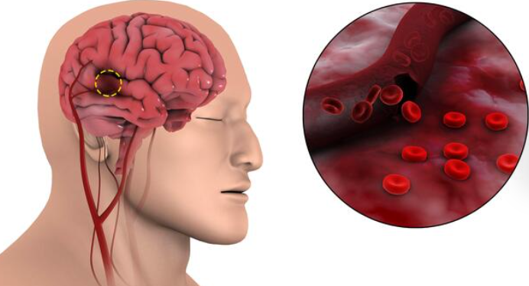
Is Reversal of Anticoagulants Necessary in Neurologically Intact Traumatic Intracranial Hemorrhage?
Introduction
Clinicians often question the necessity of reversal in patients with minor ICH, especially in the setting of increased risk of adverse events. This study aimed to identify a population of patients with minor traumatic ICH at low risk for poor neurologic status where anticoagulant reversal may not improve outcomes.

Slide 16




Inclusion Criteria
Study Design
Retrospective cohort study which retrieved data from Michigan Trauma Quality
Improvement Program (MTQIP) database from 2018 to 2021
Preinjury anticoagulant regimen
ICH due to blunt trauma
GCS score of 15
Abbreviated Injury Scale (AIS) head score
from 2-4
AIS of < 1 for non-head regions within 24 hours of hospital arrival
Age > 18 years old
Outcomes
Exclusion Criteria
Primary outcomes:
Rate of in-hospital mortality or hospice
Secondary outcomes:
ICU length of stay measured in days and composite of in-hospital serious complications
Required emergent neurosurgical procedure
On a preinjury P2Y12 inhibitor
Had an AIS > 1 outside of the head
Were a transfer from another institution
Were indicated to be on both a DOAC and VKA
Notes:
35 trauma centers

Slide 17
Results

Slide 18

Study Population
Dataset consisted of 654 patients:
  263 patients in the reversed anticoagulant group
    N = 120 Factor Xa or DTI
    N = 143 VKA
    391 patients in the non-reversed group
      N = 287 Factor Xa or DTI
      N = 104 VKA
Patients were primarily white, male, and sustained injury by fall
The most common ICH was SDH with 176 (66.9%) patients in the reversed group and 262 (67%) patients in the non-reversed
There was no statistically significant differences in comorbidities between the two cohorts

Slide 19
In-Hospital Outcomes
Unadjusted outcomes regarding mortality/hospice, ICU length of stay, and in-hospital complications did not show statistically significant differences between patients who underwent reversal of anticoagulation and those who did not
Although there were slight variations in outcomes such as hospital length of stay (5.03 days in the reversed group vs. 3.26 days in the not reversed group) and ICU length of stay (1.4 days in the reversed group vs. 1.1 days in the not reversed group), these differences were not statistically significant
Patients who underwent reversal and experienced adverse outcomes received various reversal agents, predominantly 4F-PCC, without significant differences observed between those who survived and those who didn't. However, the time to reversal was significantly longer for patients who died or were discharged to hospice compared to those who were discharged alive.

Slide 20

Discussion
Reversing oral anticoagulation in neurologically intact patients with minor traumatic intracranial hemorrhage (ICH) may not reduce mortality or hospice outcomes
Previous studies showed increased mortality rates in patients with ICH on anticoagulants prior to injury, but these patients had lower neurological intactness compared to the current study's population
Despite the trend of fewer reversals for DOACs compared to VKAs, outcomes were comparable, suggesting reversal may not be necessary
Underscores the potential risks and costs associated with reversal agents and emphasizes the need for further research to validate these findings, explore patient variables influencing reversal decisions, and assess the role of alternative testing methods

Slide 21

Limitations
Include the lack of generalizability due to the inclusion of only Level 1 and Level 2 trauma centers in the MTQIP database, limiting extrapolation to other care settings
Inability to capture certain variables, such as post-reversal CT scans, may affect the comprehensiveness of the findings
The absence of data on anticoagulant and reversal agent doses poses challenges in assessing treatment effectiveness accurately, especially considering potential variations in dosing practices across institutions
The approval of andexanet alfa in May 2018 might have influenced its availability for DOAC reversal, potentially impacting the study's results
Observational nature of the study limits its ability to establish causality, although conducting a prospective study might not be ethical due to limited literature in this area

Slide 22

Conclusion
Study observed patients with traumatic brain bleeding who were on anticoagulants
Found that reversing these medications did not make a difference in outcomes compared to not reversing them, especially in patients with no major neurological issues
Results suggest that in some cases, reversal might not be needed for patients with traumatic brain bleeding
Given the inherent risks involved in caring for such patients, it is essential to approach these findings with caution
Further research is necessary to gain a clearer understanding of which specific patients with traumatic brain bleeding truly benefit from anticoagulation reversal

Slide 23
Back to Patient JR

Slide 24
Patient Case
HPI
JR is a 96yo F who presented with a mechanical fall 2 days prior with head strike. Originally stayed home but is now feeling more lethargic and sleepier
Was getting ready for church but felt dizzy which is when she called her son to take her to the hospital
AAOx3 and denies any other complaints – no back, neck, hip or pelvic pain
PMHx
Afib on warfarin
NSVT s/p pacemaker
Aortic stenosis with mechanical aortic valve (AVR) since 2002
HLD
HTN
Uterine cancer
TIA
CHF
CAD
Gout
Hypothyroidism
CC
Mechanical fall 2 days prior
Lethargy
Sleepiness
Dizziness

Slide 25
Patient Case
Home Medications
Allopurinol 100 mg daily
Amiodarone 100 mg daily
Amlodipine 5 mg daily
Atorvastatin 40 mg at bedtime
Aspirin 81 mg daily
Calcitriol 0.5 mcg every other day
Furosemide 40 mg daily
Latanoprost 0.005% ophthalmic solution
Levothyroxine 0.75 mcg daily
Metoprolol succinate 50 mg daily
Spironolactone 25 mg daily
Warfarin 2 mg daily

Slide 26
Review of Systems
Cardio:
Gastrointestinal:
Neuro:
Passed dysphagia screen – on a regular diet
Started on senna 2 tablets HS
  Awake and alert
  Q1h neuro checks
  Started on Keppra 500 mg q12h for 7 days
  Glasgow Coma Scale (GCS) 15
  Home meds started:
    Amlodipine
    Amiodarone
    Atorvastatin
    Furosemide
    Metoprolol
    Spironolactone
Genitourinary:
Allopurinol 100 mg daily for gout
Monitor and correct electrolytes
AKI – Scr 1.61
Pulmonary:
  Slightly elevated troponins – 0.051
  BP goal of 120-140
  EF 35%
  Room air
Infectious Disease:
Endocrine:
  Levothyroxine 75 mcg daily
  HbA1c 6%
  Positive Urinalysis
  E. Coli culture
  Ceftriaxone 1g daily

Slide 27
Review of Systems
Heme
  Received Vitamin K 10 mg IVPB x1 for warfarin reversal
  Did NOT receive Kcentra
  Hemoglobin 12.2
  INR: 3.5 - Follow-up daily INR
  Holding ASA and warfarin

Slide 28
  Labs
BP: 138/56
HR: 62
RR: 18
SpO2 %: 99
Temperature: 97.7 F
  Imaging
CT head impression:
  Chronic subdural hemorrhage
  No mass effect or shift currently seen
Prothrombin: 35.4
INR: 3.5
Repeat CT head impression:
  Repeat CT head after 6 hours showed slight increase in acute component of SDH
  Tertiary Exam
Alert: Yes
GCS: 15
HEENT: small soft hematoma posterior skull, no lacerations
Neck: non-tender
Chest: non-tender, equal chest rise, non-labored
Abdomen: soft, non-tender, non-distended
Back: no deformities
Upper extremities: left shoulder limited range of motion
Lower extremities: full range of motion
CT C-spine:
  No fracture seen
Chest XR:
  Negative
XR Pelvis:
  No evidence of an acute fracture or dislocation

Slide 29

Timeline
3/17:
  S/p fall 2 days prior
  CT head significant for chronic subdural hematoma
  Received vitamin K 10 mg IVPB x1
3/19:
3/20:
INR of 1.3 this AM
3/22:
Repeat CT head: stable size of evolving subdural hemorrhage
2 days after admission anticoagulant therapy was re-started with warfarin per neurosurgery who wanted slow initiation
INR of 1.1
Bridging with Lovenox (1 mg/kg daily due to AKI) = 60 mg daily
Initiate warfarin 5 mg x1 and PT / INR for tomorrow
Discontinue Lovenox bridging due to worsening SDH overnight
Continue monotherapy with warfarin
Initiate warfarin 5 mg x1 and PT / INR for tomorrow
INR goal of 2.5 – 3.5 due to mechanical aortic valve with several risk factors
INR 2.1 - likely not therapeutic given MOA for initial factor 7 inhibition and delayed 2 and 10 inhibition
3/21:
12pm
Stroke code called – acute ischemic stroke, NIH score 4
Continue AC w/ Warfarin + therapeutic Lovenox bridge
Warfarin 5 mg x1 + PT/INR for tomorrow
BP goal was changed to allow for permissive HTN with SBP goal of 140-180
3/21:
6pm
Phenylephrine 0.5 mcg/kg/min and
NS bolus/infusion was started
Lethargic, waxing / waning mental status
Repeat CT head with worsening SDH
  Discontinued phenylephrine
  SBP goal changed to 120-140
  Avoid pressors
  Lovenox held
Notes:
*Was getting ready to be discharged and patient was not able to see anything such as her bag that was being given to her and had right gaze palsy. LKW = 45 minutes prior
3/21 – NSX wanted slow initiation of AIS
Started Neo for AIS, and fluids, bleed got worse cuz we were driving the BP up
Hemodynamic parameters got worse
Fell = brain bleed= reversed = embolic stroke= likely from her valve not being properly ac = AIS = BP parameters changed = permissive HTN = started fluid and neo to drive = bleed got worse
3/19 – waited too long to re-start the ac
MRS 4 on d/c

Slide 30
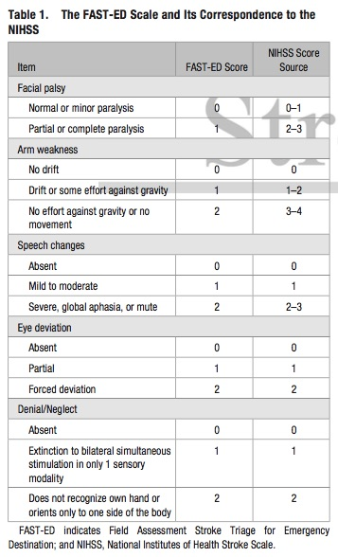
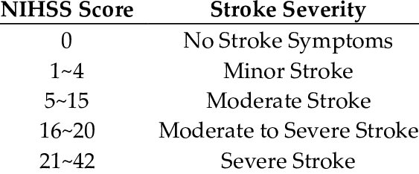
National Institutes of Health Stroke Scale
(NIHSS)
Notes:
- It is used on admission to determine patient eligibility for thrombolytic therapy, throughout the acute hospital stay, and at 3 months to assess neurologic recovery. The NIH stroke scale scores correlates with initial infarct volume, cerebral perfusion, and functional outcome.
- Studies have shown that mild stroke patients with National Institutes of Health Stroke Scale (NIHSS) score 3–5 but not 0–2 may benefit from the intravenous thrombolysis when compared with antiplatelet therapy

Slide 31
Types of Valves | INR Goal / Range
Bileaflet mechanical valve or a tilting disk valve in the aortic position who are in sinus rhythm and without left atrial enlargement | INR goal 2.5 Range 2-3
Tilting disk valves and bileaflet mechanical valves in the mitral position | INR goal 3 Range 2.5-3.5
Bioprosthetic valves in the mitral position | INR goal 2.5 Range 2-3 If additional risk factors for thromboembolism are present- INR goal 2.5 Range 2-3
Notes:
AF, previous thromboembolism, L ventricular dysfunction
Patient had #2

Slide 32

Indications and Considerations for Anticoagulation Reversal
Emergent reversal of acquired coagulation factor deficiency produced by
VKA or DOAC therapy due to the following:
Critical Bleeding Site that can compromise organ function, may cause severe disability, potentially require surgical intervention:
Intracranial
Spinal
Ocular
Thoracic e.g. pericardial tamponade, hemothorax
Intra-abdominal / Retroperitoneal
Airway bleeding associated with respiratory distress
Extremity bleeding causing compartment syndrome
Intraluminal GI bleeding is not a critical site. However, GI bleeding may be considered major in the setting of hemodynamic or overt bleeding criteria
Hemodynamic Instability
MAP < 65
SBP < 90 mm Hg
SBP decreases by at least 40 from baseline, or orthostatic blood pressure changes of SBP at least 20 mm Hg, DBP at least 10 mm Hg upon standing
Overt Bleeding
Hgb decrease of > 2 g/dL within 24 hrs, or requiring at least 2u pRBC
*Any patient with active transfusion protocol automatically meets Overt Bleeding criteria*
Need for emergent surgery or procedure in the presence of an oral anticoagulant

Slide 33

Based on the study, do YOU think patient JR required reversal?

Slide 34


Yes
No

Slide 35

No clear cut answer
Met the criteria for anticoagulation
Came 2 days post fall with no worsening neurologic symptoms
Notes:
Thinking if I need to add more bullet points to this slide

Slide 36
Post - Test
Which of the following statements is true regarding INR goal for mechanical aortic valve vs. mechanical mitral valve? Select all that apply
Mechanical mitral valve INR goal of 2 - 3
Mechanical aortic valve INR goal of 2.5 – 3.5 for high-risk patients
Mechanical aortic valve INR goal of 2 - 3 for low-risk patients
Mechanical mitral valve INR goal of 2.5 – 3.5
Notes:
B C D

Slide 37
Post - Test
Which of the following statements is true regarding INR goal for mechanical aortic valve vs. mechanical mitral valve? Select all that apply
Mechanical mitral valve INR goal of 2 - 3
Mechanical aortic valve INR goal of 2.5 – 3.5 for high-risk patients
Mechanical aortic valve INR goal of 2 - 3 for low-risk patients
Mechanical mitral valve INR goal of 2.5 – 3.5
Notes:
B C D

Slide 38
Pre - Test
What are the indications for reversal? Select all that apply
Critical Bleeding Site
Hemodynamic Instability
C) INR > 4 but ≤10 and no bleeding
D) Overt Bleeding: Hgb decrease of > 2 g/dL within 24 hrs, or requiring at least 2u pRBC
E) Emergent Surgery / Procedure in the Prescence of an Oral Anticoagulant
Notes:
• Hold until INR below upper limit of therapeutic range
• Decrease weekly maintenance dose by 5% to 20%
• If patient considered to be at significant risk for bleeding, consider low-dose oral vitamin K

Slide 39
Pre - Test
What are the indications for reversal? Select all that apply
Critical Bleeding Site
Hemodynamic Instability
C) INR > 4 but ≤10 and no bleeding
D) Overt Bleeding: Hgb decrease of > 2 g/dL within 24 hrs, or requiring at least 2u pRBC
E) Emergent Surgery / Procedure in the Prescence of an Oral Anticoagulant
Notes:
• Hold until INR below upper limit of therapeutic range
• Decrease weekly maintenance dose by 5% to 20%
• If patient considered to be at significant risk for bleeding, consider low-dose oral vitamin K

Slide 40
Pre - Test
What is the mechanism of action of warfarin?
Direct, highly-selective thrombin inhibitor which reversibly binds to the active thrombin site of free and clot-associated thrombin. Inhibits fibrin formation, activation of coagulation factors 5, 8, and 13, protein C and platelet aggregation
Inhibits the activity of vitamin K epoxide reductase (VKOR), which is essential for the synthesis of certain clotting factors in the liver. By inhibiting VKOR, warfarin interferes with the production of these clotting factors, specifically factors 2, 7, 9, 10, protein C and S, which are necessary for blood clot formation
Inhibits Factor 10 which is responsible for converting prothrombin to thrombin, a crucial step in the formation of blood clots. By inhibiting Factor 10, it interferes with the coagulation process, reducing the formation of blood clots
Potentiates the action of antithrombin III and thereby inactivates thrombin and prevents the conversion of fibrinogen to fibrin
Notes:
factors 2 (half-life 42 to 72 hours), 7 (half-life 4 to 6 hours), 9, and 10 (half-life 27-48 hours) and protein C and S
As a result, warfarin slows down the clotting process, reducing the risk of blood clots forming in conditions such as atrial fibrillation, deep vein thrombosis, and pulmonary embolism.
Answer = B

Slide 41
Pre - Test
What is the mechanism of action of warfarin?
Direct, highly-selective thrombin inhibitor which reversibly binds to the active thrombin site of free and clot-associated thrombin. Inhibits fibrin formation, activation of coagulation factors 5, 8, and 13, protein C and platelet aggregation
Inhibits the activity of vitamin K epoxide reductase (VKOR), which is essential for the synthesis of certain clotting factors in the liver. By inhibiting VKOR, warfarin interferes with the production of these clotting factors, specifically factors 2, 7, 9, 10, protein C and S, which are necessary for blood clot formation
Inhibits Factor 10 which is responsible for converting prothrombin to thrombin, a crucial step in the formation of blood clots. By inhibiting Factor 10, it interferes with the coagulation process, reducing the formation of blood clots
Potentiates the action of antithrombin III and thereby inactivates thrombin and prevents the conversion of fibrinogen to fibrin
Notes:
factors 2 (half-life 42 to 72 hours), 7 (half-life 4 to 6 hours), 9, and 10 (half-life 27-48 hours) and protein C and S
As a result, warfarin slows down the clotting process, reducing the risk of blood clots forming in conditions such as atrial fibrillation, deep vein thrombosis, and pulmonary embolism.
Answer = B

Slide 42
Pre - Test
What of the following is NOT a complication of anticoagulation reversal?
Hypersensitivity Reactions
Deep vein thrombosis
Pulmonary embolism
They can all be complications
Notes:
D

Slide 43
Pre - Test
What of the following is NOT a complication of anticoagulation reversal?
Hypersensitivity Reactions
Deep vein thrombosis
Pulmonary embolism
They can all be complications
Notes:
D

Slide 44

References
  Powell K, Curtiss W III, Sadek E, Hecht J. Is reversal of anticoagulants necessary in neurologically intact traumatic intracranial hemorrhage? Pharmacotherapy. 2024; 44: 241-248. doi:10.1002/phar.2901
  Warfarin [monograph]. In: Lexi-Drugs, Hudson, OH: (accessed 2024 April 3)
  Qureshi AI, Huang W, Lobanova I, et al. Outcomes of Intensive Systolic Blood Pressure Reduction in Patients With Intracerebral Hemorrhage and Excessively High Initial Systolic Blood Pressure: Post Hoc Analysis of a Randomized Clinical Trial. JAMA Neurol. 2020;77(11):1355–1365. doi:10.1001/jamaneurol.2020.3075
  Bloomfield P. Choice of heart valve prosthesis. Heart. 2002 Jun;87(6):583-9. doi: 10.1136/heart.87.6.583. PMID: 12010950; PMCID: PMC1767148.
  “Warfarin INR Targets.” GlobalRPH, 18 Sept. 2022, globalrph.com/warfarin-inr-targets/.

Slide 45

Thank you!!!

Slide 46
Questions?

