Slide 1
refractory status epilepticus
Amal Bittar, PharmD.
PGY-1 Pharmacy Resident, MSSN.

Slide 2
Objectives
Discuss status epilepticus patient case findings.
Understand complications that may present in patient with status epilepticus.
Review treatment options for status epilepticus complications.

Slide 3
Patient presentation
WE is a 62 female with past medical history of chronic kidney disease (CKD) stage 2/3 on peritoneal dialysis (PD), coronary artery disease status post non-ST segment elevation myocardial infarction (NSTEMI), chronic alcohol use, opioid abuse on methadone, HIV, recently admitted for bleeding from PD catheter, found to have right renal mass, admitted for a witnessed seizure
.
Social history: History of addiction to heroin, cocaine, marijuana, on methadone daily
Allergies: Tetracycline, shrimp
Home medications: Ticagrelor 90 mg q12hr, carvedilol 12.5 mg po q12hr, emtricitabine-tenofovir 200mg-25 mg po QD, Etravirine 200 mg po q12hr, lanthanum 1000 mg po TID with meals, quetiapine 25 mg po QHS, Renal caps po QD, trazodone 300 mg po QHS.
Notes:
On arrival, patient was unresponsive, intubated for airway protection, loaded with Keppra, and started on midazolam and propofol gtt.

Slide 4
Status Epilepticus

Slide 5
Definitions
Status epilepticus: seizure with 5 minutes or more of continuous clinical and/or electrographic seizure activity or recurrent seizure activity without recovery between seizures. ​
Status epilepticus may be convulsive, non-convulsive, focal motor, myoclonic, and any can become refractory.
Seizure | Definition
Convulsive SE. | Consists of generalized tonic-clonic movements and mental status impairment.
Non-convulsive SE | Seizure activity identified on an electroencephalogram (EEG) with no accompanying tonic-clonic movements.
Focal motor SE | Involves the refractory motor activity of a limb or a group of muscles on one side of the body with or without loss of consciousness is myoclonic status epilepticus.
Refractory SE | Refers to continuing seizures (convulsive or non-convulsive) despite appropriate antiepileptic drugs. Failure of initial (1st line) and subsequent (2nd line) therapy.
Super refractory SE | Failure of continuous infusion anesthetics to control seizure, or recurrence of seizure upon withdrawal of continuous infusion anesthetics

Slide 6
Etiology
Potential acute processes include:
  Central nervous system (CNS) infections (meningitis, encephalitis, and intracranial abscess)
  Metabolic abnormalities (hypoglycemia, hyponatremia, hypocalcemia, hepatic encephalopathy, and inborn errors of metabolism in children)
  Cerebrovascular accidents
  Head trauma (with or without intracranial bleed)
  Drug toxicity
  Drug withdrawal syndromes (e.g., alcohol, benzodiazepines, and barbiturates)
  Hypoxia
  Hypertensive emergency
Chronic processes that may result in status epilepticus include:
  Pre-existing epilepsy with breakthrough seizures or non-compliance with anti-epileptic drugs
  Ethanol withdrawal
  CNS tumors
  Autoimmune disorders
  Remote CNS pathology (e.g., traumatic brain injury, stroke)
Wyile T et al. StatPearls [Internet]. 2022.

Slide 7
Pathophysiology
A seizure is a paroxysmal electrical discharge of neurons in the brain resulting in a change of function or behavior. It is important to understand that a seizure is a CNS event and may present as convulsive or non-convulsive.
Excitatory neurotransmitters
Aspartate
Inhibitory neurotransmitters
gamma-aminobutyric acid
Glutamate
acetylcholine
Other mechanisms
calcium ion-dependent
potassium ion current
magnesium blockade of N-methyl-d-aspartate (NMDA)
Notes:
There are both excitatory neurotransmitters (glutamate, aspartate, and acetylcholine) and inhibitory neurotransmitters (gamma-aminobutyric acid) and mechanisms (calcium ion-dependent potassium ion current and magnesium blockade of N-methyl-d-aspartate (NMDA)) in the brain that play a role in the genesis and inhibition of isolated seizures. Excessive excitation and/or inadequate inhibition results in status epilepticus.

Slide 8
Imaging and Labs
Imaging
A head computed tomography (CTH) scan is appropriate in most situations and most easily obtained.
Magnetic resonance imaging (MRI) of the brain is more sensitive for identifying malformations in pediatric patients but may be difficult to obtain and may require sedation.
Other:
Electroencephalogram (EEG)
Labs
bedside blood glucose level, serum electrolytes, BUN, creatinine, serum bicarbonate, CBC, and a lumbar puncture with cerebrospinal fluid (CSF) evaluation.
If known seizure disorder, anti-epileptic drug levels should be obtained.
Urine toxicology screen, serum levels of specific toxins such as theophylline or lithium.
Other studies may be considered based on the presentation (liver function tests, inborn errors of metabolism, and coagulation studies).
A pregnancy test should be obtained in all women of child-bearing age.

Slide 9
Three Phases For Seizure Management
1- Emergent phase
Stabilization phase (0-5 mins)
Stabilize the patient (ABCs)
Monitor vitals.
Assess oxygenation.
Obtain a glucose level.
Obtain IV access & labs.
Initial therapy phase (5-20 mins)
Benzodiazepines are first line.
Midazolam IM (10mg > 40 kg & 5 mg for 13-40 kg) single dose.
Lorazepam IV (0.1 mg/kg/dose; max 4 mg/dose) may repeat once.
If none of these options are available:
Phenobarbital IV (15mg/kg/dose) single dose.
Diazepam IV (0.15-0.2 mg/kg/dose; max 10 mg/dose) may repeat once.
Intranasal/buccal midazolam.
Diazepam rectal (0.2-0.5 mg/kg/dose; max 20 mg/dose) once dose.

Slide 10
Three Phases For Seizure Management
2- Urgent phase (20-40 min)
Fosphenytoin IV 20 mg PE/kg x1
Max 1500 PE/dose
Valproic acid IV 40 mg/kg x1
Max 3000 mg/dose
Levetiracetam IV 60mg/kg x1
Max 4500 mg/dose
Alternative: phenobarbital IV 15 mg/kg x1

Slide 11
Three Phases For Seizure Management
3- Refractory phase (40-60 min): continuous EEG monitoring
  Repeat second line therapy or
  Anesthetic doses of the following
Thiopental
Midazolam
Phenobarbital
Propofol

Slide 12
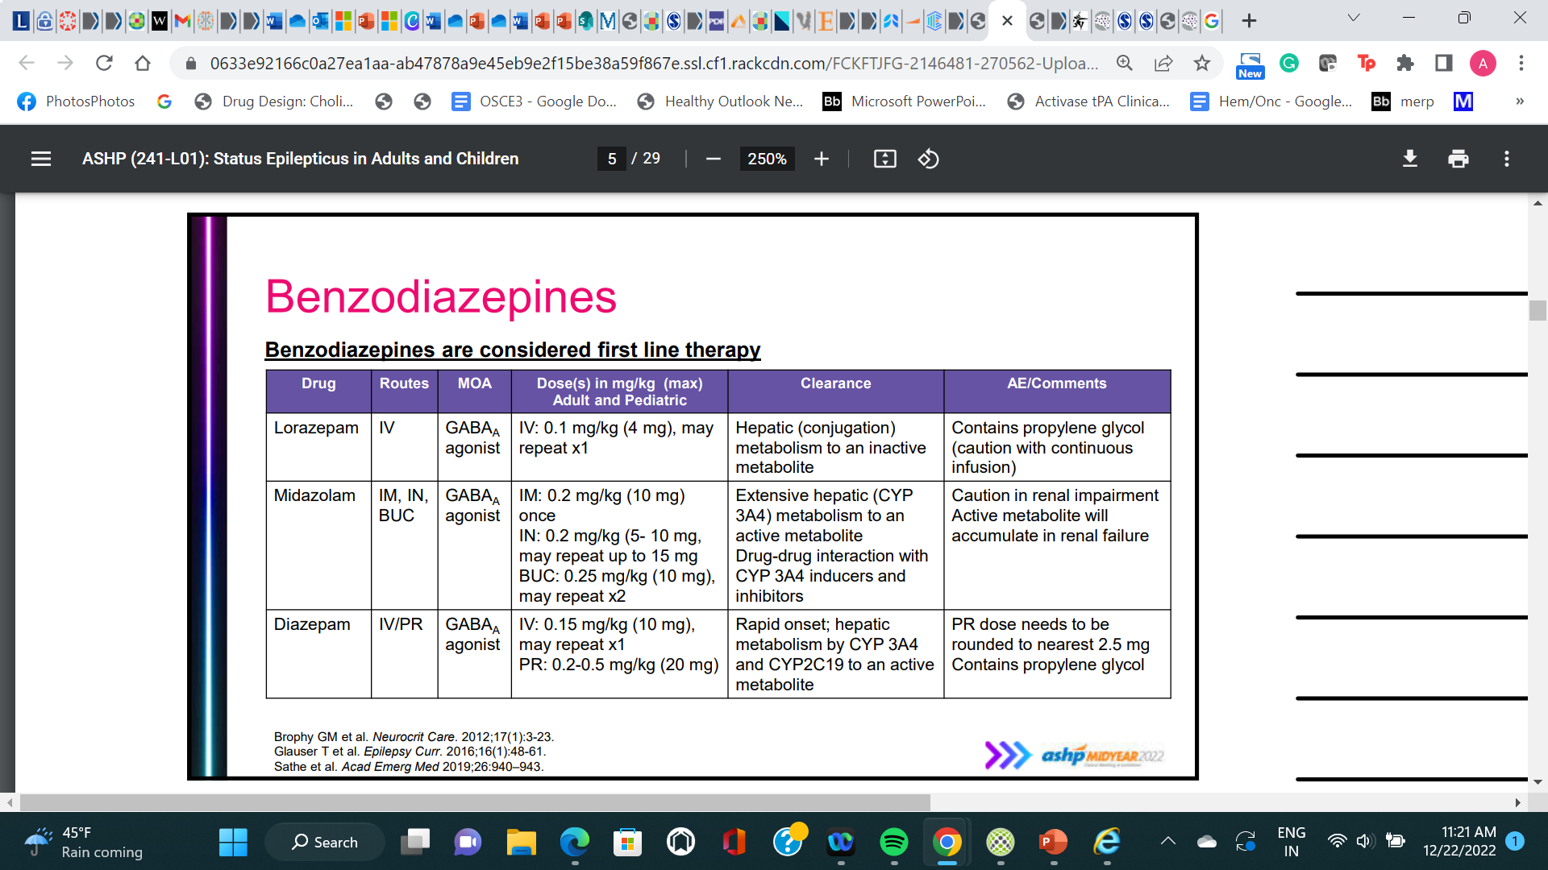
Benzodiazepines

Slide 13
Urgent Phase

Slide 14
Drug | Mechanism |  |  |  | Dose | Side Effects | Comments
 | Na | GABA |  | SV2A
Fosphenytoin | +++ |  | - | - | Loading: 20 mg PE/kg IV Maintenance: 4-7 mg PE/kg/day in 2- 4 doses IV or PO | Dose-related sedation: nystagmus, lethargy, coma Thrombocytopenia, gingival hyperplasia, rash – Stevens Johnson Syndrome (SJS) | Do not exceed infusion rate of 150 mg PE/minute – hypotension CYP 3A4 enzyme inducer
Valproic acid | + |  | ++ | - | Loading: 20-40 mg/kg (3000 mg) IV Maintenance: 10-15 mg/kg/day in 3 doses IV or PO | Drowsiness, thrombocytopenia, hyperammonemia, hepatotoxicity, polycystic ovarian syndrome, teratogenic | Monitor ammonia level in critically ill patients with malnutrition CYP 3A4 DDI
Levetiracetam | - |  | + | +++ | Loading: 20-60 mg/kg (4500 mg) IV Maintenance: 1000-2000 mg twice daily IV or PO | Aggression, psychosis, sedation | Well tolerated compared with previous generations of AEDs
Lacosamide | +++ |  | - | - | Loading: 200-400 mg IV Maintenance: 100-300 mg twice daily IV or PO | PR interval prolongation – risk of atrioventricular block, bradycardia, balance & coordination difficulties | PR prolongation and bradycardia especially with IV push
Phenobarbital | - |  | +++ | - | Loading: 15-20 mg/kg IV Maintenance: 2 mg/kg/day in 2 doses IV or PO | Drowsiness, hypotension, hepatoxicity, rash - SJS/TENS, thrombocytopenia | CYP 3A4 enzyme inducer, IV formulation contains propylene glycol
GABA: Gamma aminobutyric acid SVA2A: Synaptic Vesicle Glycoprotein 2A

Slide 15
Refractory Phase

Slide 16
Therapeutic goal
Burst Suppression on EEG

Slide 17
Midazolam
Enhancement of the inhibitory effect of GABA which results by increased neuronal membrane permeability to chloride ions. This shift in chloride ions results in hyperpolarization (a less excitable state) and stabilization.
Dose:
  0.2 mg/kg IV bolus given at a rate of 2 mg/min (max 2mg/kg). Additional boluses should be given every five minutes until seizures stop.
  Followed by a continuous infusion of 0.05-2 mg/kg/hour. Can be titrated upwards to as high as 3 mg/kg/hour.
  For breakthrough, IV bolus of 0.1 to 0.2 mg/kg every 3 to 5 minutes in addition to increasing infusion rate by 0.05 to 0.1 mg/kg/hour every 3 to 4 hours
  If this is unsuccessful within 45 to 60 minutes, a propofol or pentobarbital infusion should be started.

Slide 18
Midazolam
Taper
  After 24 hours of burst suppression, gradually decrease the dose 50% every 3 hours to prevent recurrent status epilepticus or taper off over 4 to 6 hours.
Adverse drug reactions:
  Hypotension with higher doses, tachyphylaxis.
Pharmacokinetics
  Midazolam is lipophilic at physiologic PH.
  Onset: 1 to 5 minutes (dose dependent).
  Metabolism: Extensively hepatic via CYP3A4; 60% to 70% of biotransformed midazolam is the active metabolite 1-hydroxy-midazolam (or alpha-hydroxymidazolam).

Slide 19
Propofol
Propofol is a highly lipophilic phenol derivative and gamma-aminobutyric acid A (GABA-A) agonist with anticonvulsant properties.
Dose
  1 to 2 mg/kg IV loading dose over 5 minutes and repeated (0.5 to 2 mg/kg) until seizures stop, max 10 mg/kg.
  After loading dose, start continuous propofol infusion at 20 mcg/kg/minute (1.2 mg/kg/hour) and titrated over the next 20 to 60 minutes to maintain a seizure-free state.
  For breakthrough status epilepticus.
    IV bolus of 0.5 to 2 mg/kg every 3-5 minutes in addition to increasing the continuous infusion rate by 5 to 10 mcg/kg/minute (0.3 to 0.6 mg/kg/hour) every 5 minutes until seizures are controlled.
    Infusion rates of up to 170 to 200 mcg/kg per minute (10 to 12 mg/kg per hour) may be required but should not be maintained for more than 48 hours because of the risk of the propofol infusion syndrome.
Notes:
If seizures are controlled with propofol, the effective infusion rate should be maintained for 24 hours and then tapered at a rate of 5 percent per hour. This helps to prevent rebound seizures that commonly occur with abrupt propofol discontinuation. It is critical that high therapeutic levels of at least one longer-acting antiseizure medication are maintained prior to tapering the propofol in order to reduce the risk of seizure recurrence.
Treatment with propofol should generally be considered unsuccessful if it does not terminate seizure activity within approximately 60 minutes. In this case, switching to or adding a benzodiazepine drip (midazolam) or a high-dose barbiturate (ie, pentobarbital or thiopental) infusion may help.

Slide 20
Propofol
Taper
  If seizures are controlled with propofol, the effective infusion rate should be maintained for 24 hours and then tapered at a rate of 5% per hour to prevent rebound seizures that commonly occur with abrupt propofol discontinuation.
  It is critical that high therapeutic levels of at least one longer-acting antiseizure medication are maintained prior to tapering the propofol in order to reduce the risk of seizure recurrence.
ADE
  Dose-dependent hypotension, hypertriglyceridemia,
  Propofol infusion syndrome consists of rhabdomyolysis, severe metabolic acidosis, and cardiac and renal failure. It appears to be more common with prolonged use (over 48 hours), in children, and with infusion rates of greater than 5 mg/kg/hour.
Treatment with propofol should generally be considered unsuccessful if it does not terminate seizure activity within approximately 60 minutes. Consider switching to or adding a benzodiazepine drip (midazolam) or a high-dose barbiturate (ie, pentobarbital or thiopental) infusion.

Slide 21
Pentobarbital
Long-acting barbiturate with sedative, hypnotic, and antiseizure properties. Barbiturates depress the sensory cortex, decrease motor activity, alter cerebellar function, and produce drowsiness, sedation, and hypnosis. In high doses, barbiturates exhibit antiseizure activity; barbiturates produce dose-dependent respiratory depression.
Dose
  An initial dose of 5 mg/kg infused over 10 minutes (maximum rate 50 mg/minute).
  If seizure activity continues, additional 5 mg/kg re-bolus should be administered with careful attention to the EEG and hemodynamic status.
  Followed by a continuous infusion of 1 mg/kg/hour, titrated as needed by 0.5 to 1 mg/kg/hour every 12 hours up to 5 mg/kg/hour to achieve seizure control or a burst suppression pattern on EEG.
Taper
  If seizures are terminated with pentobarbital, the infusion is typically maintained for at least 24 hours before tapering.
  Before tapering pentobarbital, high therapeutic concentrations of other antiseizure medications should be maintained.

Slide 22
Ketamine
Ketamine, an N-methyl-D-aspartate (NMDA) antagonist that blocks the excitatory neurotransmitter glutamate, has promise as a treatment for RSE. Glutamate antagonists might be particularly helpful in the later phases of status epilepticus when GABA agonists or promoters (eg, benzodiazepines and barbiturates) have lost some effectiveness and excessive glutamatergic activity may perpetuate seizures.
Dose
  2 mg/kg, followed by an infusion of 1.5 to 10 mg/kg per hour, titrated to suppression of electrographic seizures.
  Optimal dosing has not yet been defined.
ADE
  Unlike most other drugs used in the treatment of refractory SE, ketamine does not suppress cardiovascular function and may have advantages for patients at risk of hypotension.
  CNS depression, increase intracranial and ocular pressure, hepatotoxicity, thyroid disorders, delirium, hallucinations.

Slide 23
Back To The Case

Slide 24
Labs and Imaging on Admission
CTH: negative for acute hemorrhage
MRI brain: No acute intracranial pathology.
Chest Xray: Minimal right basilar atelectasis. No acute cardiopulmonary process.
Urine Toxins screen: + methadone.
Peritoneal fluids: + WBC 25, +RBC 6000.
Peritoneal, urine, CSF, blood cultures pending.
Height 152.4 cm
Weight ​42.3 kg
HR 98 bpm
BP 222/122
RR: 14
Temp: 97.5
136
102
9.8
56
151
7.8
180
5.4
22
6.71
28.5

Slide 25
Active Problems
Status epilepticus
Hypertensive emergency
Meningoencephalitis
CKD stage 2/3 on PD
Notes:
Meningitis

Slide 26
Hospitalization Day 1
Status Epilepticus
  midazolam 5 mg in the field
  lorazepam 2 mg in the ED
  loaded with levetiracetam 1 g IVP
  started on propofol drip @ 35 mcg/kg/min
  Midazolam drip @ 0.38 mg/hr
  cEEG: background activity is discontinuous, asymmetric, disorganized and consistent of predominantly delta activity with frontally predominant overriding low voltage theta and alpha activity. There is also frequent lower voltage diffuse beta activity.
  Frequent 1-3 second periods of diffuse attenuation.
Hypertensive emergency
  Clevidipine drip
Chronic kidney disease on PD
  Intermittent hemodialysis
Suspected meningitis/HIV
  Lumbar puncture pending.
  CD4 count, cryptococcus Antigen CSF negative, VDRL negative, toxoplasma titer, CMV titer, QuantiFeron TB Gold, viral load not detected, Varicella zoster CSF negative, CSF culture, blood cultures, urine culture pending.
  Acyclovir, fluconazole, vancomycin, ampicillin and ceftriaxone
VDRL: venereal disease research laboratory
CMV: cytomegalovirus

Slide 27
Hospitalization Day 2
Status Epilepticus
  levetiracetam 500 mg po q12hr
  started on propofol drip @ titrated up 50 mcg/kg/min
  Midazolam drip @ titrated up 20 mg/hr
  cEEG: Frequent 1-3 second periods of diffuse attenuation. Occasional to frequent diffuse sharp waves.
Hypertensive emergency
  Clevidipine drip held
  carvedilol 12.5mg PO q12hrs
  Norepinephrine drip
Chronic kidney disease on PD
  Intermittent hemodialysis
Suspected meningitis/HIV
  Lumbar puncture abnormal with elevated Protein 90.4, glucose 133.
  CD4 count 405, cryptococcus Antigen CSF and blood negative, VDRL negative, toxoplasma titer negative, CMV titer IgG + and IgM negative, QuantiFeron TB Gold, repeat viral load not detected, urine cultures negative
  Acyclovir, vancomycin, and ceftriaxone.
VDRL: venereal disease research laboratory
CMV: cytomegalovirus

Slide 28
Hospitalization Day 3
Status Epilepticus
  levetiracetam 500 mg po q12hr
  propofol drip @ titrated up 50 mcg/kg/min
  No seizures noted, midazolam drip tapered off > return of seizure activity on EEG > Vimpat load 200 mg IVPB and Vimpat 100 mg q12hr initiated
  cEEG: rare 1-2 second periods of diffuse attenuation. Abundant generalized sharp waves.
Hypertensive emergency
  Clevidipine drip held
  carvedilol 12.5mg PO q12hrs
Chronic kidney disease on PD
  Intermittent hemodialysis
Suspected meningitis/HIV
  Blood cultures, CSF culture pending
  Acyclovir, vancomycin, and ceftriaxone
VDRL: venereal disease research laboratory
CMV: cytomegalovirus

Slide 29
Hospitalization Day 4
Status Epilepticus
  levetiracetam 500 mg po q12hr
  Vimpat increases 150 mg q12hr initiated
  started on propofol drip @ titrated 30 mcg/kg/min
  Restarted midazolam drip @ titrated 20 mg/hr
  cEEG: Frequent second periods of diffuse attenuation. Moderate to severe generalized slowing. Abundant generalized sharp waves, becomes rare after 11 am.
Hypertensive emergency
  Clevidipine drip held
  carvedilol 12.5mg PO q12hrs
  Amlodipine 10 mg po daily.
Chronic kidney disease on PD
  Intermittent hemodialysis
Suspected meningitis/HIV
  Blood cultures, CSF culture pending
  Acyclovir, vancomycin, and ceftriaxone
VDRL: venereal disease research laboratory
CMV: cytomegalovirus
Notes:
Fentanyl drip 250 mcg/hr
Precedex held

Slide 30
Hospitalization Day 5
Status Epilepticus
  levetiracetam 500 mg po q12hr
  Vimpat 150 mg q12hr initiated
  Valproic acid 500 mg IVPB q6hr
  propofol drip @ 45 mcg/kg/min
  Midazolam drip @ 13 mg/hr
  cEEG: frequent 2-3 second periods of diffuse suppression. Occasional generalized sharp waves.
Hypertensive emergency
  Clevidipine drip held
  carvedilol 12.5mg PO q12hrs
  Amlodipine 10 mg po daily.
Chronic kidney disease on PD
  Intermittent hemodialysis
Suspected meningitis/HIV
  Blood cultures, CSF culture pending .
  Acyclovir, vancomycin, and ceftriaxone
VDRL: venereal disease research laboratory
CMV: cytomegalovirus

Slide 31
Hospitalization Day 6
Status Epilepticus
  levetiracetam 500 mg po q12hr
  Vimpat 150 mg q12hr initiated
  Valproic acid 500 mg IVPB q6hr
  started on propofol drip @ tapered off
  Midazolam drip @ tapered off
  cEEG: rare 1-2 second periods of diffuse attenuation. Abundant generalized sharp waves lasting very brief to long durations
Hypertensive emergency
  Clevidipine drip held
  carvedilol 12.5mg PO q12hrs
  Amlodipine 10 mg po daily added.
Chronic kidney disease on PD
  Intermittent hemodialysis
Suspected meningitis/HIV
  Lumbar puncture abnormal with elevated Protein 90.4, glucose 133.
  Blood cultures negative, CSF culture pending
  Acyclovir, vancomycin, and ceftriaxone
VDRL: venereal disease research laboratory
CMV: cytomegalovirus

Slide 32
Hospitalization Day 7
VPA level day 7: 24.2
Status Epilepticus
  levetiracetam 500 mg po q12hr
  Valproic acid load 900 mg IVPB
  Valproic acid 500 mg IVPB q6hr
  started on propofol drip @ titrated up 50 mcg/kg/min
  Midazolam drip @ titrated up 20 mg/hr
  cEEG: Occasional 1-2 second periods of diffuse attenuation. Abundant generalized sharp waves lasting very brief to long durations. This decreases after the addition of VPA load, sharp waves become lower in amplitude still abundant in wake periods but less periodic.
Hypertensive emergency
  Clevidipine drip held
  carvedilol 12.5mg PO q12hrs
  Amlodipine 10 mg po daily.
Chronic kidney disease on PD
  Intermittent hemodialysis
Suspected meningitis/HIV
  CSF cultures NGTD.
  Acyclovir, vancomycin, and ceftriaxone
VDRL: venereal disease research laboratory
CMV: cytomegalovirus

Slide 33
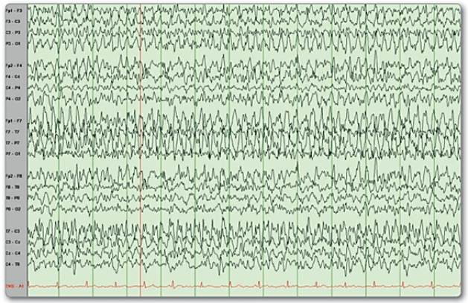
Summary of cEEG findings
Severe generalized slowing which improves to moderate diffuse slowing as anesthesia medications are tapered off on day 6.
Abundant generalized sharp waves very brief in duration which becomes rare on day 4 and increases on day 6 when sedation is tapered off. This improves after the additional VPA on day 7.

Slide 34
Test your knowledge
What is the goal from refractory status epilepticus treatment?
  Return the patient to baseline mental status.
  Enhance activity of daily living when patient returns to baseline.
  Burst wave suppression on EEG.
  Suppression of convulsion.

Slide 35
References
Bledsoe, K.A., Kramer, A.H. Propylene Glycol Toxicity Complicating Use of Barbiturate Coma. Neurocrit Care 9, 122–124 (2008). https://doi.org/10.1007/s12028-008-9065-z.
Brophy GM, Bell R, Claassen J et al. Guidelines for the evaluation and management of status epilepticus. Neurocrit Care. 2012; 17:3-23.
Glauser T, Shinnar S, Gloss D et al. Evidence-based guideline: treatment of convulsive status epilepticus in children and adults: report of the guideline committee of the American Epilepsy Society. Epilepsy Curr. 2016; 16:48-61. 2.
Lexi-Drugs/Ketamine. Lexicomp app. UpToDate Inc. Accessed December 29, 2021.
Lexi-Drugs/Midazolam. Lexicomp app. UpToDate Inc. Accessed December 29, 2021.
Lexi-Drugs/Phenobarbitol. Lexicomp app. UpToDate Inc. Accessed December 29, 2021.
Lexi-Drugs/Propofol. Lexicomp app. UpToDate Inc. Accessed December 29, 2021.
Wylie T, Sandhu DS, Murr N. Status Epilepticus. 2022 May 15. In: StatPearls [Internet]. Treasure Island (FL): StatPearls Publishing; 2022 Jan–. PMID: 28613459.

Slide 36


