Slide 1
Cardiac Questions

Slide 2
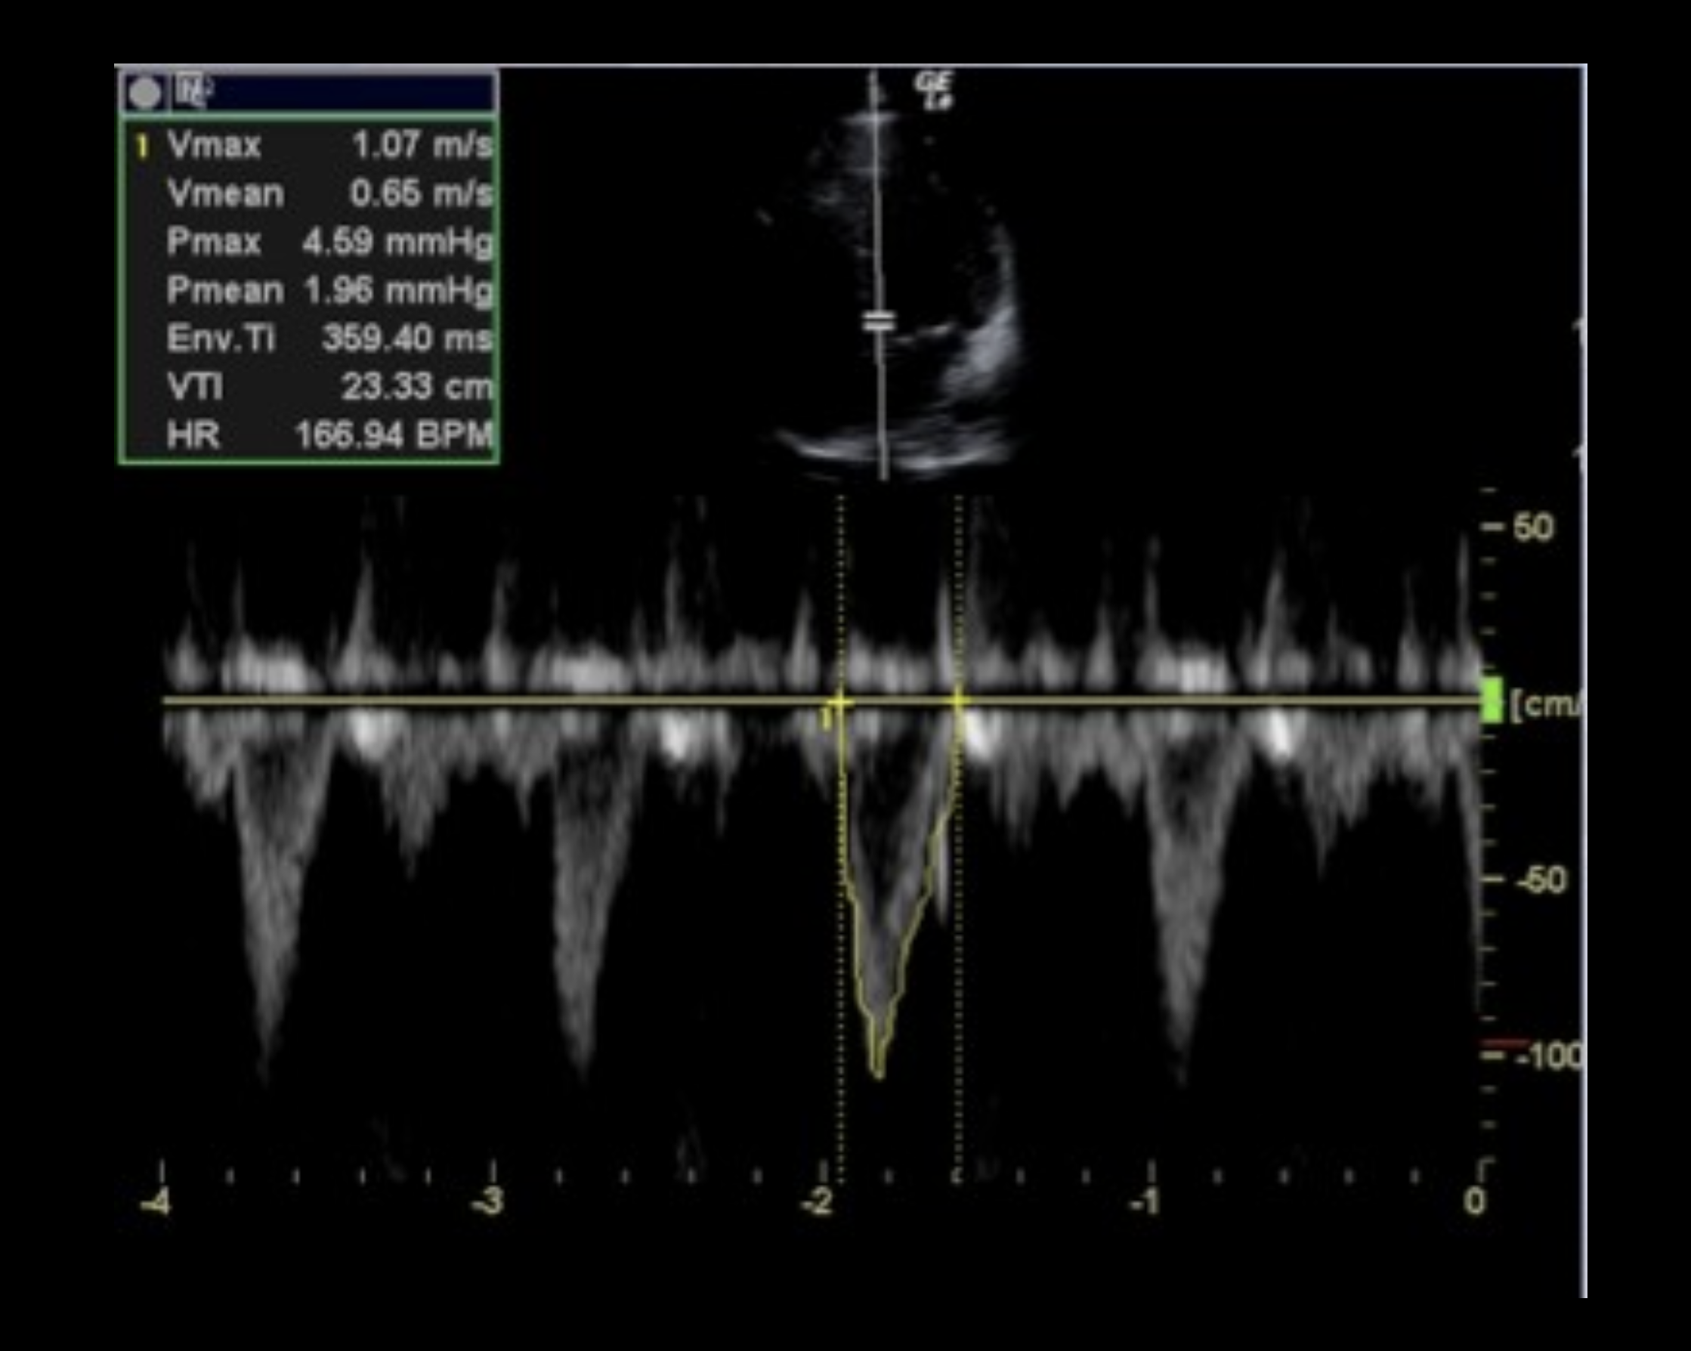
Question: Why are the wave forms downward on the screen?

Slide 3
Question: Why are the wave forms downward on the screen?
Blood is moving AWAY from the probe. The marker is at the opening of the aortic outflow tract. Blood moves from LV out the outflow tract which is away from the probe (probe at top of screen, this is in A5C view)

Slide 4
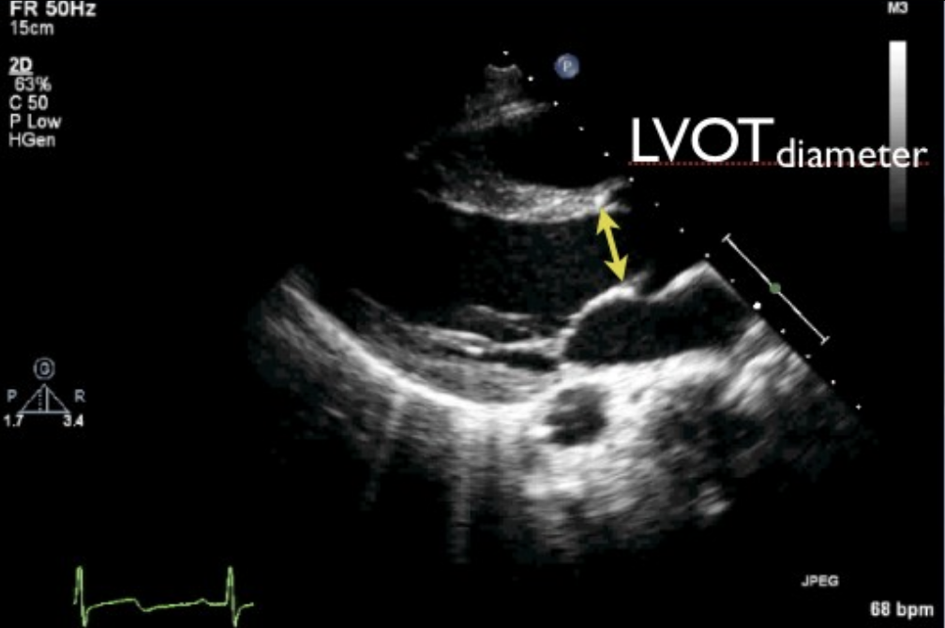
Question: What happens if you measure the LVOT during diastole (filling) or just not during mid-SYSTOLE?

Slide 5
Question: What happens if you measure the LVOT during diastole (filling) or just not during midSYSTOLE?
Your diameter will be smaller than it really is and therefore your area will be smaller than it really is (remember that diameter is in the numerator/proportional). If you’re not measuring when the blood is being pushed out at the max opening of the AORTIC valves, when the valves are all the way open, you’re not measuring at it’s greatest diameter.

Slide 6
Question: If your pulsed wave doppler gate is not in the middle of the blood flow (aka parallel to the blood flow) where you measured the LVOT diameter what could happen?

Slide 7
Question: If your pulsed wave doppler gate is not in the middle of the blood flow (aka parallel to the blood flow) where you measured the LVOT diameter what could happen?
Your velocity will be less because the fastest flow is in the middle so your VTI will be underestimated. When plugged into the main equation, your stroke volume and therefore cardiac output will also be underestimated

Slide 8
Question: What does VTI measure?

Slide 9
What does VTI measure?
The distance blood travels in one cardiac cycle (aka heart beat)

Slide 10
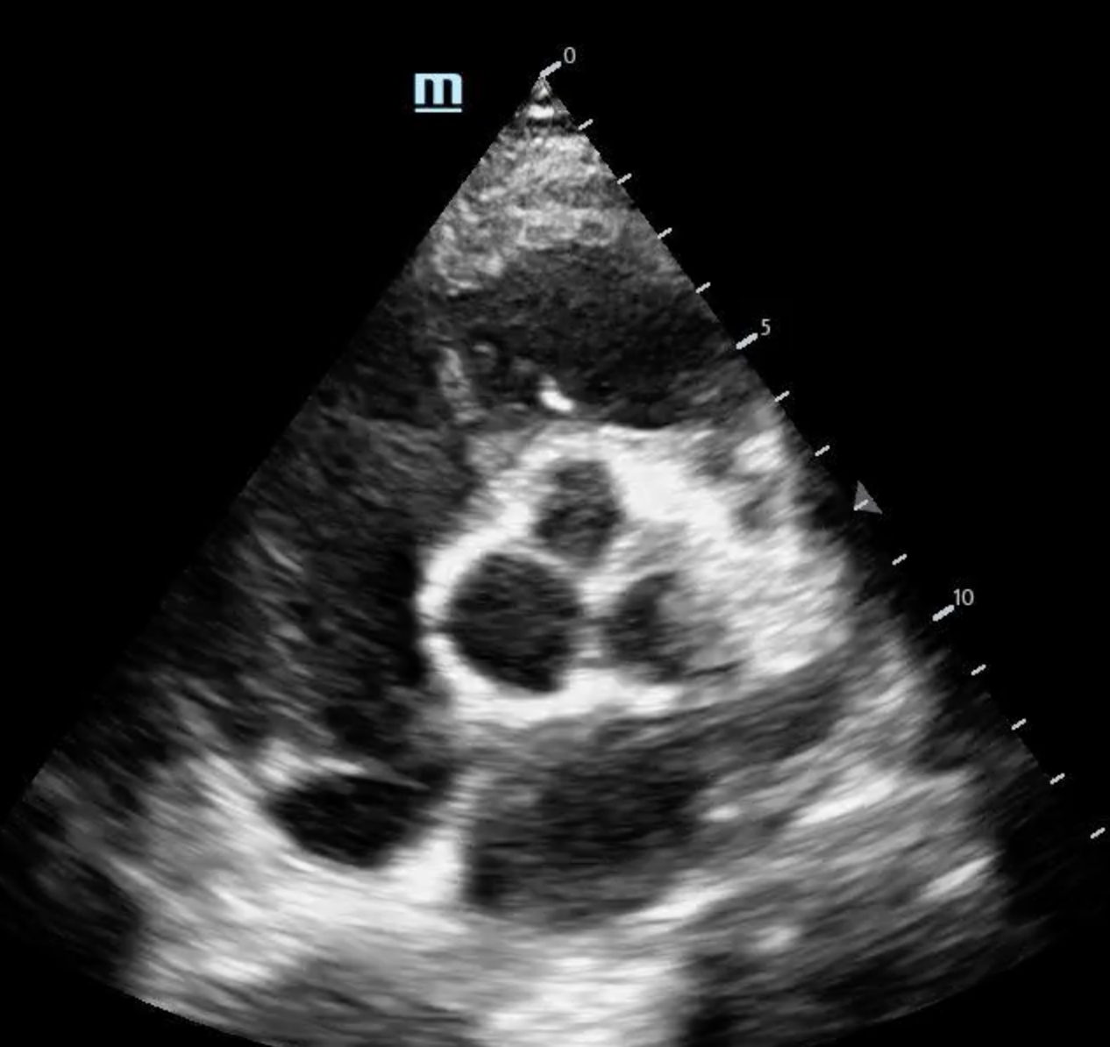
Name the Anatomy

Slide 11
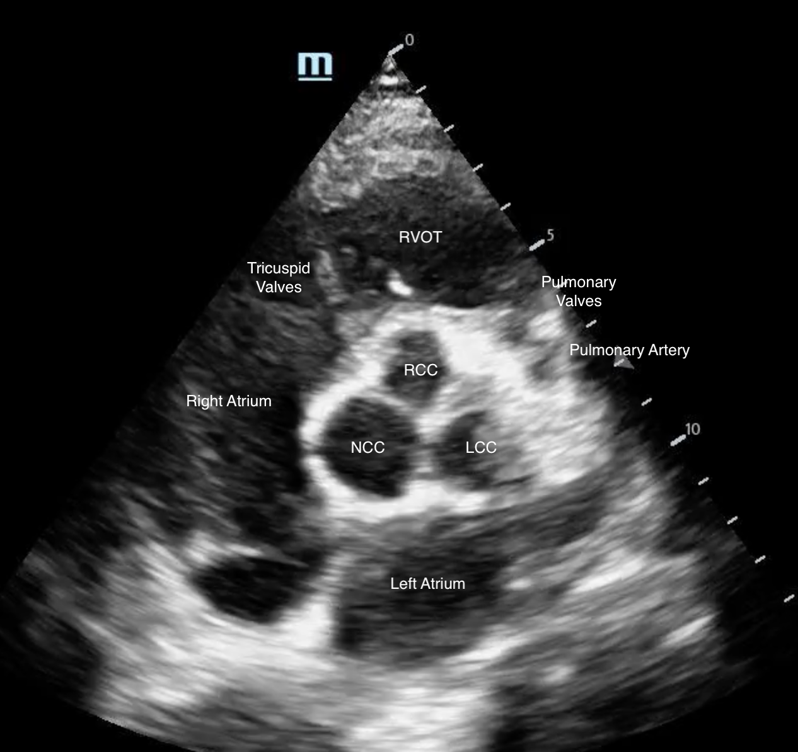
Name the Anatomy

Slide 12
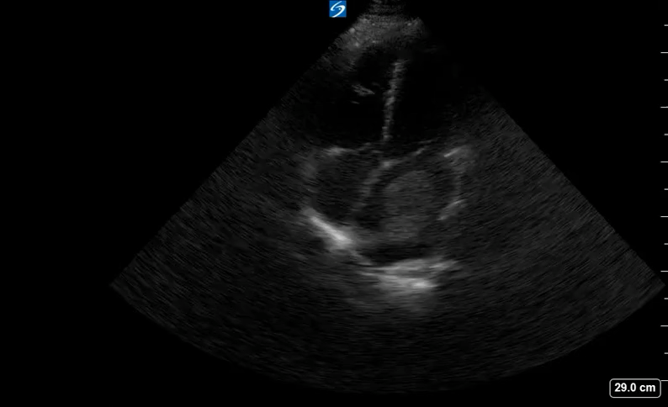
What kind of murmur would you expect to hear with the following image?
Mid-diastolic Rumble
Holosystolic murmur
Mid-systolic click
Systolic crescendo decrescendo murmur
Notes:
Adapted from Chiem EUS board review book?

Slide 13
A. Mid-diastolic rumble
Atrial myxomas are usually in the left atrium and can cause obstructions leading to shortness of breath, heart failure, arrhythmias, myocardial infarctions and death. It acts as a mitral stenosis, making the opening SMALLER, hence the mid-diastolic rumble. Remember the mneumonic:
hARD ASS MRS MSD
Aortic regurg=diastolic
Aortic stenosis=systolic
Mitral regurg systolic
Mitral stenosis diastolic

