Slide 1

Pericardiocentesis
Elizabeth Yetter MD
Yasamin Soltanianzadeh MD
Edmund HSU MD
Daniel Weinick MD

Slide 2
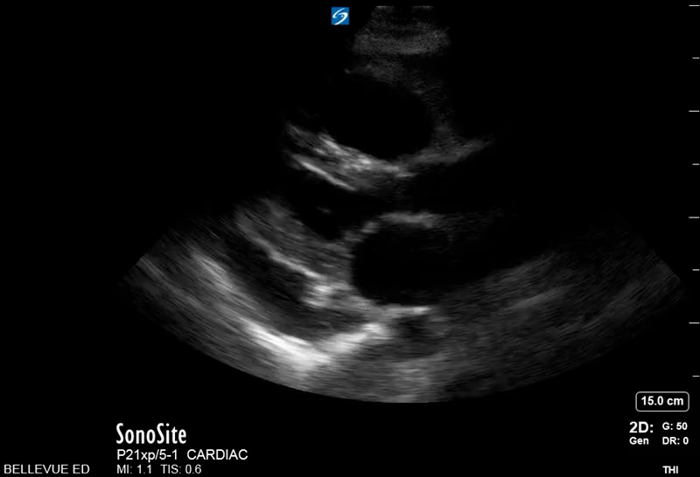
What’s the difference between this:
Notes:
Large effusion in PSSL, no RV diastolic collapse

Slide 3
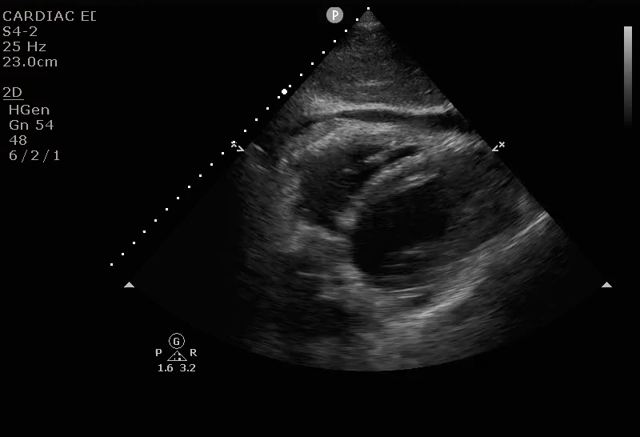
And this?
Notes:
Tamponade in SubX view. Note RV Diastolic Collapse (Diastole when valves open and blood supposed to fill from atrium to ventricles)
Pressure in pericardium is greater than the pressure in the ventricle, causing the collapse.
Remember that the RV is thin and it’s pressure is lowest at EARLY diastole (you just started filling!)

Slide 4
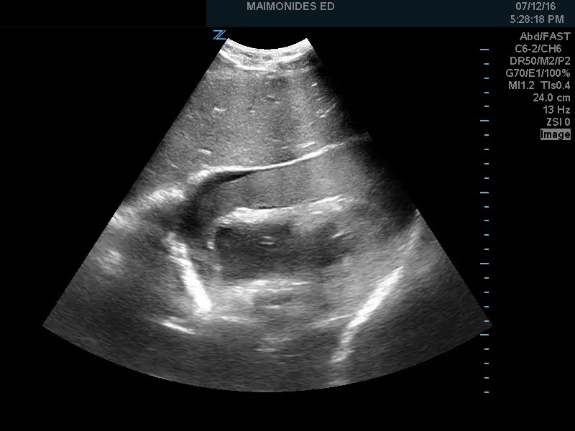
What about this one?
Notes:
Tamponade with large clot
subX view

Slide 5
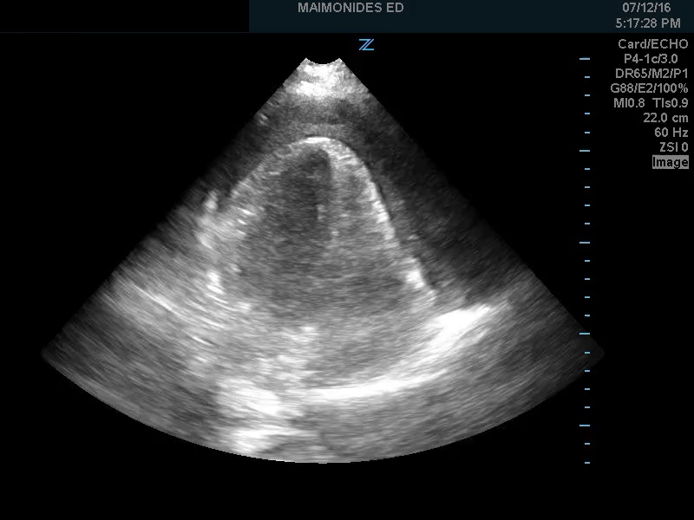
Notes:
Note the swinging back and forth in the sac (electrical alternans)

Slide 6
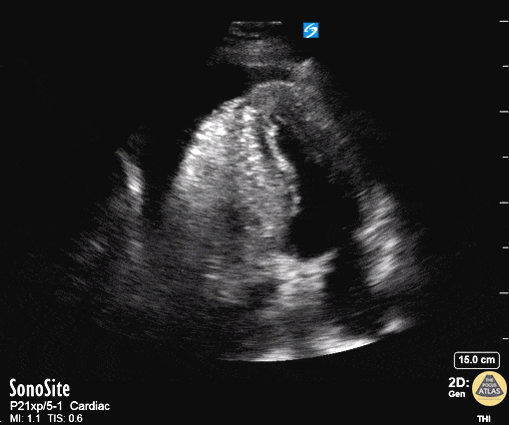
Last one…
Notes:
Aortic Dissection with Tamponade - Parasternal Long
50 year old mandarin speaking man complains of vague central chest pain. You pursue a routine cardiac workup which is fairly normal. Upon discharging him, the nurse tells you his systolic in now in the 80's.
You perform a RUSH exam - echo demonstrates a widened aortic outflow tract (well exceeding the rule of thirds) suggesting a Type A aortic dissection. You also see a pericardial effusion with right ventricular diastolic collapse. This is "the man jumping on the trampoline" or dimpling of of the right ventricular free wall during diastole while it should be filling - clenching the diagnosis of tamponade.
You better hope your CT surgeon is in house. Scroll to see the rest of the case for further images.
Dr. Matthew Riscinti - Kings County Emergency Medicine, Dr. Benjamin Clearly - NYU Langone Emergency Medicine

Slide 7
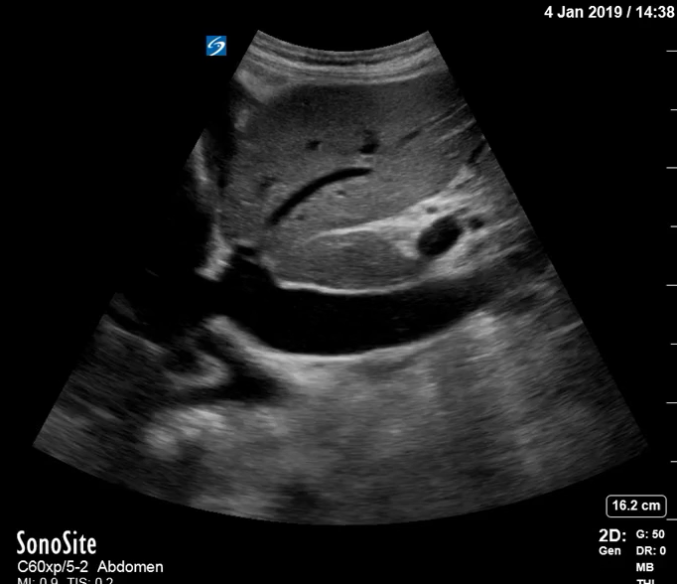
Notes:
Look for a plethoric IVC with little respiratory variation

Slide 8
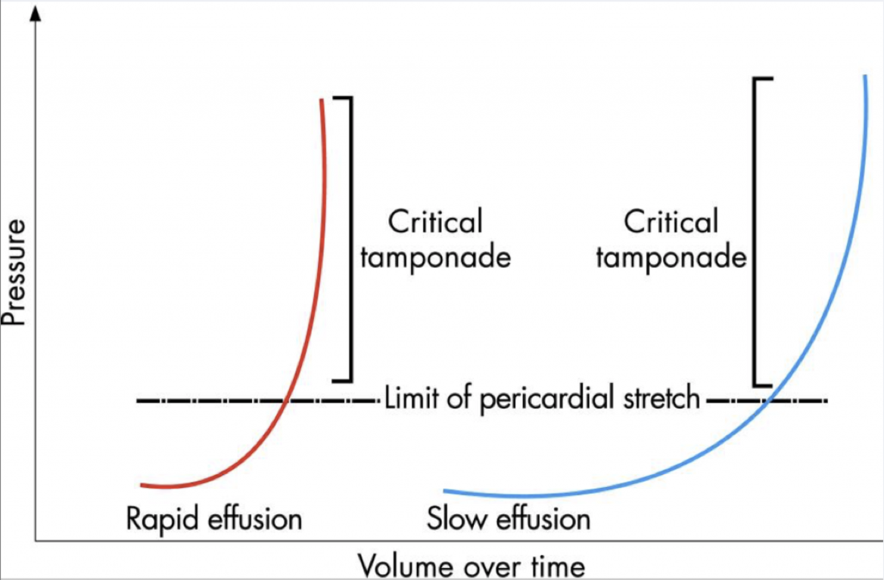

Slide 9
Signs of tamponade on echo
RV Diastolic Collapse
  Most Specific Sign
RA Systolic collapse
  Earliest Sign of Tamponade
Notes:
From Stephen Allerhand: “Diastolic collapse of the RV carries a high specificity (75-90%), with a relatively lower sensitivity (48-60%) [22-25]. This is more specific but less sensitive than the next echocardiographic finding to be discussed: systolic right atrial (RA) collapse [26]. Altogether, the absence of any chamber collapse has a 90% negative predictive value for tamponade [27].
The RA is at its lowest pressure during systole, or more precisely, in late diastole at the onset of atrial relaxation. During this period, it is most susceptible to collapse from increased intrapericardial pressure. Its pressure during systole is lower than that of the RV in diastole, so systolic RA collapse is therefore the earliest echocardiographic sign of tamponade [28].”
http://www.emdocs.net/us-probe-when-does-an-effusion-become-pericardial-tamponade/

Slide 10
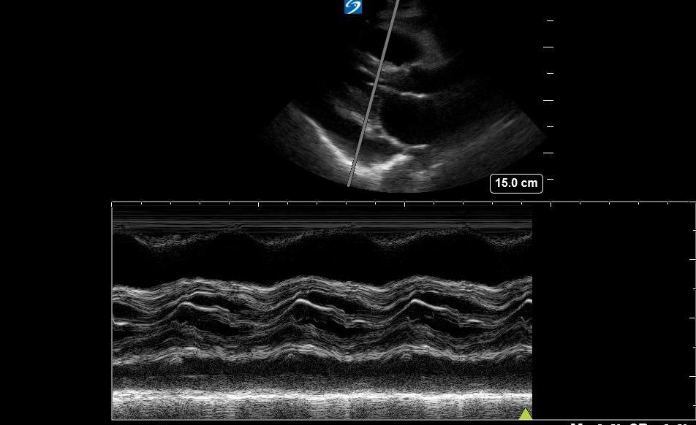
An Extra Tool
Notes:
Using M-mode through the mitral leaflets as if you’re doing EPSS

Slide 11
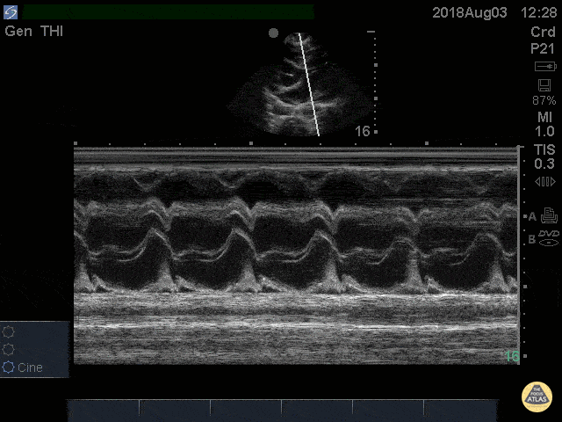
Using M-Mode for Tamponade
Notes:
E wave- early diastole (when the RV collapses), A wave = atrial kick
From POCUS ATLAS: Cardiac Tamponade RV Diastolic Collapse M-mode
41 yo M with history of stage 4 lung cancer presents with AMS and dyspnea, normotensive and tachycardic to 140s.
Parasternal long view showed moderate pericardial effusion with RV collapse. With M mode we are able to see the RV wall collapse (top line) corresponds with the mitral valve opening i.e. it occurs during diastole. Even though the patient was normotensive he was taken to the OR for a pericardial window within the hour given this evidence of echocardiographic tamponade.
Nathan Kabariti MS4, Dr. Charles Murchison, Dr. John Riggins, Dr. Donald Doukas - Kings County Emergency Medicine

Slide 12




Approaches

Slide 13
  Apical
    Shortest path,
    Risk of ventricular puncture
  Parasternal (usually most optimal approach)
    Good visualization of pericardial structures
    Risk of PTX
  Subxiphoid
    Lowest risk of PTx
    Requires steeper angle, longer path, possible right atrial puncture
Notes:
Dan Weinick Slide

Slide 14
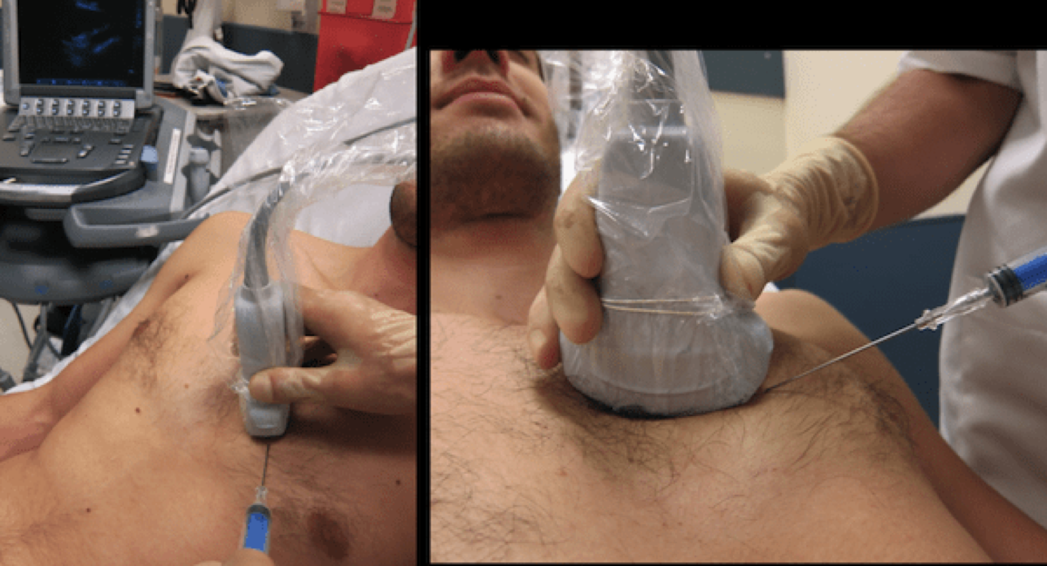
Parasternal Approach
Notes:
Dan Weinick
Select a site 3-5cm lateral of the sternal edge to avoid the left internal mammary artery
Direct needle over superior margin of rib to avoid neuro vascular bundle
Always Visualize the needle! Look at it tenting the skin and once through, always follow on the screen. Visualize tenting pericardium
Too easy? Might have gone through the ventricle.
Don’t move it around once you’re inside as you can lacerate the wall/coronary arteries

Slide 15
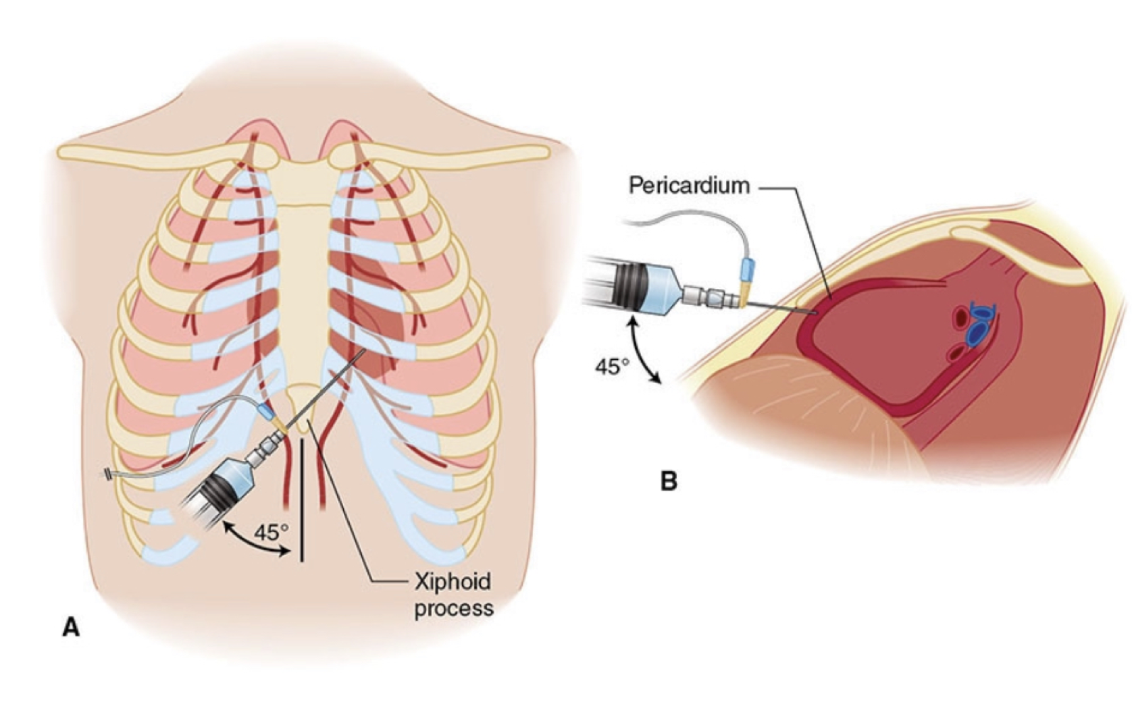
Blind Subxiphoid Approach
Notes:
Dan Weinick
Aim for left shoulder, longer needle, 45 degrees to midsag
Pitfall: liver lac

Slide 16
Pitfalls

Slide 17
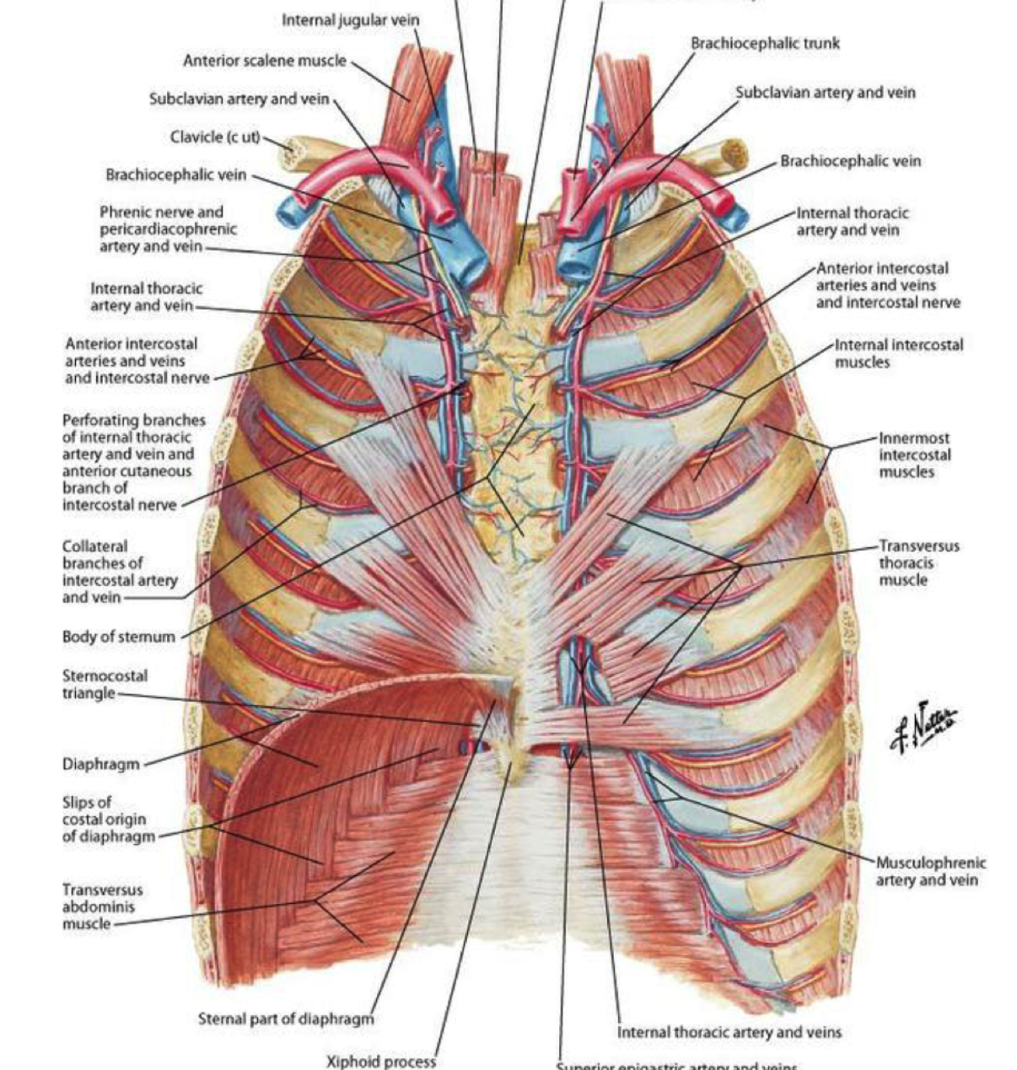
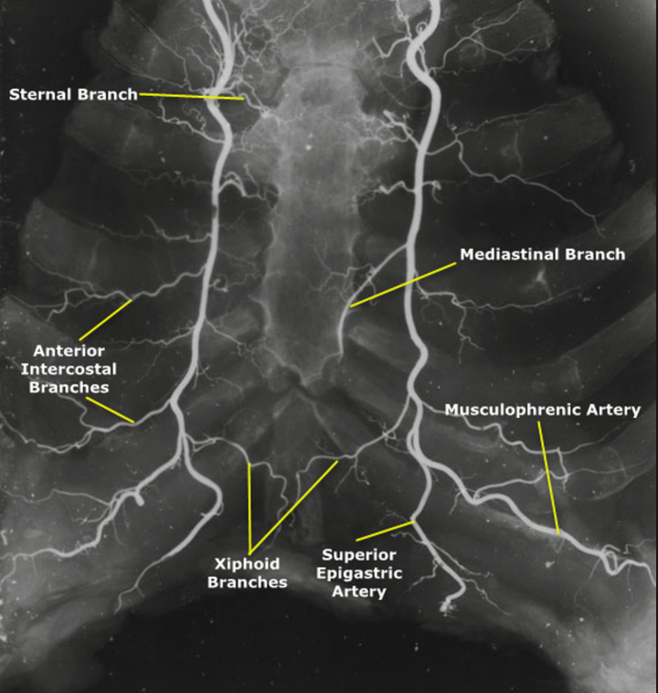
Notes:
Left Internal Mammary Artery

Slide 18
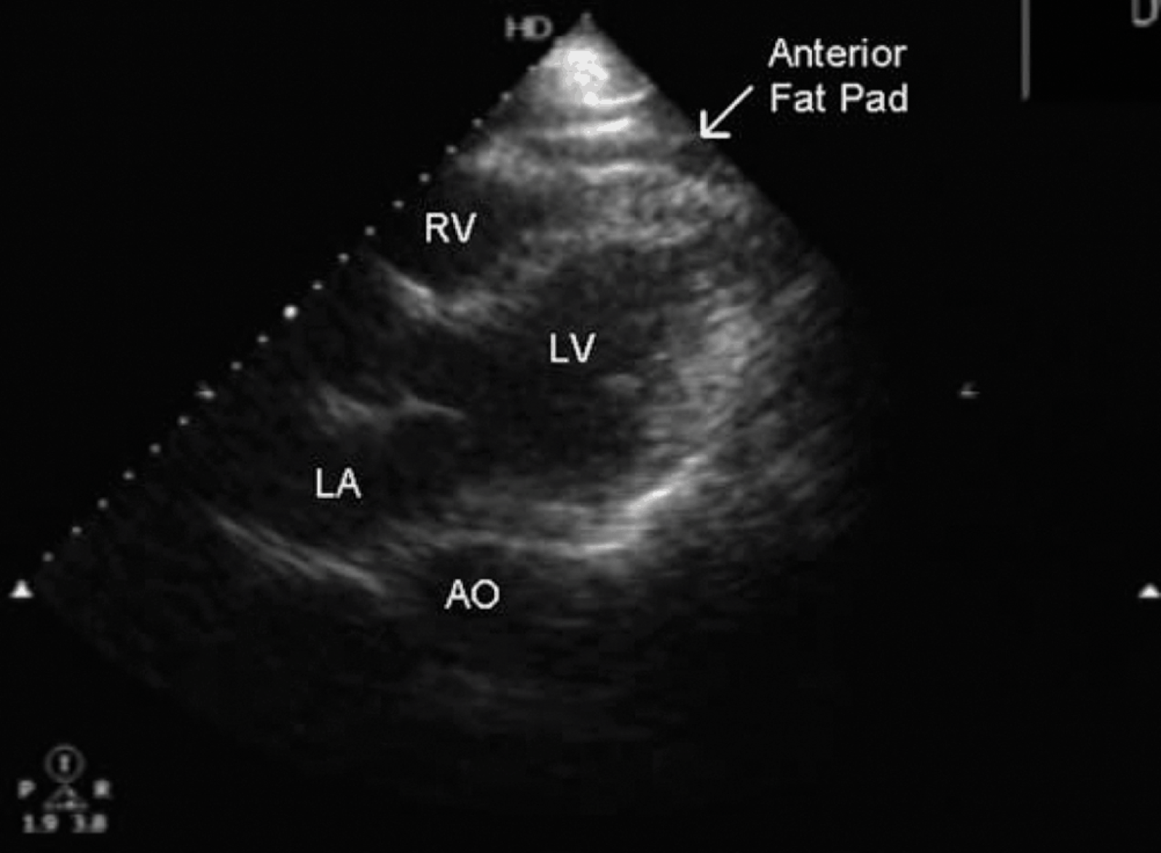
Notes:
From Dan Weinick- Epicardial Fat Pad
Do not mistake this!

Slide 19
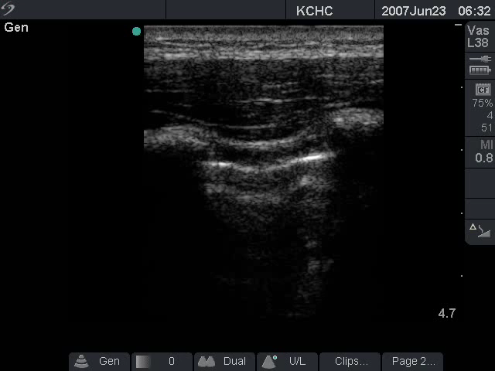
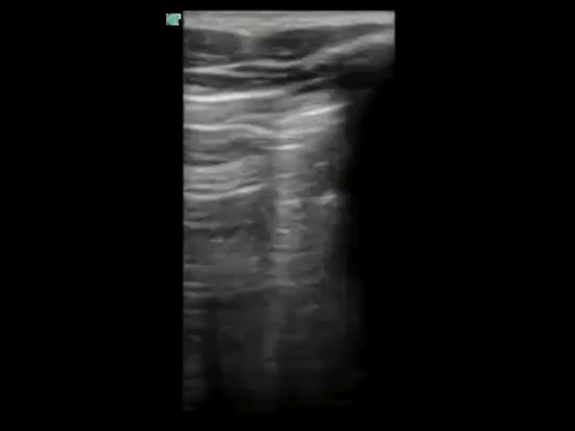
Notes:
From Uche Blackstock, MD- PTX
Parasternal approach may risk this

Slide 20
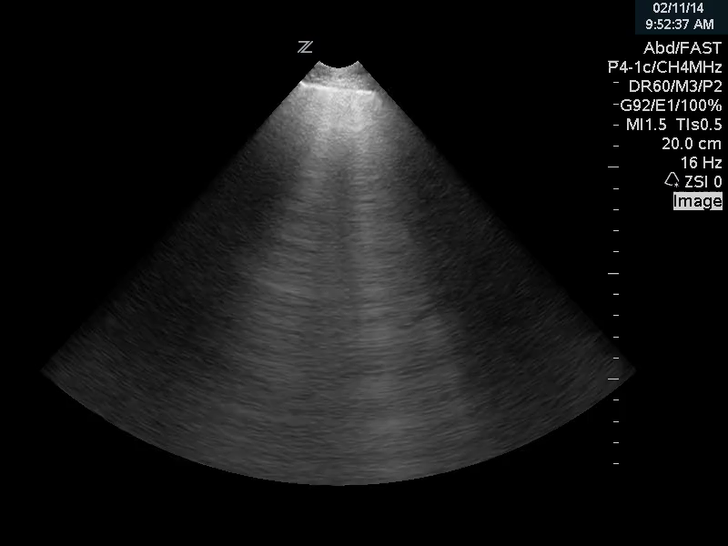
Notes:
From Uche Blackstock
Rapid drainage (like with a pleural effusion) can cause flash pulmonary edema

Slide 21
Other complications
Liver Laceration from Subxiphoid Blind Approach
Bacteremia
V-tach/Arrhythmia
Puncture the myocardium

