Slide 1
Pulmonary Embolism &
Deep Venous Thrombosis
Elizabeth Yetter, MD MHPE
Turandot Saul, MD
Regina Saylor, MD

Slide 2
Objectives
Indications for PE & DVT Ultrasound
Probe selection and screen orientation
Normal anatomy
Selected pathology
Pitfalls

Slide 3
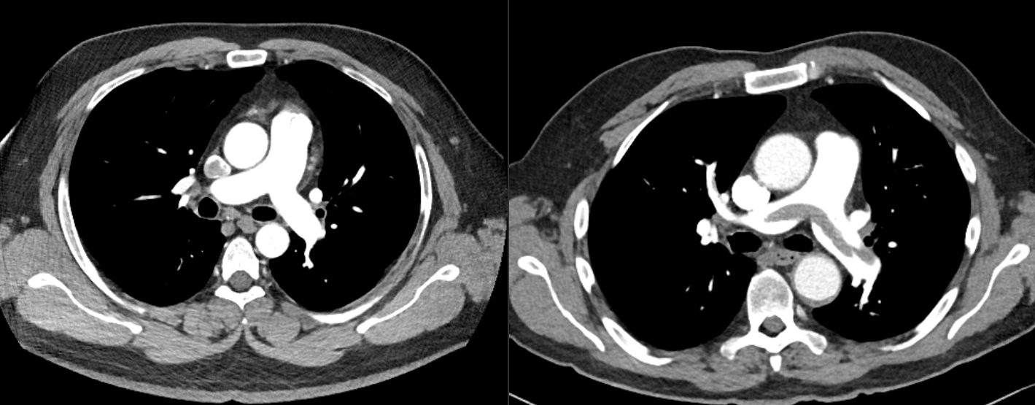
Pulmonary Embolism
Notes:
Thanks to Kira Melamud!

Slide 4

Indications
Shortness of Breath
Undifferentiated hypoxemia or shock
Consider PERC & Wells Scores

Slide 5
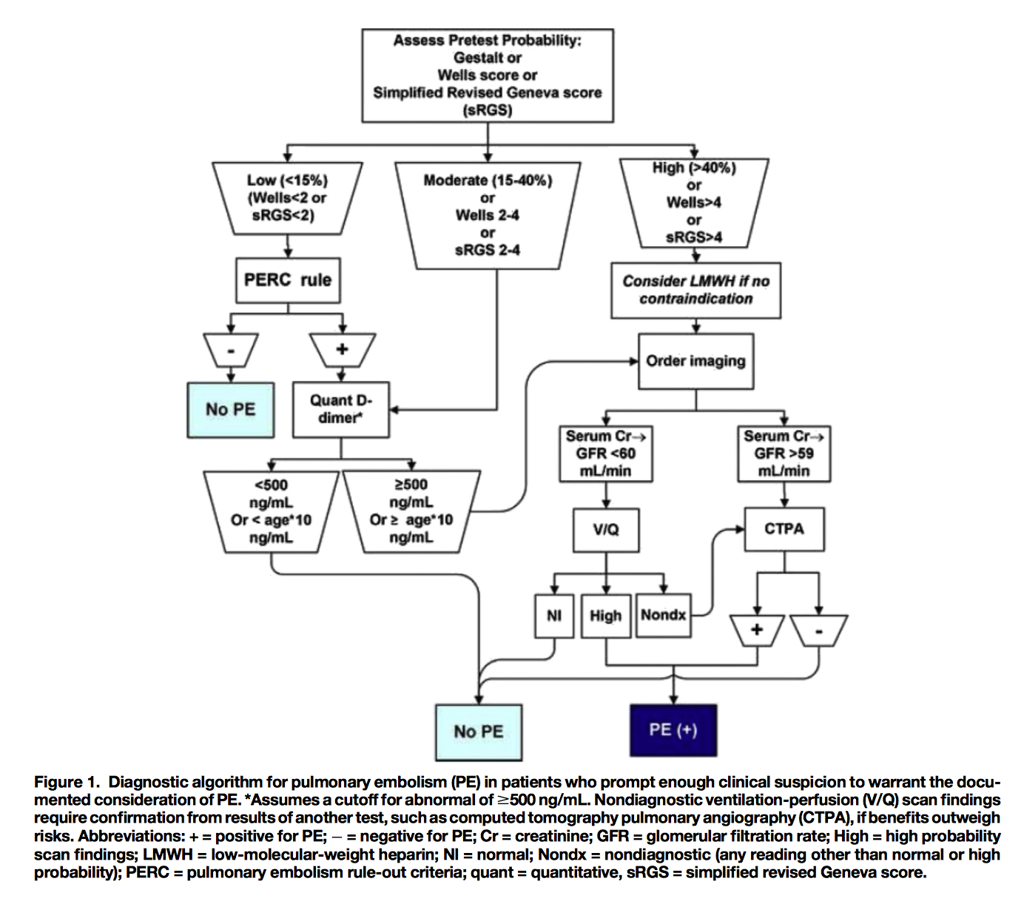
Kline’s Flowchart
Notes:
From Kline

Slide 6
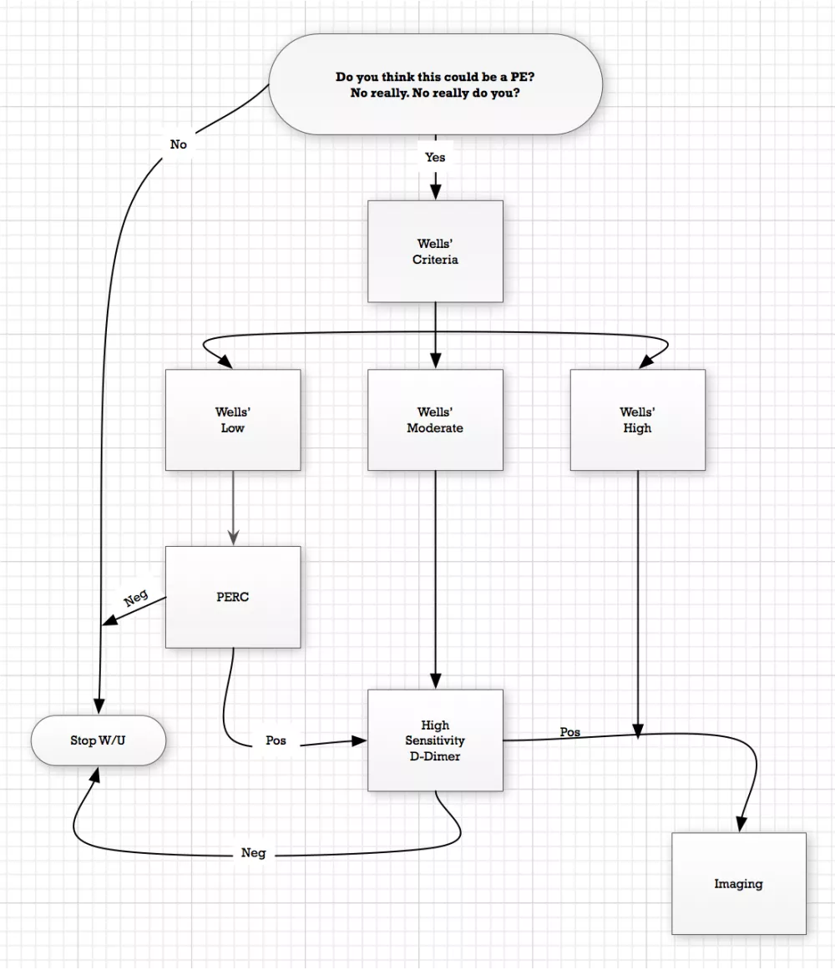
A more straightforward version from EMCRIT
Notes:
Well’s criteria for PE: 1. Clinical signs/symptoms of DVT (+3) 2. PE is #1 diagnosis or equally likely (+3) 3. HR >100 (+1.5) 4. Immobilization of at least 3 days, or surgery in previous 4 wks (+1.5) 5. Previous, objectively diagnosed PE or DVT (+1.5) 6. Hemoptysis (+1) 7. Malignancy w/ treatment within 6 months or palliative (+1)

Slide 7
Pulmonary Embolism Rule-out Criteria (PERC)
Age <50
Pulse <100 (for the whole ED stay!)
Pulse Ox >94% (at sea level
No hemoptysis
No prior VTE hx
No surgery or trauma within last 4 weeks
No estrogen
No unilateral leg swelling
Notes:
Pulmonary Embolism Rule-Out Criteria Rule (All 9 must be present to rule out PE/clinical low probability of <15% based on gestalt)
1. Age <50yo 2. Pulse <100bmp during entire ED stay 3. Pulse Oximetry >94% at near sea level or >92% at altitudes of 5000 ft+ 4. No hemoptysis 5. No prior VTE history 6. No surgery or trauma requiring endotracheal or epidural anesthesia within last 4 weeks 7. No estrogen use 8. No unilateral leg swelling, defined as asymmetrical calves on visual inspection w/ patient’s heels raised off of bed.
One example where PERC would be used would be if you suspect PE but have a low Wells criteria score. Do a PERC and if negative, stop the work up. If Positive, get a d-dimer. If d-dimer neg, stop work up; if positive, get a CTA.

Slide 8
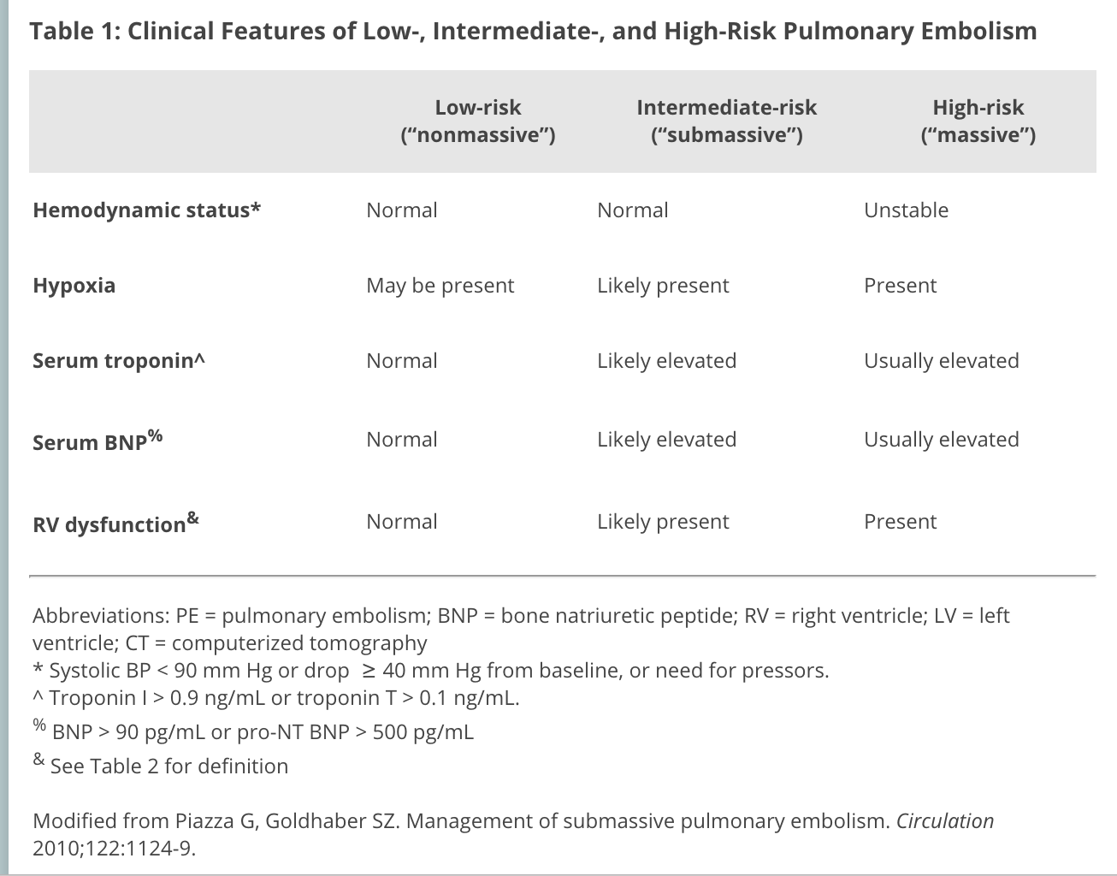
Types of Pulmonary Embolisms
Notes:
http://www.acc.org/latest-in-cardiology/articles/2015/03/30/09/03/contemporary-management-of-acute-pulmonary-embolism

Slide 9
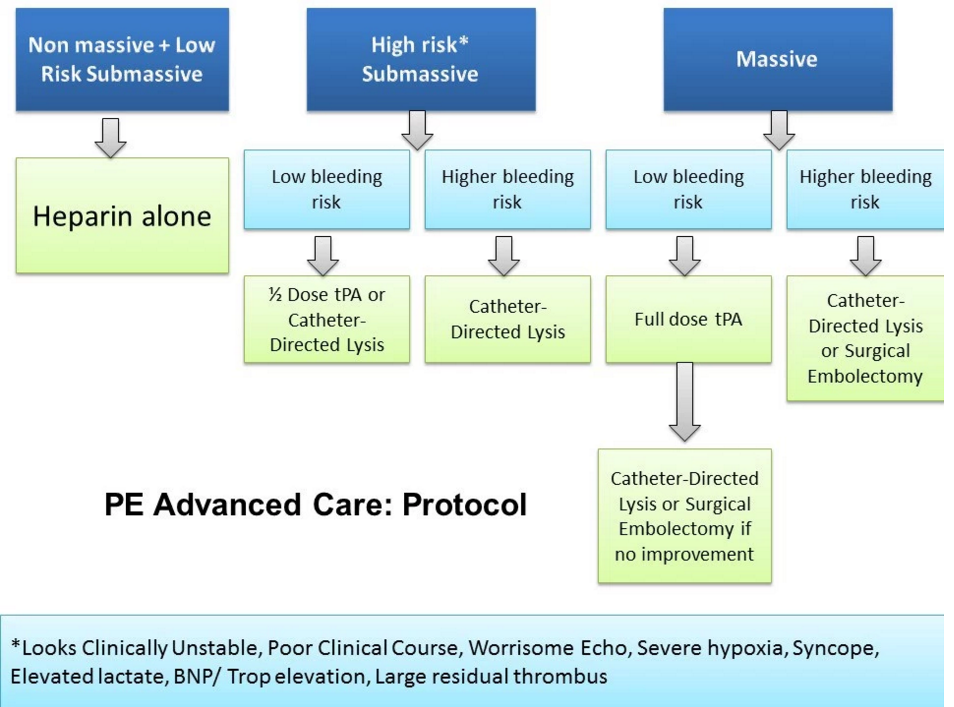
Notes:
From EM Crit 128
PE tx: IV Heparin for anticoagulation and if submassive or massive, add fibrinolysis (tPA) as above. If you suspect PE and have high Well’s Criteria, start Heparin while you’re waiting for your CTA. Unfractionated heparin Bolus 80u/kg IV followed by infusion of 18u/kg/hr IV.
Fibrinolysis:
tPA Dosing for PE:
-IV bolus 10 mg then 90 mg infusion over 2 hours (max 100mg total if going with full dose). If hemodynamic compromise, start heparin or LMWH after tPA finishes. Hold heparin while giving tPA.
If you are doing half dose tPA for certain submassive PE with the beginning of hemodynamic decompensation, dosing is a total of 50mg total rather than 100mg (10mg bolus and 40mg infusion over 2 hours)-MOPETT dosing.
Going with a half dose and checking the patient’s vitals may be a better solution as there is lowered risk of bleeding:
http://www.ncbi.nlm.nih.gov/pubmed/24412030
The results of this meta-analysis were hypothesis-generating. Based on the limited data, our systematic review suggested that low dose rt-PA had similar efficacy but was safer than standard dose of rt-PA. In addition, compared with heparin, low dose rt-PA didn't increase the risk of major bleeding for eligible PE patients.

Slide 10
Outpatient Treatment
Unfractionated Heparin | 80u/kg bolus, then 18u/k/h infusion | if out patient not appropriate or SEVERE renal failure and can’t do LMWH.
LMWH/Indirect Thrombin Inhibitor: Enoxaparin (Lovenox) | 1mg/kg sc q12 or 1.5mg/kg sc qdaily (NO maximum) | Do not use if renal impairment
Factor Xa inhibitor: Apixaban (Eliquis) | 10mg po BID x7days then 5mg BID thereafter | No heparin requirement; good for outpatient tx; ok for pt w/ renal impairment
Factor Xa inhibitor: Rivaroxiban (Xarelto) | 15mg po BID x21days, then 20mg daily w/ food | No heparin requirement; good for outpatient tx; ok for pt w/ renal impairment
Direct Thrombin Inhibitor: Dabibatran (Pradaxa) | 150mg po BID | Requires run of heparin for 5-10 days; renal excretion so not for renal patients
Notes:
More extensive list tintinalli’s ch 56

Slide 11
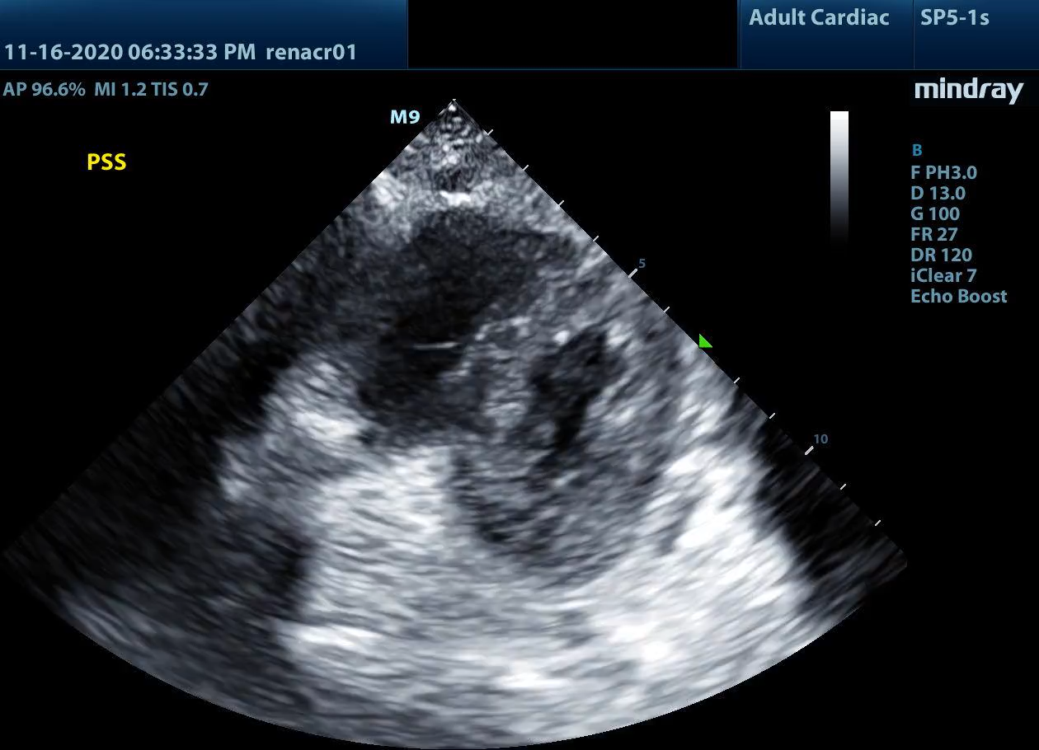
D- Sign

Slide 12
Eccentricity Index

Slide 13
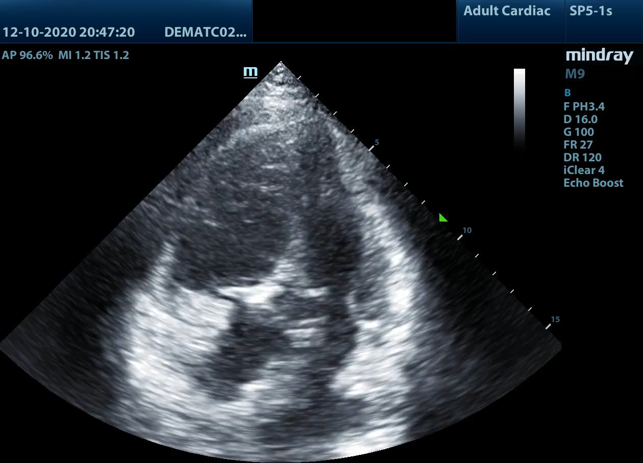
McConnell’s Sign

Slide 14
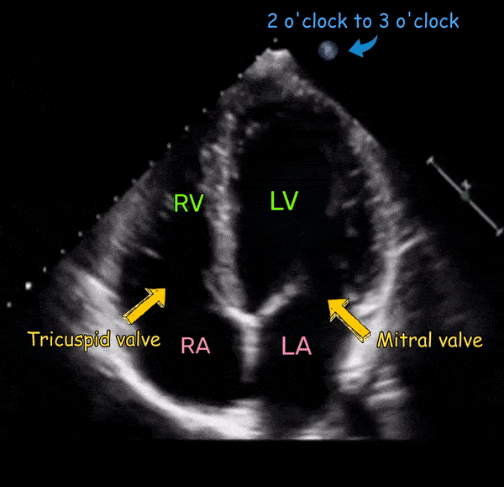
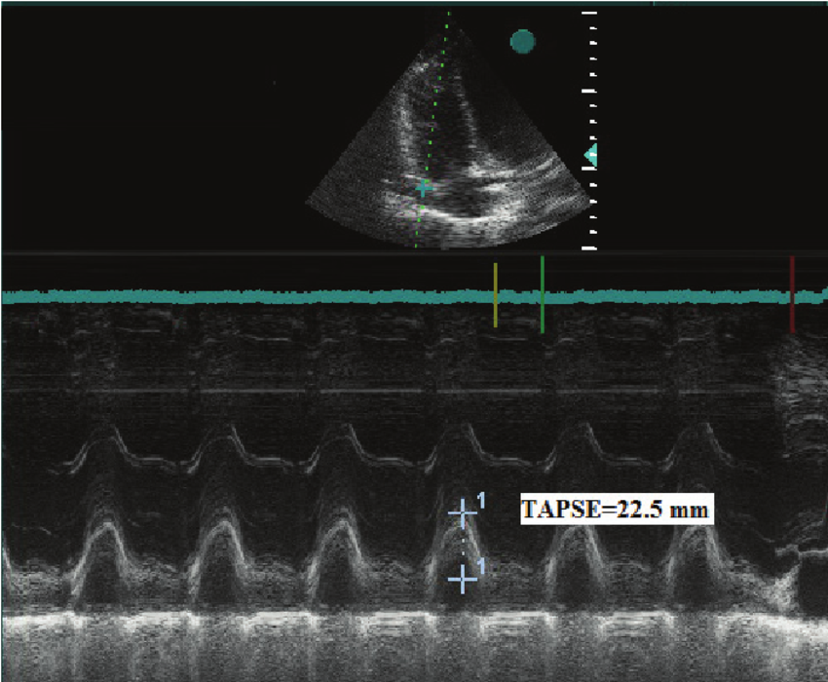
TAPSE
Notes:
Tricuspid Annular Plane Systolic Excursion
< 17mm is bad, < 14mm is very bad
Shout out to Jake Canavan

Slide 15
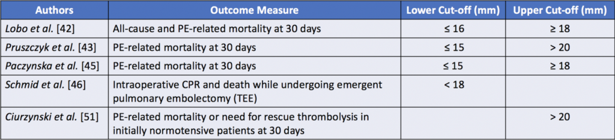
American Society of Echocardiography cutoffs
  17mm = RV dysfunction
  14mm = poor prognosis, survival implications

Slide 16
Deep Venous Thrombosis

Slide 17

Indications
Swollen, tender extremity
  In EM, we most often look for this in the lower extremities
Undifferentiated hypoxemia or shock
Consider the Wells DVT Score
Notes:
Active cancer +1
Bedridden for 3+ days or major surgery within 4 weeks +1
Calf swelling >3cm compared to other leg +1
Collateral superficial veins present +1
Entire Leg Swollen +1
Localized tenderness along the deep venous system +1
Pitting edema, confined to symptomatic leg +1
Paralysis, paresis, or recent plaster immobilization of the lower extremity +1
Prior documented DVT +1
Alternative diagnosis to DVT as likely ore more likely -2
If 0 or less: negative d-dimer = rule out/probability <1%/no ultrasound. + d-dimer = get ultrasound; if negative, ruled out. If +, start anticoagulation. (Per ACEP 2009 guidelines, repeat US in 1 week).
If 1-2 or less: negative high-sensitivity d-dimer sufficient to rule out DVT with probability of <1% DVT. + d-dimer = get Ultrasound; if negative, ruled out. If +, start anticoagulation.
If 3+; go straight to ultrasound.
D-dimer for risk-stratifying:
negative dimer and negative US = discharge.
negative dimer/+ ultrasound, anticoagulate.
positive dimer/+ ultrasound, anticoagulation.
positive dimer/-ultrasound, repeat ultrasound in 1 week for re-evaluation.

Slide 18




Probe Orientation & Technique
Notes:
https://www.ultrasoundpaedia.com/normal-dvt-leg/
Image: https://clinicalgate.com/ultrasound-guided-regional-anesthesia/
High frequency linear probe ~7.5 MHz
Probe marker toward the patient’s RIGHT, transverse
Hip slightly flexed, externally rotated and abducted with knee in slight flexion (i.e. frog leg)
Can place towel under patient’s knee for comfort
Goldilocks- Enough pressure to collapse the vein (may tent the artery a little). Should not compress the artery nor should be so light that you don’t compress the vein completely. Excessive pressure can collapse an artery in a volume depleted patient. Can use color flow or pulse wave doppler if unable to distinguish between artery and vein.

Slide 19
Notes:
Blausen.com staff (2014). "Medical gallery of Blausen Medical 2014". WikiJournal of Medicine 1 (2). DOI:10.15347/wjm/2014.010. ISSN 2002-4436.
Get images at the Common Femoral Vein-Saphenous vein junction and compress every 1-2 cm going distal for 15 cm.
Start at popliteal in proximal popliteal fossa and compress going ever cm distally until you are through the trifurcation
The femoral vein is sometimes called the superficial femoral vein even though it is a deep vein.

Slide 20
Notes:
Lee, D-K, Ahn, K-S, Kang, C.H., & Cho, S.B. (2017). Ultrasonography of the lower extremity veins: anatomy and basic approach. Ultrasonography; 36(2): 120-130. doi: 10.14366/usg.17001
Quick anatomy top to bottom:
-The external iliac vein becomes the common femoral vein once you cross the inguinal ligament (EIV --> CFV)
-The CFV divides into the deep femoral vein and the femoral vein (formerly called the superficial femoral vein despite the fact that it’s a deep vein) approximately 1-2 cm past where the greater saphenous was feeding into the CFV..
-Deep femoral vein runs the inner thigh along the deep femoral artery. Moving distally, the femoral vein (aka superficial femoral vein) runs from medial to the artery, to behind, and finally lateral to the femoral artery as it passes through the adductor hiatus
-Femoral vein becomes the popliteal vein once it crosses the adductor hiatus. The popliteal vein is superficial to the artery in the popliteal fossa (Pop on top)
-The popliteal vein splits into the anterior and posterior tibial veins in the lower aspect of the posterior knee.
-Posterior tibial receives blood from the medial and lateral plantar veins and drains the posterior compartment of the leg/plantar surface of the foot. Lies behind the tibia and joins the popliteal at the posterior knee. Look for it behind the medial malleolus.
-Anterior tibial is continuous with the dorsalis pedal vein, runs along the anterior compartment of the leg between the tibial and fibula. Joins the posterior tibial a the tibioperoneal trunk/popliteal vein.
-Peroneal/fibular vein runs posterior-medial aspect of the fibula and joins the posterior tibial vein.
-

Slide 21
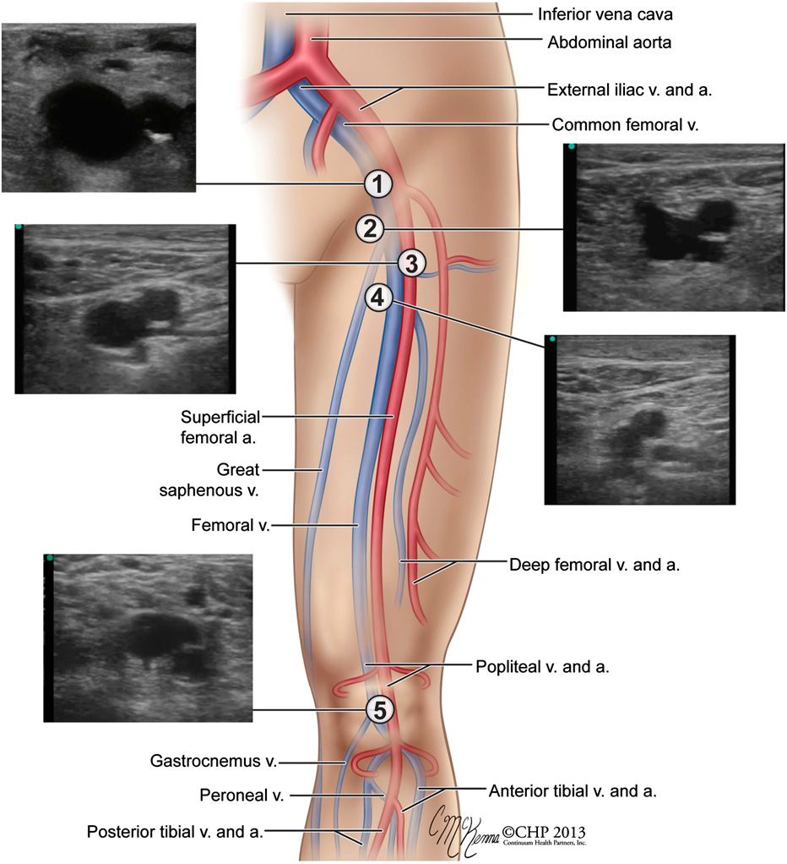
Notes:
From Goertz
Start at 2: where GSV joins at Common Fem V (you see the artery split in this version also)
See the artery split
Superficial and Deep Vein (now called just the Femoral and Deep Femoral)

Slide 22
Normal Images

Slide 23
Common Femoral at Saphenous
Notes:
Start at inguinal ligament, looking for where the saphenous feeds into the common femoral vein
Continue distally until the common femoral splits into the deep and superficial femoral veins
Image from Ma, Mateer, Reardon, Jong’s Emergency Ultrasound book.
Vein is medial to the artery.
Note that this image is showing the patient’s left leg but the ultrasound image is for the patient’s right leg because the GSV is always medial.

Slide 24
Right Leg
Left Leg
Great Saph V.
Great Saph V.
Common Femoral A.
Common Femoral V.
Common Femoral V.
Common Femoral A.
Superficial FA
Superficial FA
Common Femoral V.
Common Femoral V.
Deep FA
Deep FA
Femoral Vein
Femoral Vein
Deep FV
Deep FV
Notes:
Veins are medial.
“Femoral Vein” is the former “superficial femoral vein”. It’s superficial to the deep femoral vein but it is still a deep vein thus the name confusion.

Slide 25
Notes:
From AUES video by Dr. Frances Russell
Replace with mine

Slide 26
Mid-Thigh/Femoral Vein
Notes:
Continue distally until the common femoral splits into the deep and superficial femoral veins
Left: Common femoral splitting into the deep (open arrow) and femoral (aka superficial femoral) veins (thin arrow). Approximately 1-2 cm below where the saphenous feeds into the CFV
Right: Only the femoral vein visible in the more distal medial thigh.
https://www.ncbi.nlm.nih.gov/pmc/articles/PMC5381851/ for images. Replace with mine

Slide 27
Popliteal Fossa
Notes:
Find the popliteal vein in the popliteal fossa. Remember the popliteal vein is superficial to the artery “pop on top”. In reality, the vein is deep to the artery; you’re just coming at it from behind.
https://www.ncbi.nlm.nih.gov/pmc/articles/PMC5381851/ for images. Replace with mine
Note that you can have duplication of popliteal vessels

Slide 28
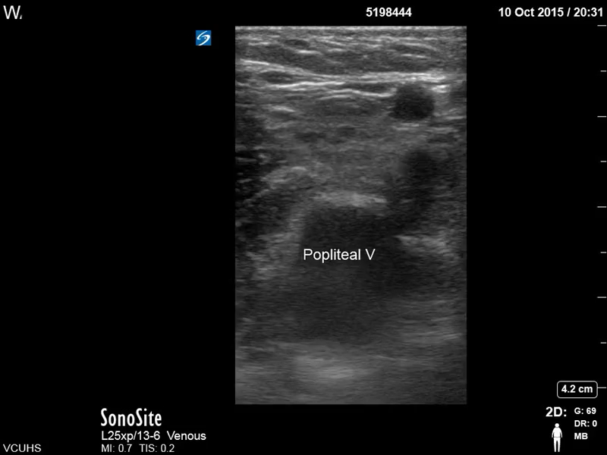
Trifurcation
Notes:
Credit to: http://wp.vcu.edu/ultrasound/required-views/dvt/ VCU Replace with mine
Splits into the peroneal, posterior tibial and anterior tibial. Can have duplicates of them.

Slide 29
Pathology
Notes:
Clots often appear hyperechoic; chronic clots moreso than acute clots. Acute clots may be anechoic which is why decisions are based off of compression. If the artery is being compressed and the vein is not, there’s a clot even if it is not visible.

Slide 30
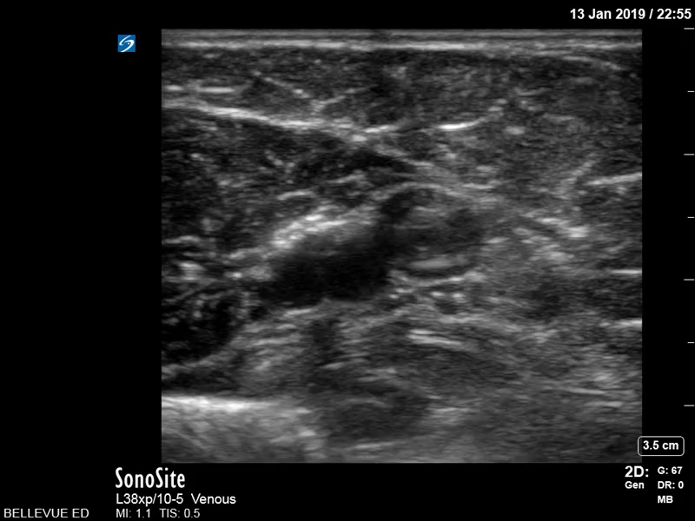
Notes:
Upper extremity brachial vein with clot
Arm DVT- Menlove

Slide 31
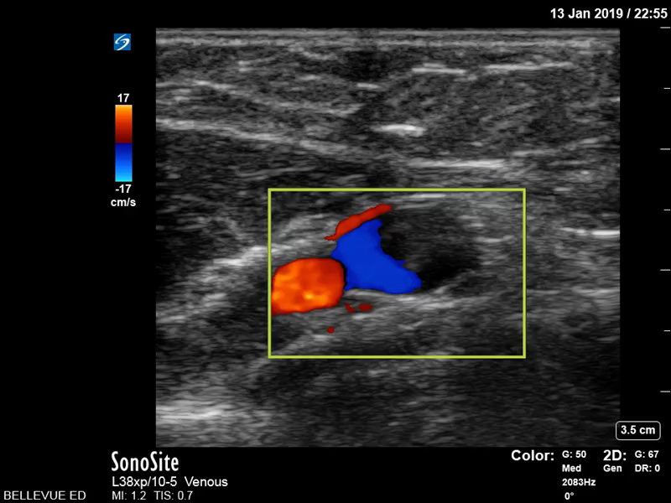
Notes:
Arm DVT- Menlove

Slide 32
Notes:
Popliteal venous thrombus (Di Coneybeare)

Slide 33
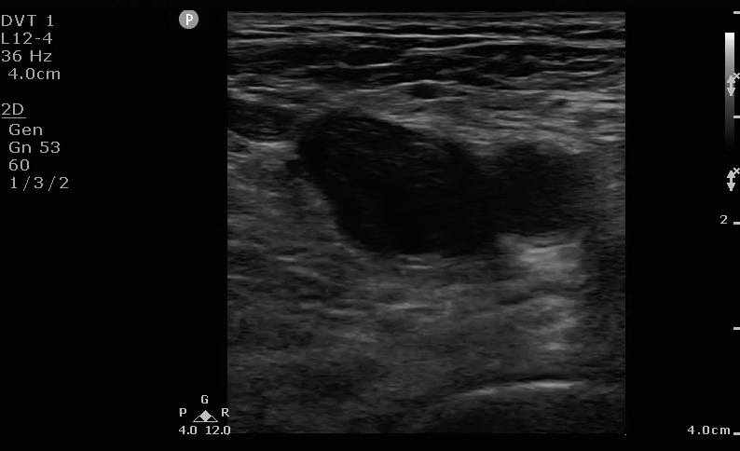
Notes:
DVT at the level of the common fem/saphenous- Dan McFarland

Slide 34
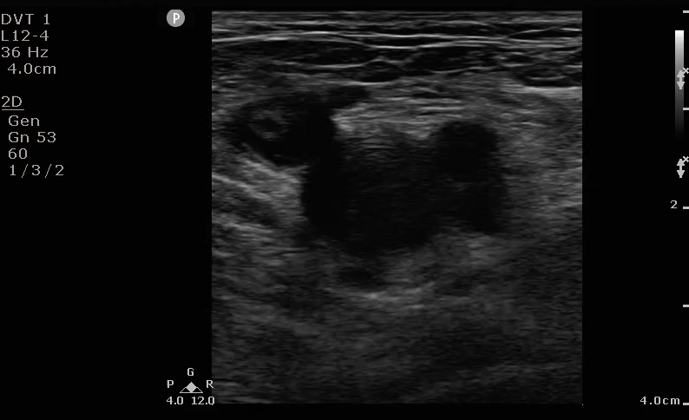
Notes:
DVT at the level of the common fem/saphenous- Dan McFarland

Slide 35
Case:
30yoM w/ no PMH p/w L lower extremity swelling x 3 days.

Slide 36
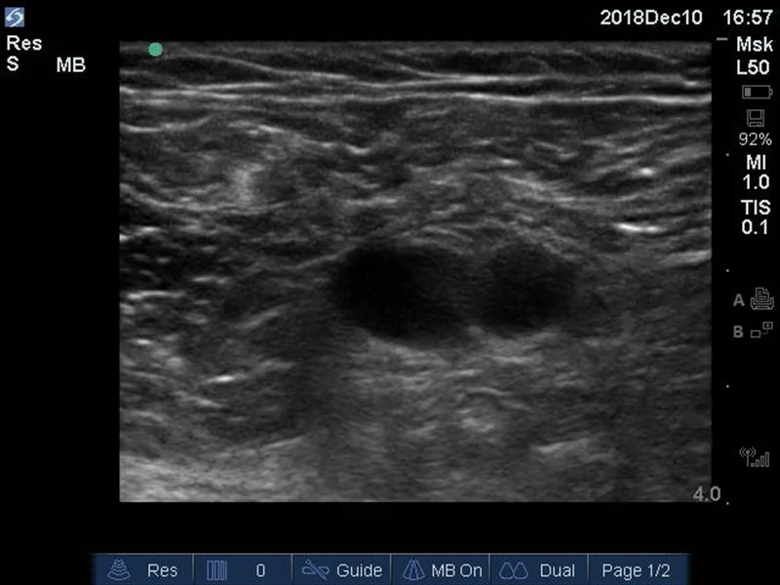

Slide 37
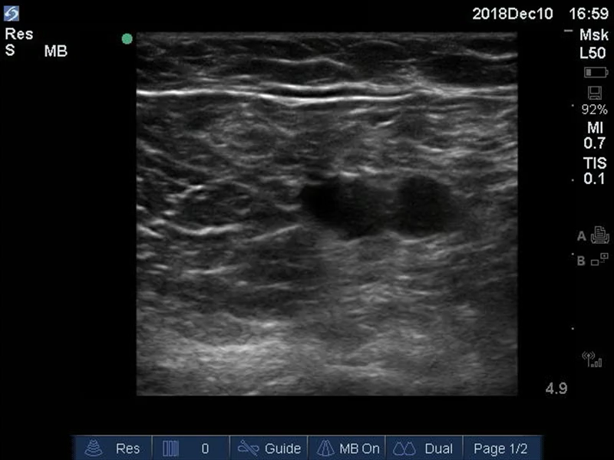

Slide 38
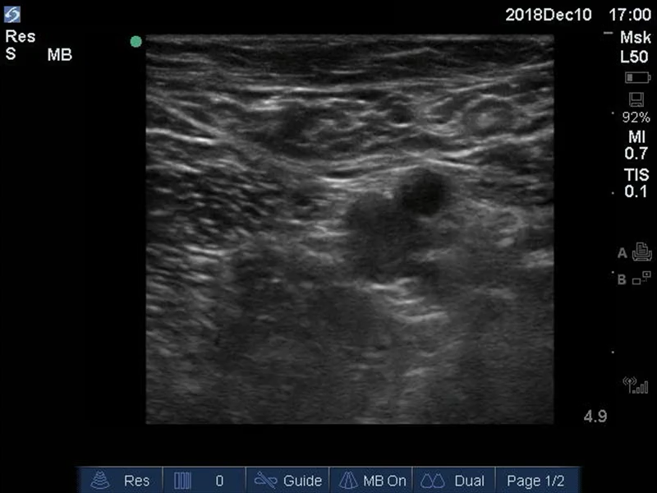

Slide 39
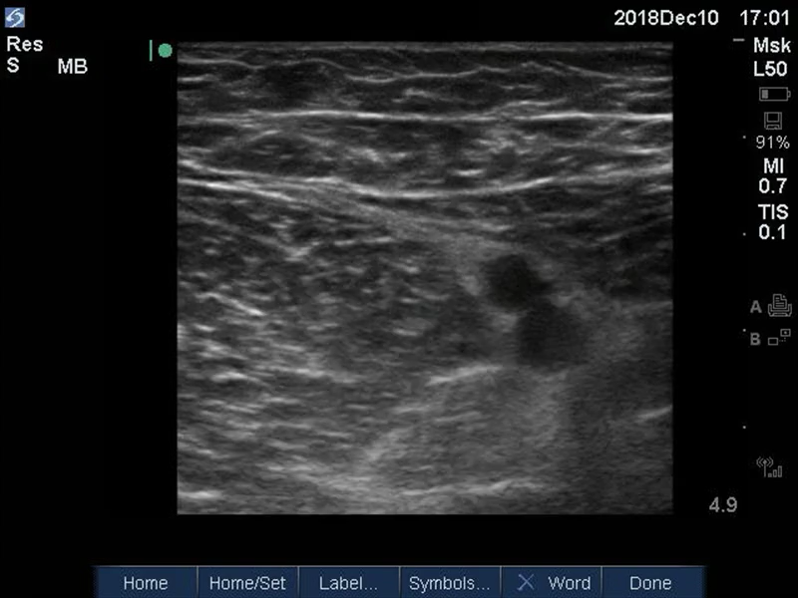
Notes:
Start of DVT

Slide 40
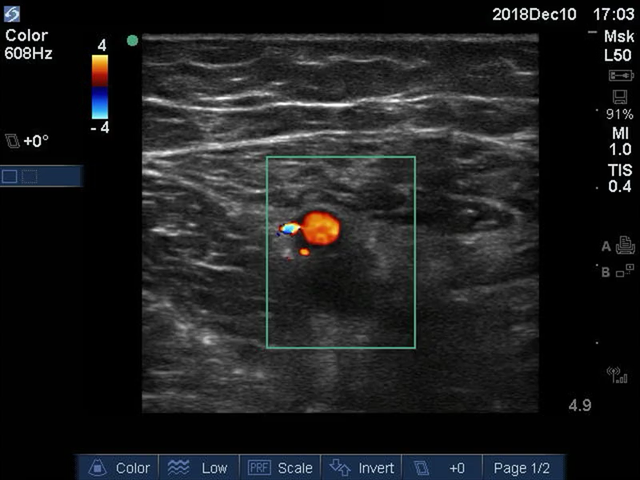

Slide 41
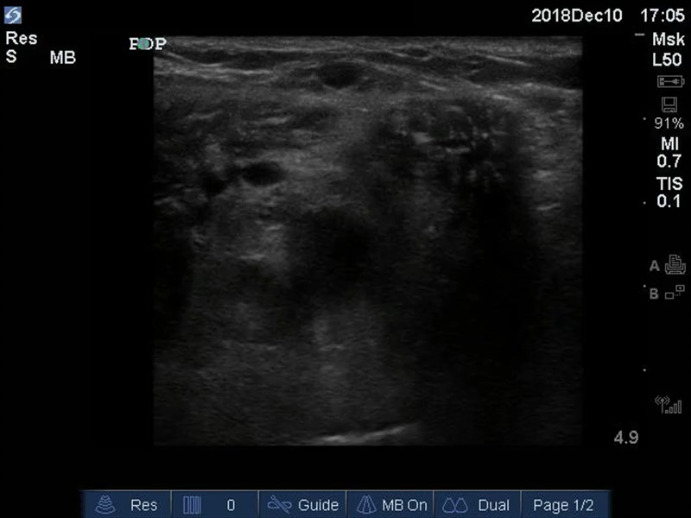

Slide 42
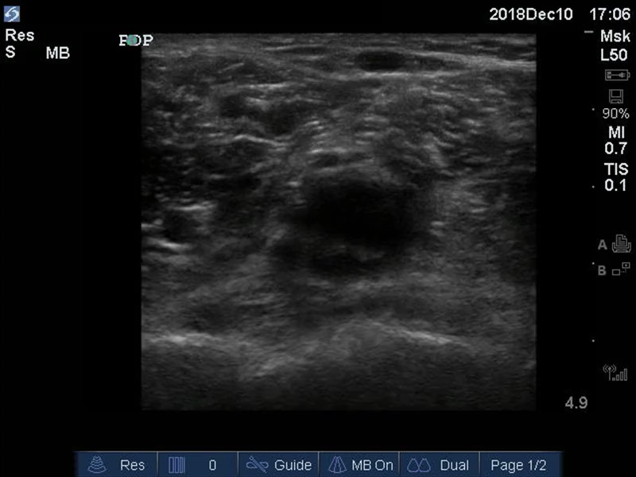
Notes:
Official results:
LLE duplex: acute DVT in LLE from midthigh to calf level.
Femoral, popliteal, peroneal and gastrocnemius veins are dilated and totally non-compressible. There is no venous flow in the veins. The femoral, popliteal, peroneal, and gastrocnemius are occluded.
The GSV and SSV are compressive and negative for SVT.
The Doppler waveform in the right CFV is phasic and symmetrical with the contralateral CFV waveform.

Slide 43
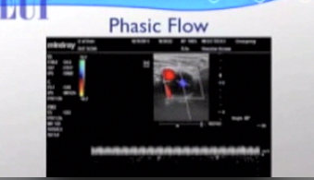
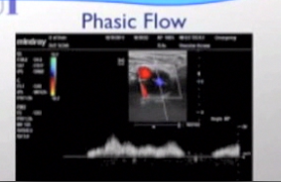
Notes:
monophasic like this suggests DVT
variation suggests no DVT. As we breathe in, we increase intrathoracic pressure and the phase drops down (less flow), as we breathe out, intrathoracic pressure decreases and the venous return/phase rises. However, this is for lower extremity. Keep in mind that it’s the opposite when looking at the upper extremities (breathing in sucks the blood back toward the thorax so you have an increase in the wave instead of a decrease.
This is suggestive of a proximal clot (perhaps up in the iliacs).
http://www.ultrasoundpodcast.com/2011/10/dvt-how-to/ for more on phasic flow and augmentation
Phasic Flow with pulse wave doppler on common femoral: flow will increase or decrease if patent. Will be monophasic if there’s iliac thrombus further up (more proximal)

Slide 44
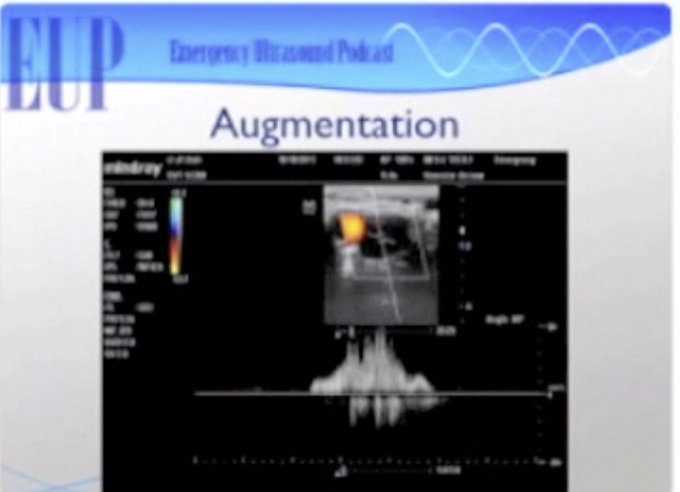
Notes:
From the Ultrasound Podcast
Augmentation: Color or pulse wave on common femoral vein. When squeeze calf, should see flash or flow, indicating patency between where you squeezed and where your doppler is (can also do on calf)

Slide 45
Pitfalls
Edematous legs or morbidly obese
  May require a lower frequency probe such as a curvilinear probe for dept
Compressible veins mistaken for arteries (False Negative)
Non-compressible artery mistaken for veins (False Positive)
Large superficial veins mistaken for deep veins

Slide 46
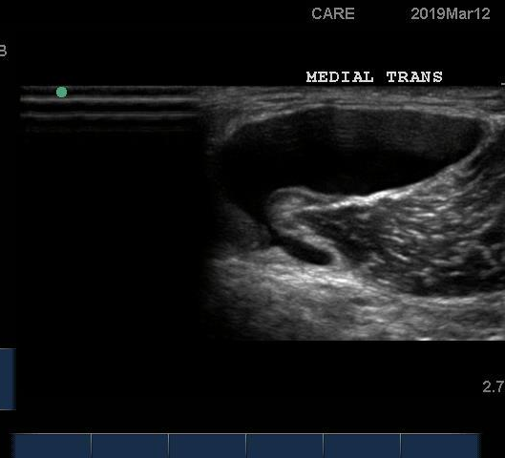
Baker’s Cyst
Notes:
Rothberg image

Slide 47
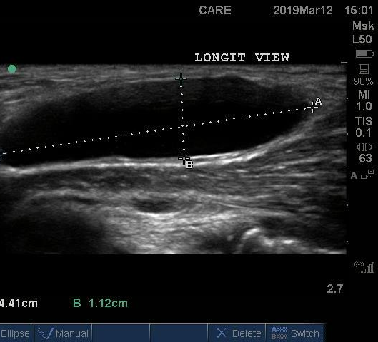
Baker’s Cyst
Notes:
Rothberg image

Slide 48
Lymph Nodes
Notes:
http://www.ultrasoundcases.info/Slide-View.aspx?cat=591&case=3007
Meer J, Taylor T, & Beck S. (2015). Emergency Ultrasound: Soft-Tissue Assessment. Emergency Medicine; 47(4): 181-182. Retrieved from: https://www.mdedge.com/emergencymedicine/article/98900/imaging/emergency-ultrasound-soft-tissue-assessment#

Slide 49
References
Dawson M. (2011). DVT Scanning. Retrieved from: http://www.ultrasoundpodcast.com/2011/08/dvt/
Dean, A.J. & Ku B.S. (2008). Sonoguide: Deep Venous Thrombosis. Retrieved from: https://www.acep.org/sonoguide/dvt.html
Kory P & Kaplan A.E. (2011). Ultrasound for Deep Venous Thrombosis. In KA Carmody, CL Moore, & D Feller-Kopman (Eds.), Handbook of Critical Care & Emergency Ultrasound. (pp. 193-205). New York, NY: McGraw Hill Medical.
Lee, D-K, Ahn, K-S, Kang, C.H., & Cho, S.B. (2017). Ultrasonography of the lower extremity veins: anatomy and basic approach. Ultrasonography; 36(2): 120-130. doi: 10.14366/usg.17001
Meer J, Taylor T, & Beck S. (2015). Emergency Ultrasound: Soft-Tissue Assessment. Emergency Medicine; 47(4): 181-182. Retrieved from: https://www.mdedge.com/emergencymedicine/article/98900/imaging/emergency-ultrasound-soft-tissue-assessment#
Russell, F. (2013). Point-of-Care Ultrasonography for Evaluation of Lower Extremity Deep Venous Thrombosis. Retrieved from: https://vimeo.com/52819569
Additional images- please see individual slides for references.

