Slide 1
Diastology
Elizabeth j. yetter, md mhpe

Slide 2
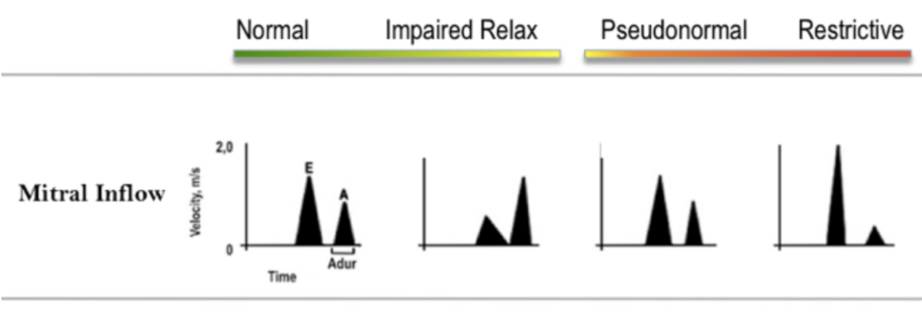
Physiology
LV Relaxes which pulls blood from LA into LV
  This is an energy dependent (ATP) process despite the name
  E-wave or Early-filling
LA “kicks” or pushes the rest of the blood

Slide 3
Diastolic Failure
Grade I- Impaired relaxation. LAP not yet elevated but LA has to have a greater kick since the pull from the LV isn’t as strong
Grade II- LV even stiffer and the LAP now rising to have increased early diastolic filling (increased push from LA). E>A because of the increased push from the atria during early diastole
Grade III- Restrictive Pattern- severe increase in LAP due to severe restriction. Most filling from the push from the very high pressures from the left atria, hence the high E wave

Slide 4
Tissue Doppler
Greater Velocity = greater relaxation
E’ lateral wall >10 and septal wall >7 is normal
E/e’, if >10, increase in LAP
Could also look at deceleration time and left atria area
>20cm^2
If e’ < a’, be worried

