Slide 1
Advanced Echo
Elizabeth J. Yetter, MD MHPE

Slide 2
Contents
Left Heart
  Anatomy Review and Measurements
  Cardiac Output
    LVOT Diameter & VTI
    Ejection Fraction
      EPSS
      FS
      Simpson’s Method/Method of Discs

Slide 3
Contents
Right Heart
  Anatomy Review and Measurements
  TAPSE
  S’
  Volume Overload: Eccentricity Index
  PASP
  60/60
Pathology

Slide 4
Left Heart

Slide 5
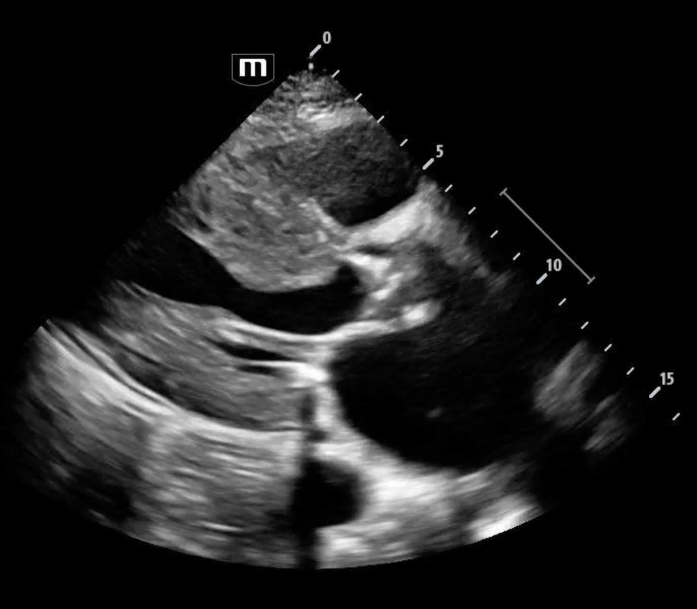
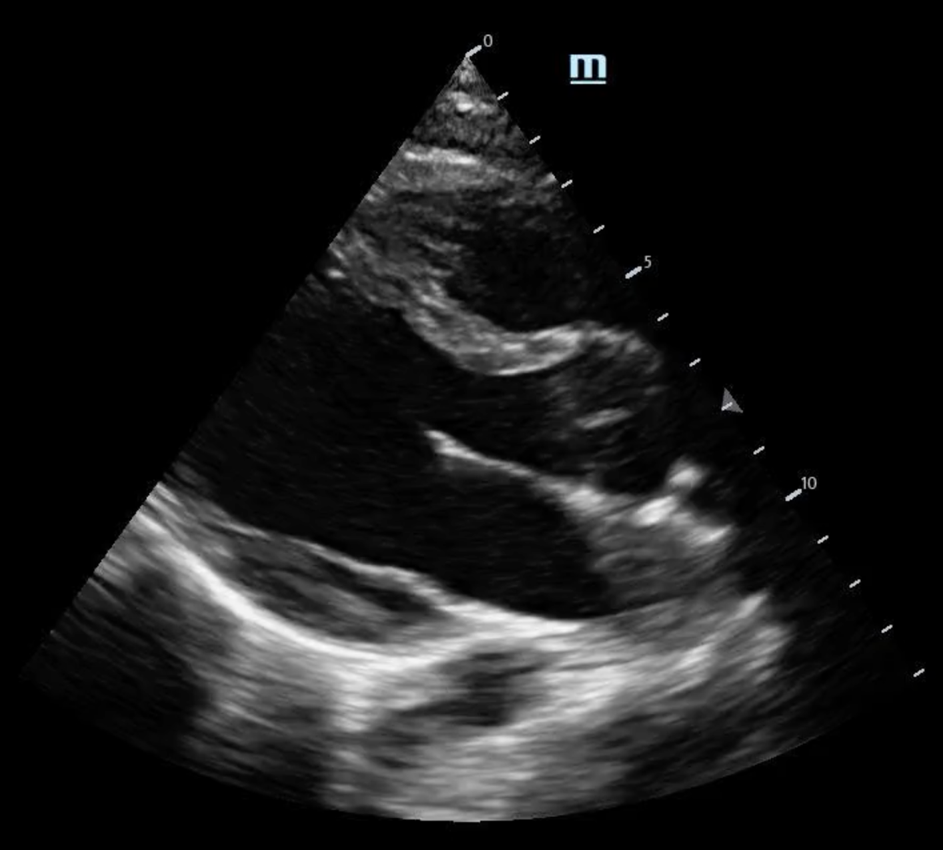
Anatomy
LV Diameter during diastole < 5.2cm
LV Thickness during diastole <1.2cm
Atria diameter <4cm
Notes:
From AEMUS review basics video
Bottom is a normal heart
Top Right is a heart with known LVH (and poor EF and aortic stenosis and a small pericardial effusion)
Measure just below the mitral valve in diastole

Slide 6
Cardiac Output
LVOT diameter and VTI
Ejection Fraction
  E-Point Septal Separation (EPSS)
  Fractional Shortening (FS)
  Simpson’s Method (Method of Discs)

Slide 7
LVOT Diameter & VTI

Slide 8
Cardiac Output
Cardiac Output (mL/min)= Heart Rate (beats/min) x Stroke Volume (mL/cycle)
Stroke Volume (cm³)= LVOT area (cm²) X VTI (cm)
Where LVOT is the Left Ventricular Outflow Tract area and VTI is the Velocity Time Interval
Notes:
Using PULSED WAVEFORM DOPPLER
SV is the volume of blood ejected during ventricular contraction or for each stroke of the heart
Cardiac output in humans is generally 5-6 L/min in an at-rest to more than 35 L/min in elite athletes during exercise.
https://www.ncbi.nlm.nih.gov/books/NBK470455/#:~:text=Cardiac%20output%20is%20the%20product,heart%20beats%20in%20one%20minute.

Slide 9
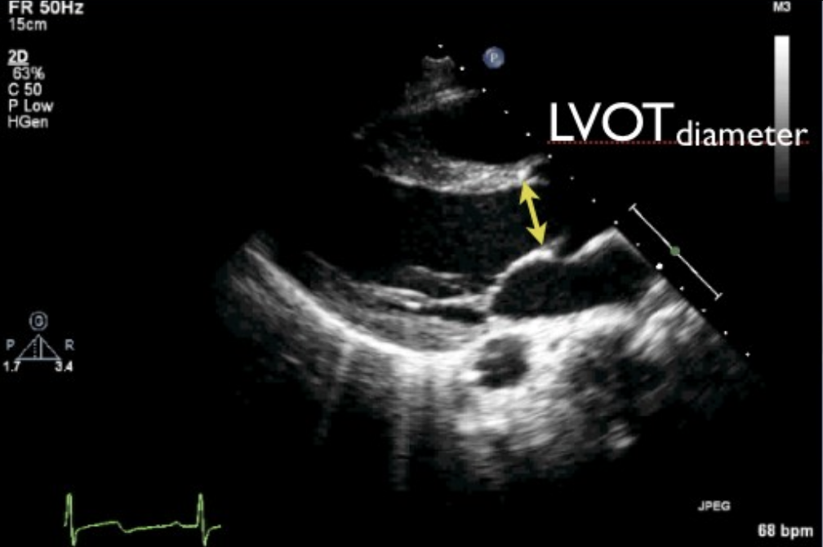

Measuring LVOT Area
Only need to do once
Measure at level of the aortic annulus aka base of leaflets
Mid-Systole (valves fully open)
Inner wall to inner wall to obtain diameter
Must be perpendicular to LVOT
AREA is $A=πr^{2}$ where radius is diameter/2
Notes:
Images from Dawson Mallin vol 2
How is this different from when we usually measure the outflow tract when we’re looking for dilation? In that case we are measuring above the sinus of Valsalva in END DIASTOLE and leading edge to leading edge
Aortic annulus -measure just below the valves (looks like a butt) when valves all the way open, inner wall to inner wall.
Assume the LVOT is a circle; it doesn’t change so you only need to measure it once (unlike velocities). Measurement must be perpendicular to the LVOT
Take your diameter measurement, divide by 2 and plug it in
Remember mid-systole in the AORTIC valve is during squeeze which is when the aortic valve is open to push the blood out. Diastole is when the mitral and tricuspids open for filling of the ventricles.
The normal measurement is approximately 2cm

Slide 10
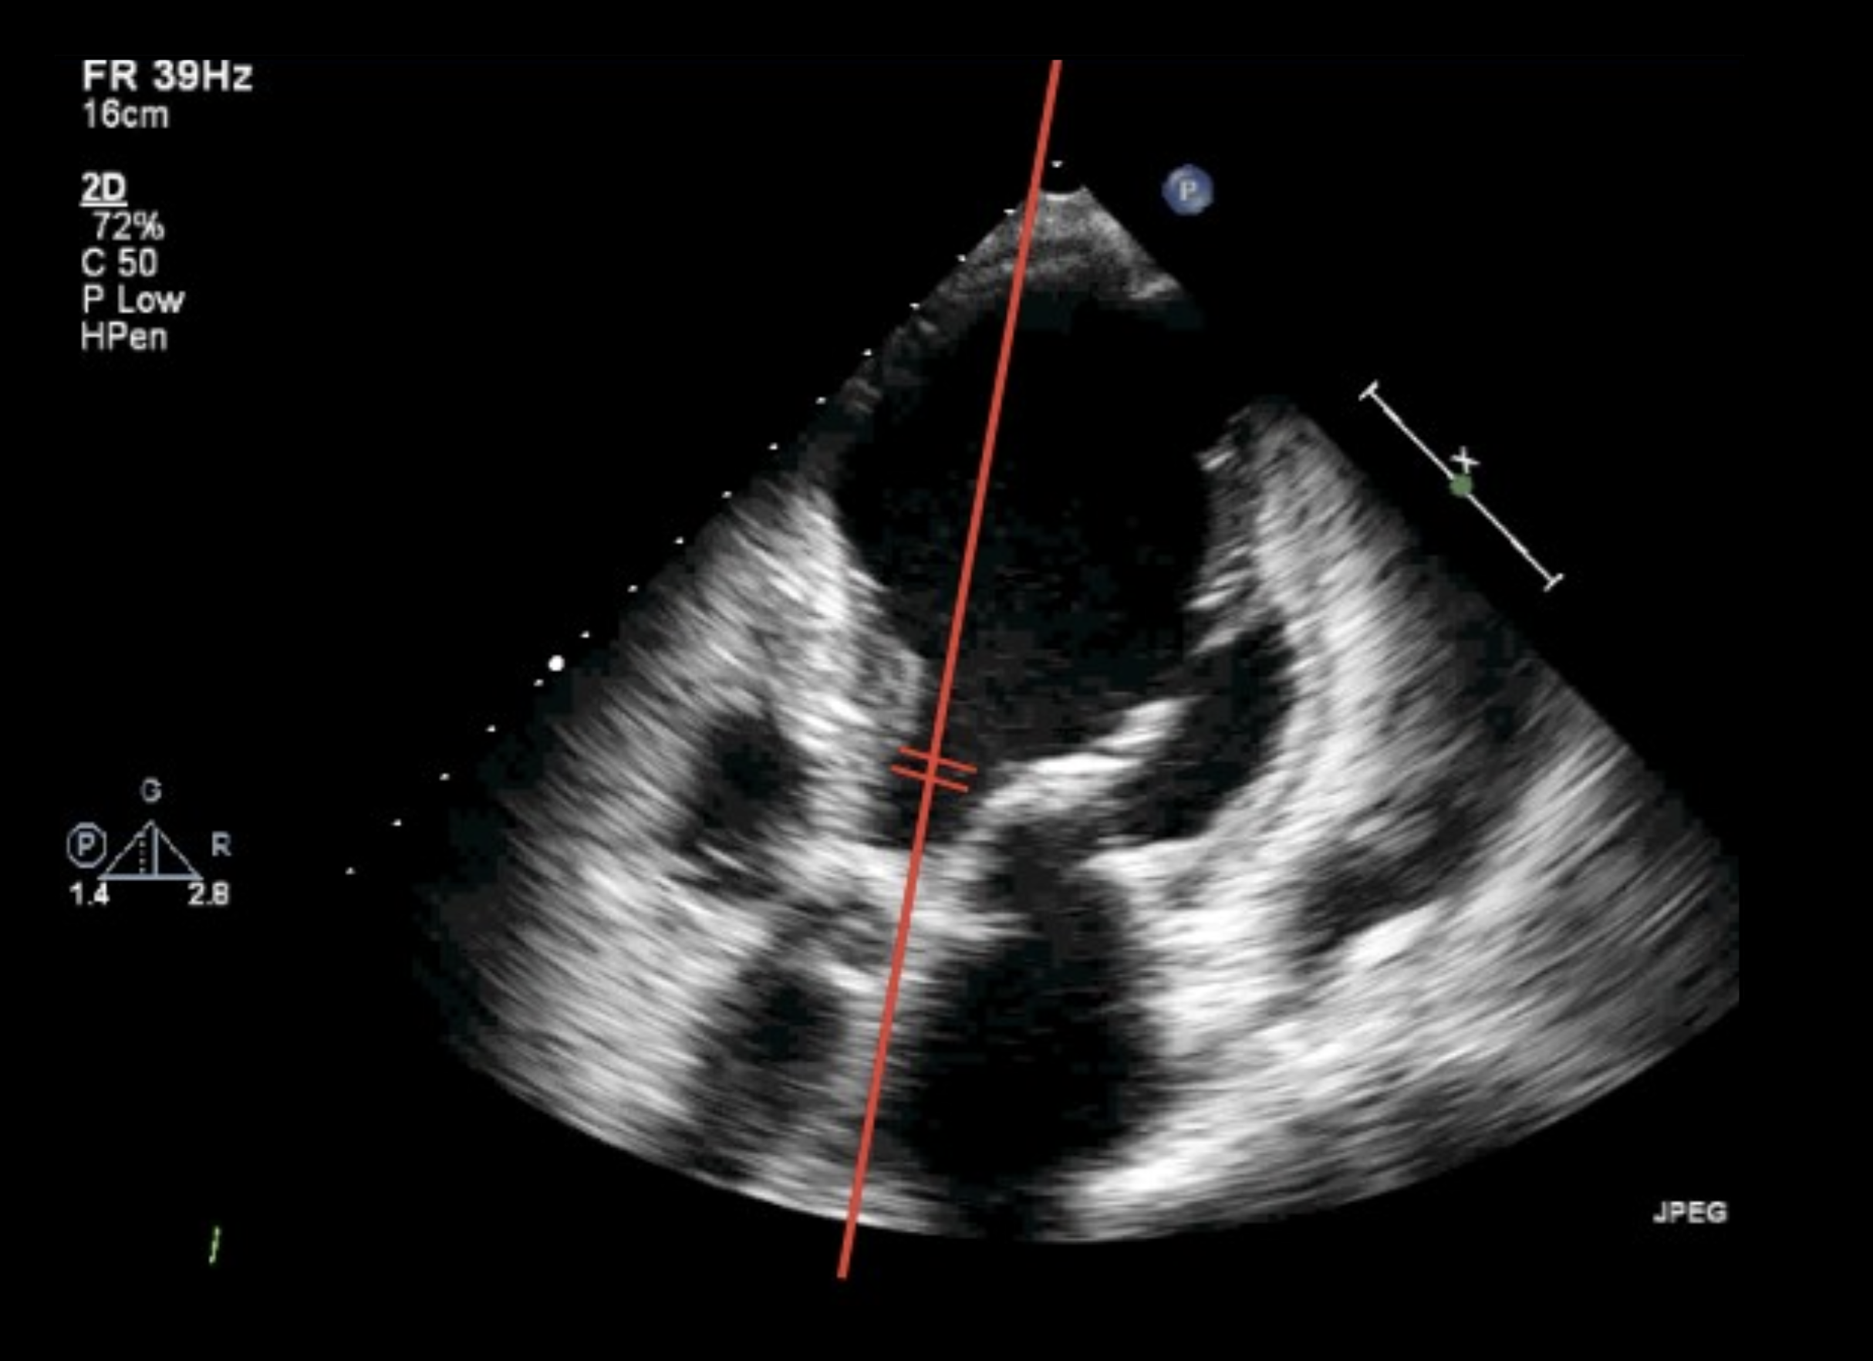
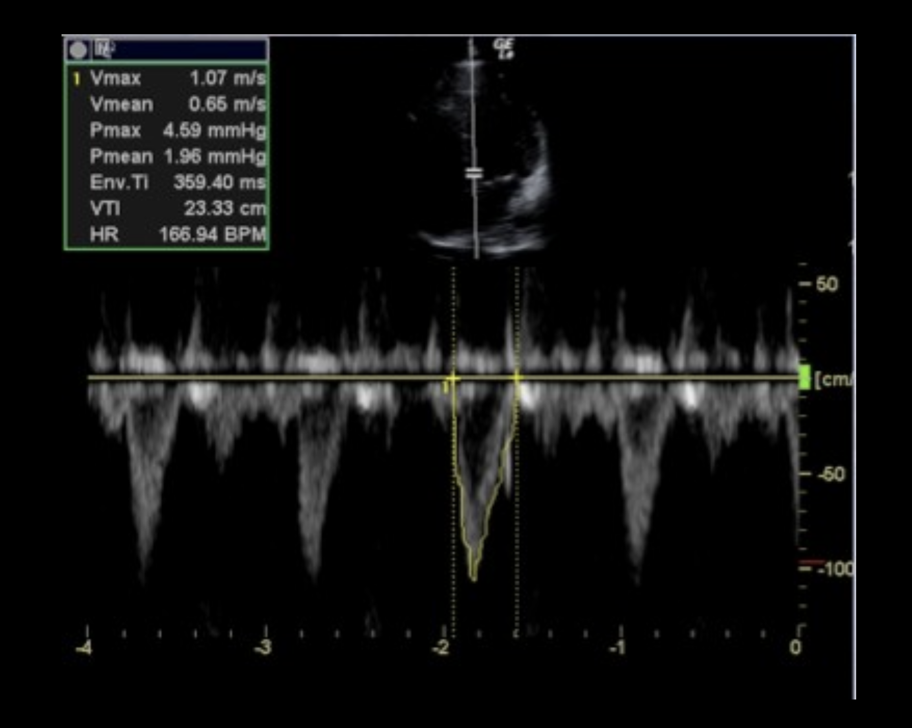
Measuring VTI
Obtain either Apical 5 Chamber or Apical Long Axis with clear outflow tract
At level where LVOT measured, place Pulsed Wave Doppler Gate
  Must be in middle of blood flow
Select VTI and trace the negative wave form
Notes:
The wave forms will be negative because the blood is flowing AWAY from the probe
If there is any ANGLE between the blood flow and the pulsed wave doppler gate, the VTI will be UNDERestimated
Make sure LVOT area was done during midSYSTOLE or there will be underestimation of the
Question: Why are the wave forms downward on the screen? Blood is moving AWAY from the probe
Question: What happens if you measure the LVOT during diastole (filling) or just not during midSYSTOLE? Your diameter will be smaller than it really is and therefore your area will be smaller than it really is (remember that diameter is in the numerator/proportional). If you’re not measuring when the blood is being pushed out at the max opening of the AORTIC valves, when the valves are all the way open, you’re not measuring at it’s greatest diameter.
Question: If your pulsed wave doppler gate is not in the middle of the blood flow (aka parallel to the blood flow) where you measured the LVOT diameter what could happen? Your velocity will be less because the fastest flow is in the middle so your VTI will be underestimated. When plugged into the main equation, your stroke volume and therefore cardiac output will also be underestimated
Question: What does VTI measure? The distance blood travels in one cardiac cycle (aka heart beat)

Slide 11
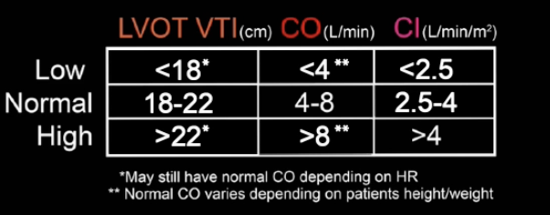
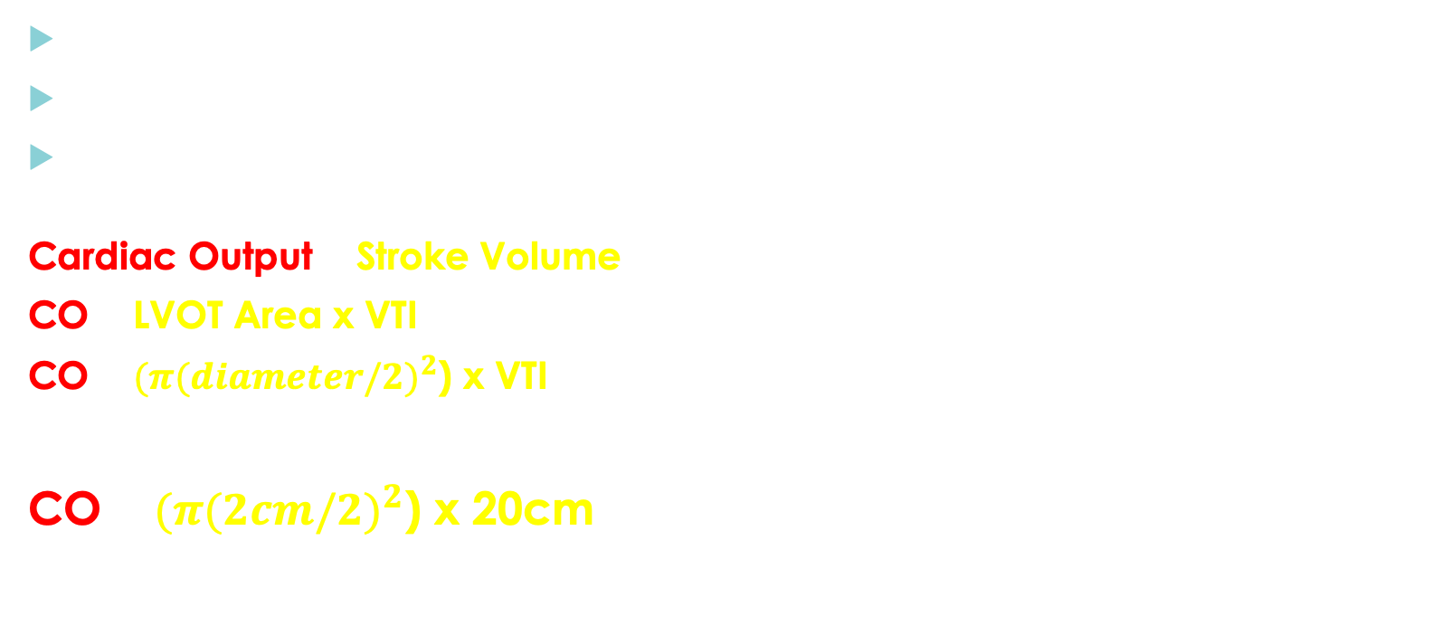
Putting It All Together…
Normal HR of approximately 60 beats/minute
LVOT diameter measurement is usually 2cm
Normal VTI (aka distance blood travels in one heart beat) is approximately 20 cm
Cardiac Output = Stroke Volume X Heart Rate
CO = LVOT Area x VTI x HR
CO= $(π{(diameter/2)}^{2}$) x VTI x HR
CO= $(π{(2cm/2)}^{2}$) x 20cm x 60 beats/min= 3,768 mL/min
or 3.7L/min
Notes:
POCUS 101 Tip: A rule of thumb we like to use is that a normal LVOT VTI is around 20cm. This is calculated that by assuming a normal stroke volume is 60ml and an average LVOT diameter is 2cm. If you use the cylinder formula to back-calculate this, a “normal” LVOT comes to just about 20cm!
Volume of a cylinder is area x height where height is actually VTI
https://www.pocus101.com/measuring-cardiac-output-with-echocardiography-made-easy/#:~:text=The%20LVOT%20VTI%20will%20output,average%20LVOT%20diameter%20is%202cm.
60mL/cm^3= [3.14*(2cm/2)^2)]xVTI
60mL/cm^3= [3.14*(1cm^2)]xVTI
60mL/cm^3=3.14cm^2xVTI
60mL/cm^3/3.14cm^2=VTI
VTI= about 20cm
If HR is about 80, comes to about 5L/min

Slide 12
Images Tips for Getting the Best VTI Tracing
Adjust your Gain
  So you can see the whole waveform
Adjust your Baseline
  So you capture the top of the wave form
Adjust your Sweep Speed
  So you have enough cycles to choose the best one (or measure 5-10 waveforms for atrial fibrillation)
Notes:
See pocus 101 video under Step 5

Slide 13
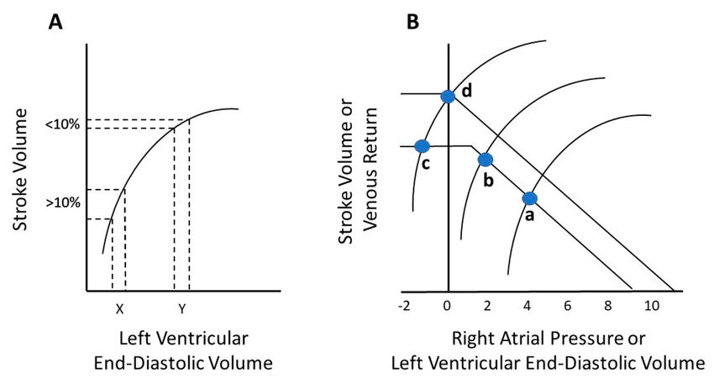
LVOT diameter, VTI, & Passive Leg Raise
Using the VTI method to obtain stroke volume, calculate while the patient’s head of bed is at 30 degrees
Provide 250mL fluid bolus
Raise legs to 45 degrees with head down and remeasure stroke volume after approximately 30 seconds
A change in stroke volume of >10% or change in VTI >15% indicates volume responsiveness
Notes:
Frank–Starling curve (A). An increase in stroke volume of >10% after a fluid bolus is indicative of fluid responsiveness (X). When stroke volume increases <10% in response to fluid administration (Y), further fluid resuscitation is not indicated, and the “peak of the Frank–Starling curve” is reached. Guyton’s venous return curve interposed on Frank–Starling curve (B). Point (a) is the intersection of the venous return and stroke volume curves referred to as the hemodynamic “operating point” of the system. A leftward shift of the Frank–Starling curve from (a) to (b) with an inotrope results in a higher stroke volume and a lower right atrial pressure (RAP). A decrease in RAP to sub-atmospheric levels causes collapse of the great veins entering the thorax and prevents stroke volume and venous return from increasing (c), despite the further leftward shift of the Frank–Starling curve. The addition of fluids could move the operating point from (c) to (d) by increasing the stressed volume and mean systemic filling pressure, which is the upstream pressure for venous return to the right heart.
Russell, Amy & Rivers, Emanuel & Giri, Paresh & Jaehne, Anja & Nguyen, H.. (2020). A Physiologic Approach to Hemodynamic Monitoring and Optimizing Oxygen Delivery in Shock Resuscitation. Journal of Clinical Medicine. 9. 2052. 10.3390/jcm9072052.

Slide 14
Ejection Fraction
EPSS
Fractional Shortening
Simpson’s Method (Method of Discs)
Notes:
Hyperdynamic >70%,
normal 50-70%
Mild 40-49%
Moderate 30-39%
Severe <30%

Slide 15
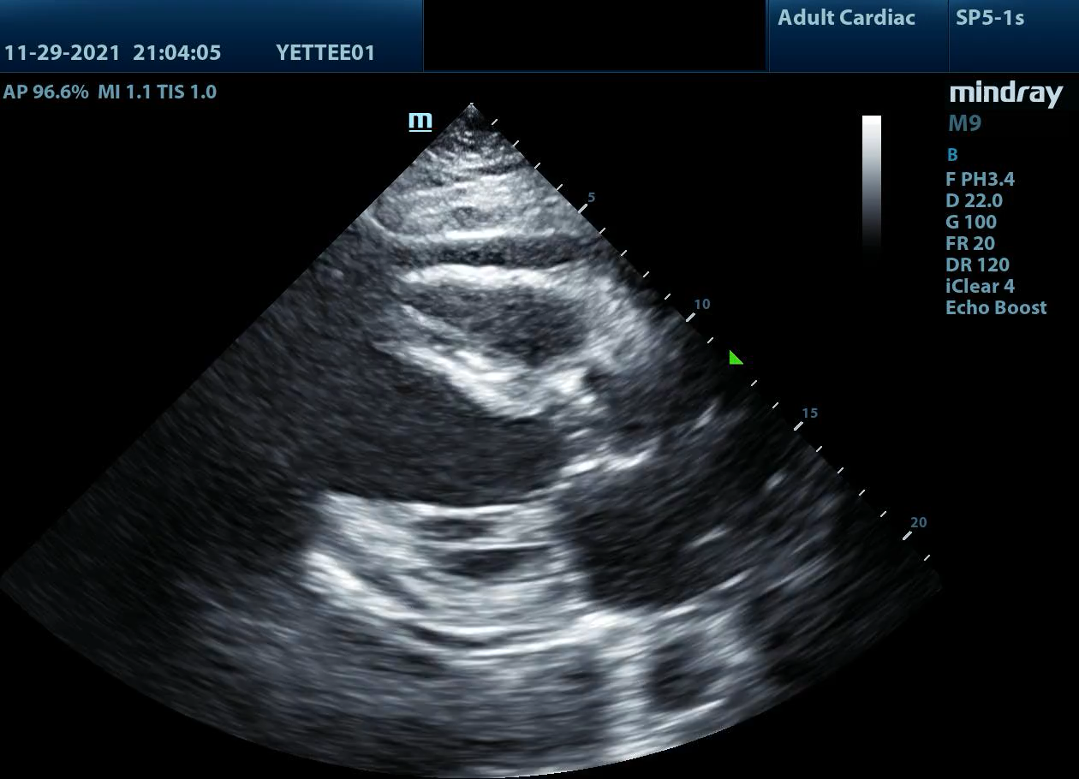
Ejection Fraction: Visual Estimation
Hyperdynamic >70%
Normal 50-70%
Mild 40-49%
Moderate 30-39%
Severe <30%
Notes:
This is a patient with severely decreased EF

Slide 16
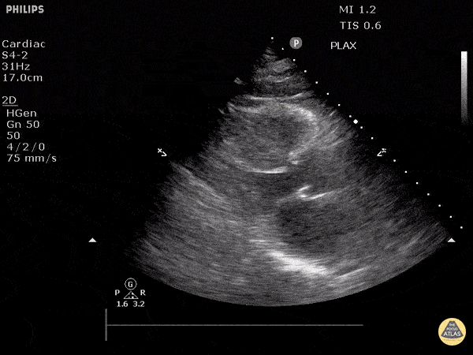
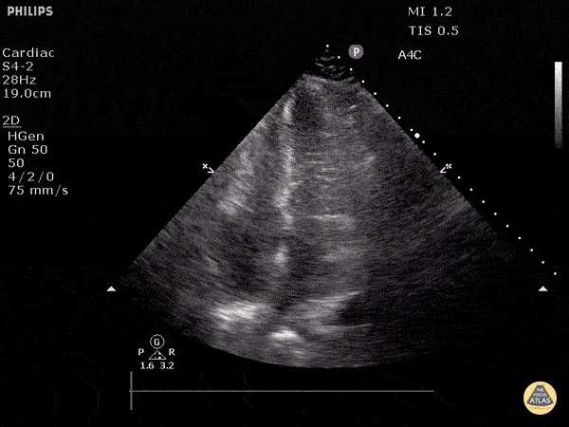
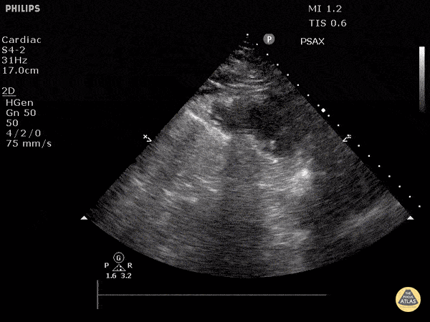
A note on Hyperdynamic EF
Greater than 70% EF
It is NOT just tachycardia although often seen with tachycardia
Both walls of LV touch
Often due to hypovolemia

Slide 17
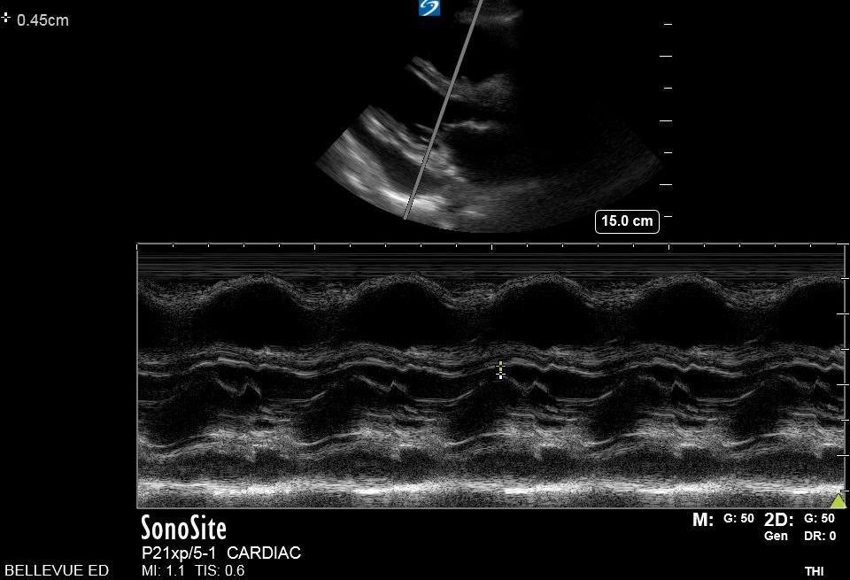
E-Point Septal Separation (EPSS)
<7 mm = Normal EF
>10mm = Low EF
LVEF=75.5-(2.5xEPSS)
Not valid if Mitral Stenosis, Mitral Regurgitation, Mitral Valve Calcification or Aortic Regurgitation, Mitral Annulus Dilation due to Cardiomyopathy or Extreme LV Hypertrophy
Notes:
https://www.youtube.com/watch?v=BqVkAnnzX6c
Image mine. Normal EF with 0.45cm EPSS
Some say <5mm is normal, SLR we use 7. See the Malin/Dawsom book Volume 1 One Minute Ultrasound on page 36
If MV anterior leaflet tip touches the septum during diastole, EF is >55% aka normal
Equation is derived from an MRI study but visualization is still best.
Per Goertz:
Normal EF: EPSS < 5 mm
EF < 50%: EPSS > 7 mm
EF < 30%: EPSS > 18 mm

Slide 18
1
2
3
4
1. RV Free Wall
2. Right Ventricle
3. Septum
4. Mitral Valve
E
A
Notes:
Details of anatomy with corresponding sections on M-mode field

Slide 19
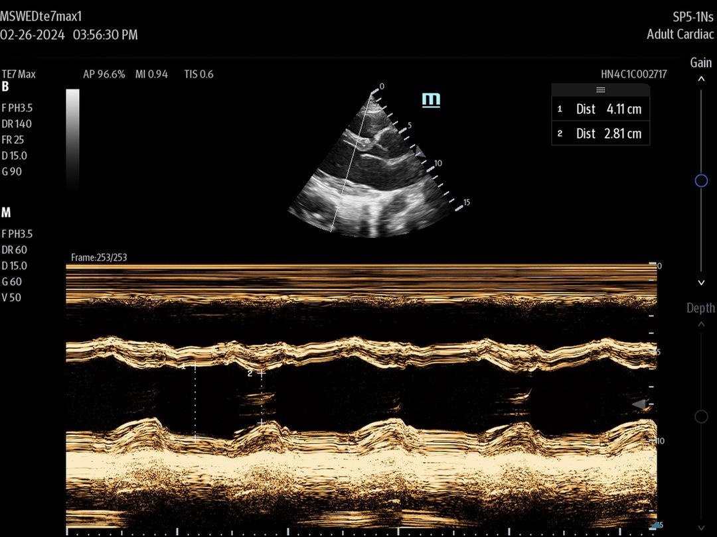
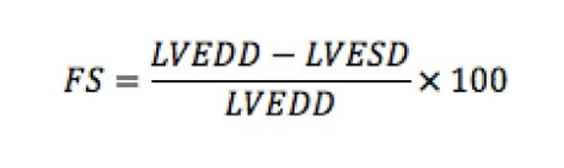
Fractional Shortening
If significant cardiovascular disease or regional wall motion abnormalities, it will be inaccurate
Does not account for the heart being a 3D object
Normal is 25-45%
FS is usually half the ejection fraction
FS=[(4.11-2.81)/4.11]*100= 31.6%
Notes:
https://www.youtube.com/watch?v=ERGxpZ4qdYI
Left Ventricle End Diastolic Diameter minus Left Ventricle End sysstolic Diameter and then divide by Left Ventricle End Diastolic Diameter

Slide 20
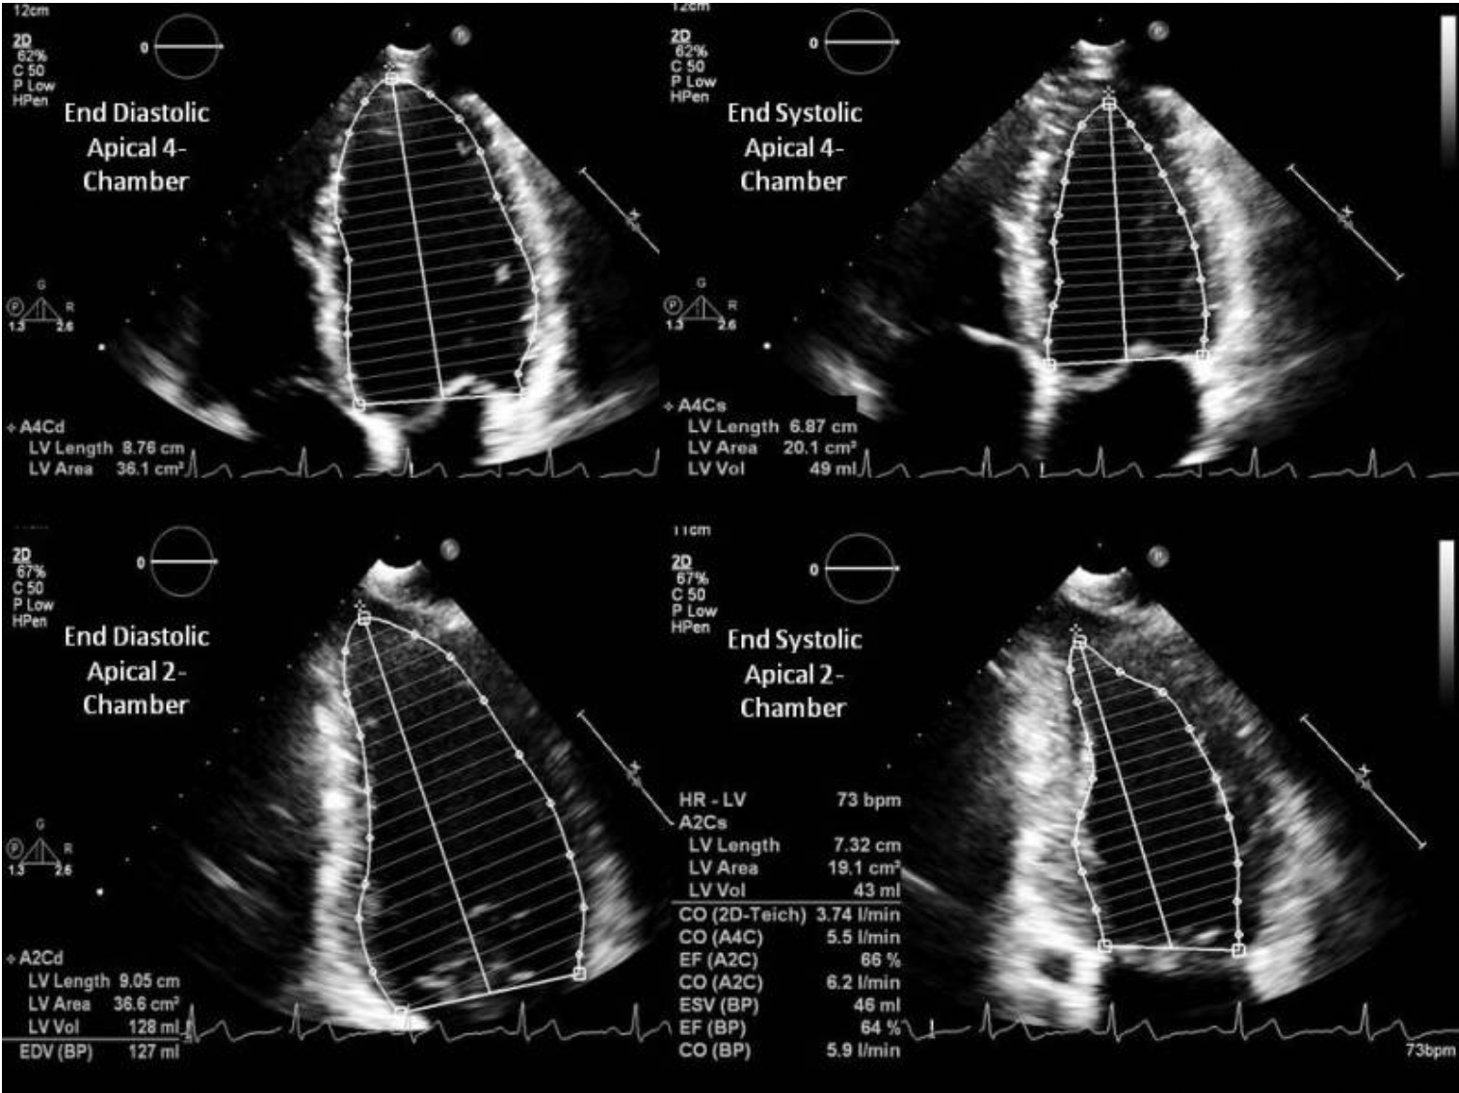
Simpson’s Method of Discs
Require special software
Need A4C and Apical 2 Chamber views
Trace the endocardial borders
Most accurate estimate of EF
LVEF= (EDV-ESV)/EDV*100
Notes:
Kosaraju A, Goyal A, Grigorova Y, et al. Left Ventricular Ejection Fraction. [Updated 2023 Apr 24]. In: StatPearls [Internet]. Treasure Island (FL): StatPearls Publishing; 2024 Jan-. [Figure, Biplane Simpson Method using the...]Available from: https://www.ncbi.nlm.nih.gov/books/NBK459131/figure/article-24159.image.f1/

Slide 21
Right Heart

Slide 22
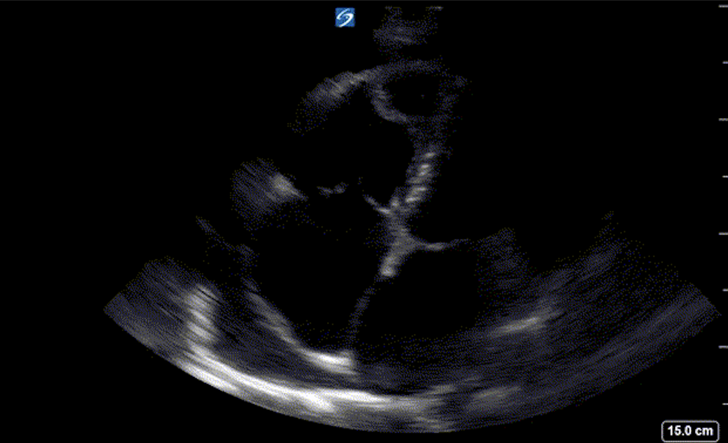
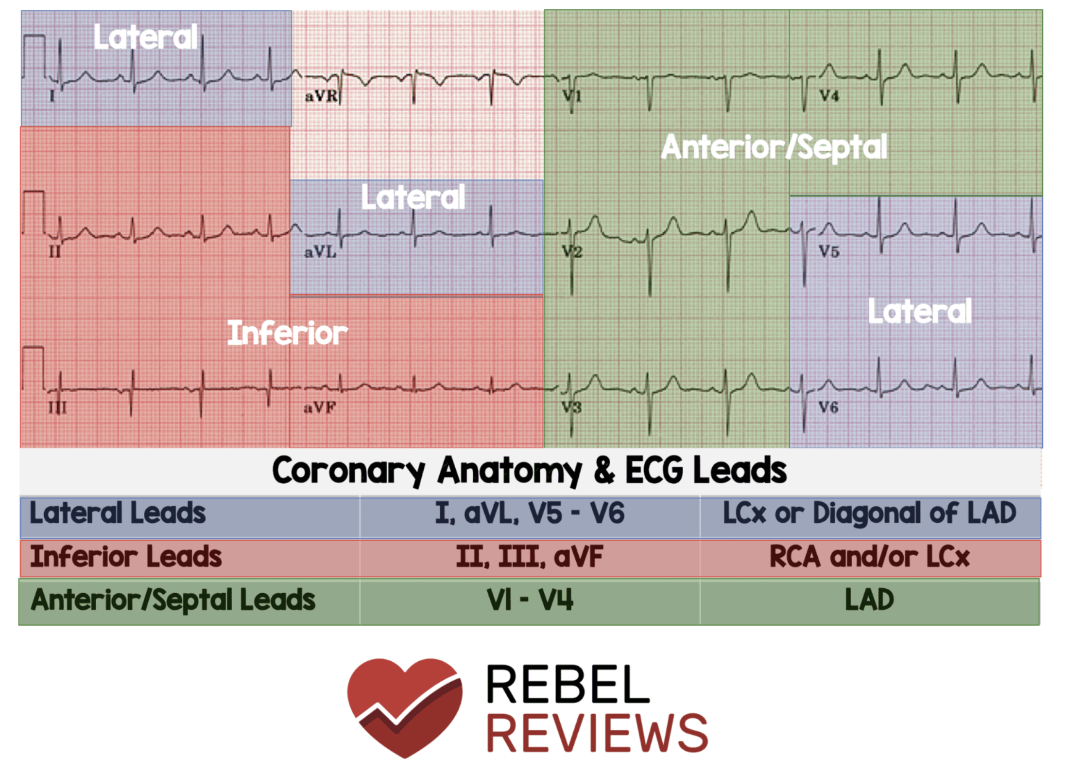


Anatomy
RCA perfuses right free wall
LAD perfuses moderator band
LV contracts concentrically whereas the RV contracts longitudinally “Like an accordion”

Slide 23
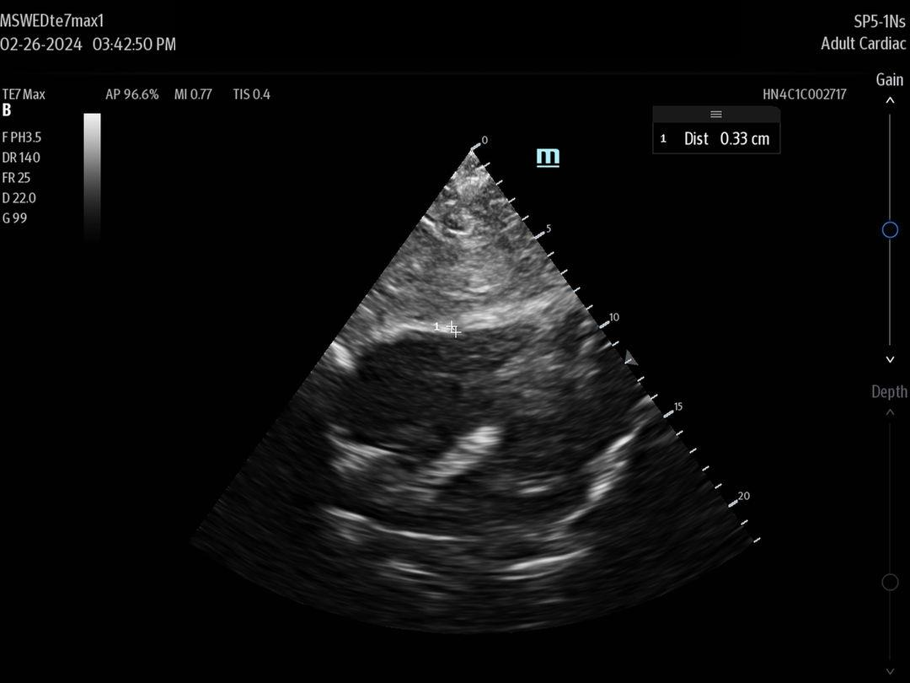
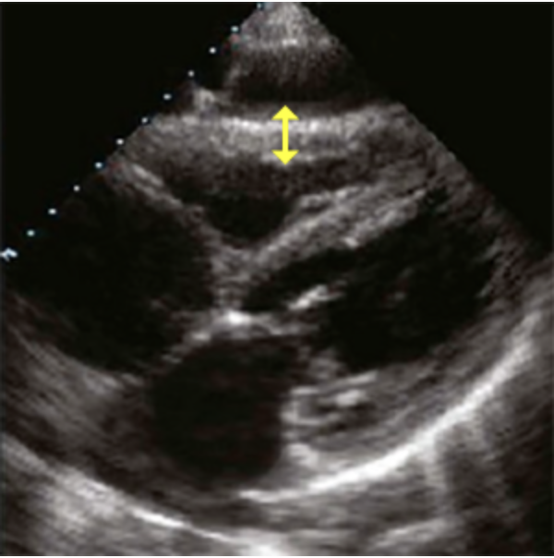
Anatomy
Right Free Wall <5mm
  Thickened in Pulmonary Hypertension, Heart Failure, Cardiomyopathies
  Measure from Subxiphoid view in Diastole

Slide 24
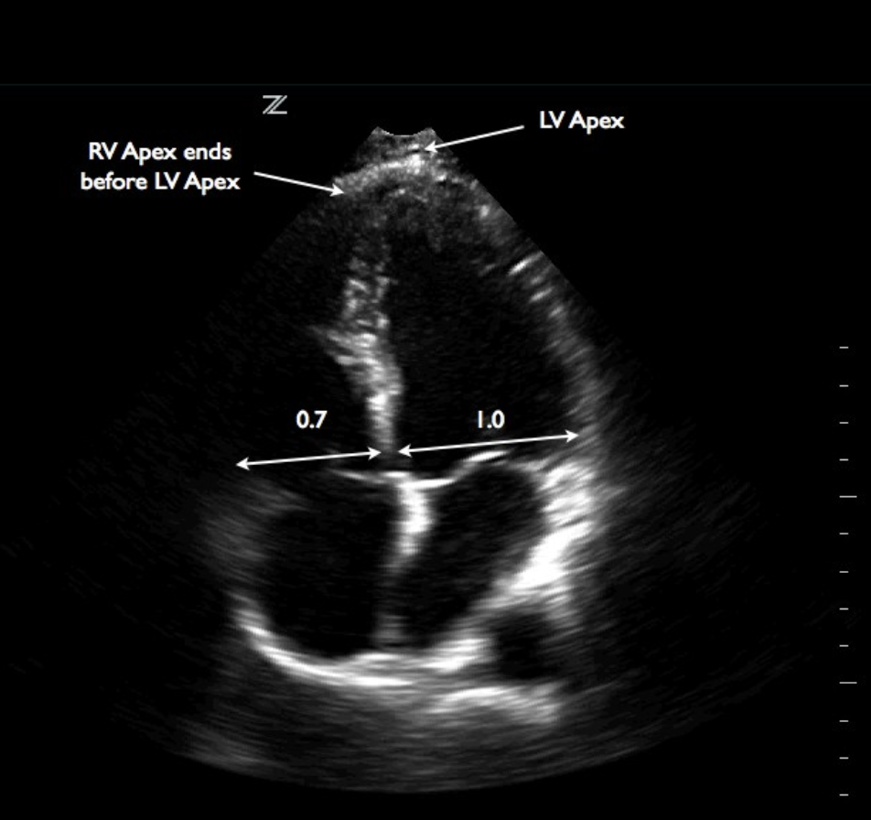
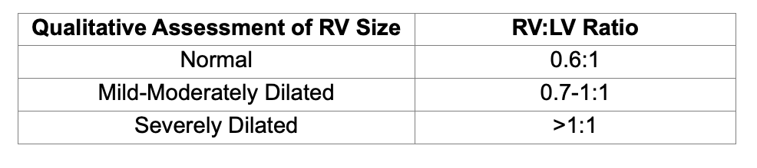
Anatomy
Measure just above the annulus on the screen

Slide 25
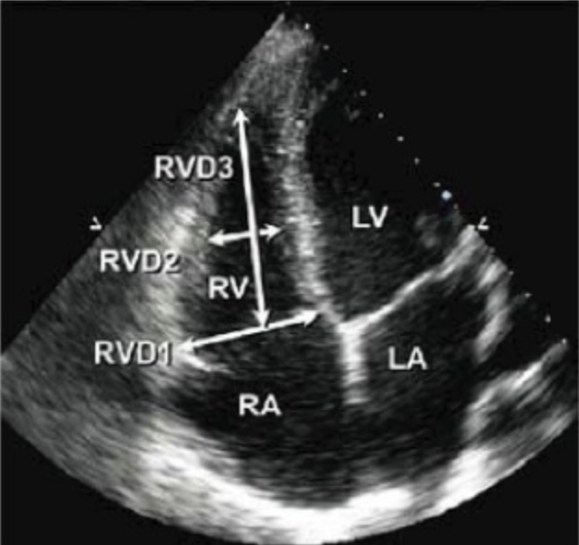
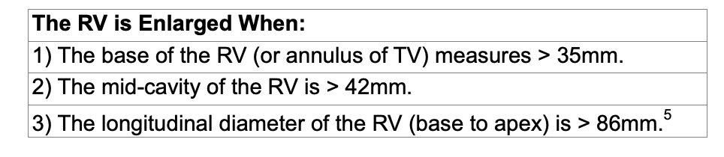
Anatomy
Measuring RV size
  Width just above the annulus
  Width Mid- ventricle
  Length from apex to annulus
Notes:
Images from dawson and malllin, echo 123

Slide 26
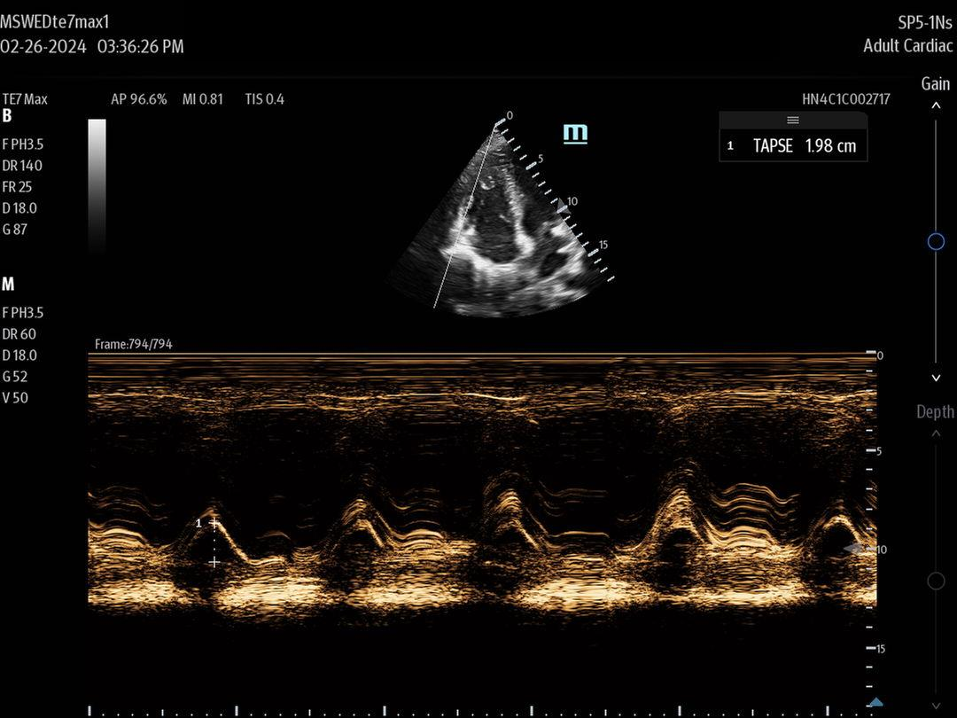
TAPSE
Tricuspid Annular Plane of Systolic Excursion
In A4C view, place M-Mode marker along the right free wall over the tricuspid annulus
Measure from the peak to trough of the annulus movement
Notes:
Other sources may say 17mm is cut off of normal but less than 16mm is definitely abnormal
Remember that the RV moves in a longitudinal fashion so the tricuspid annulus moves up and down; decreased movement in that direction corresponds with RV dysfunction

Slide 27
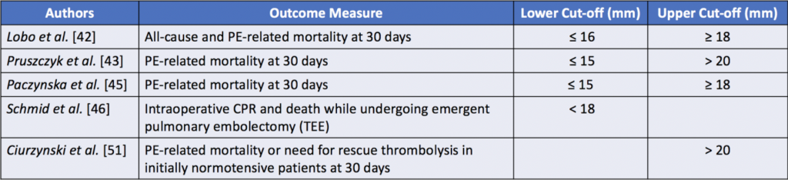
Interpretation
*American Society of Echocardiography cutoffs
  <17mm = RV dysfunction
  <14mm = poor prognosis, survival implications
Notes:
Credit to Jake Canavan
(some say 16mm-20mm is normal)

Slide 28
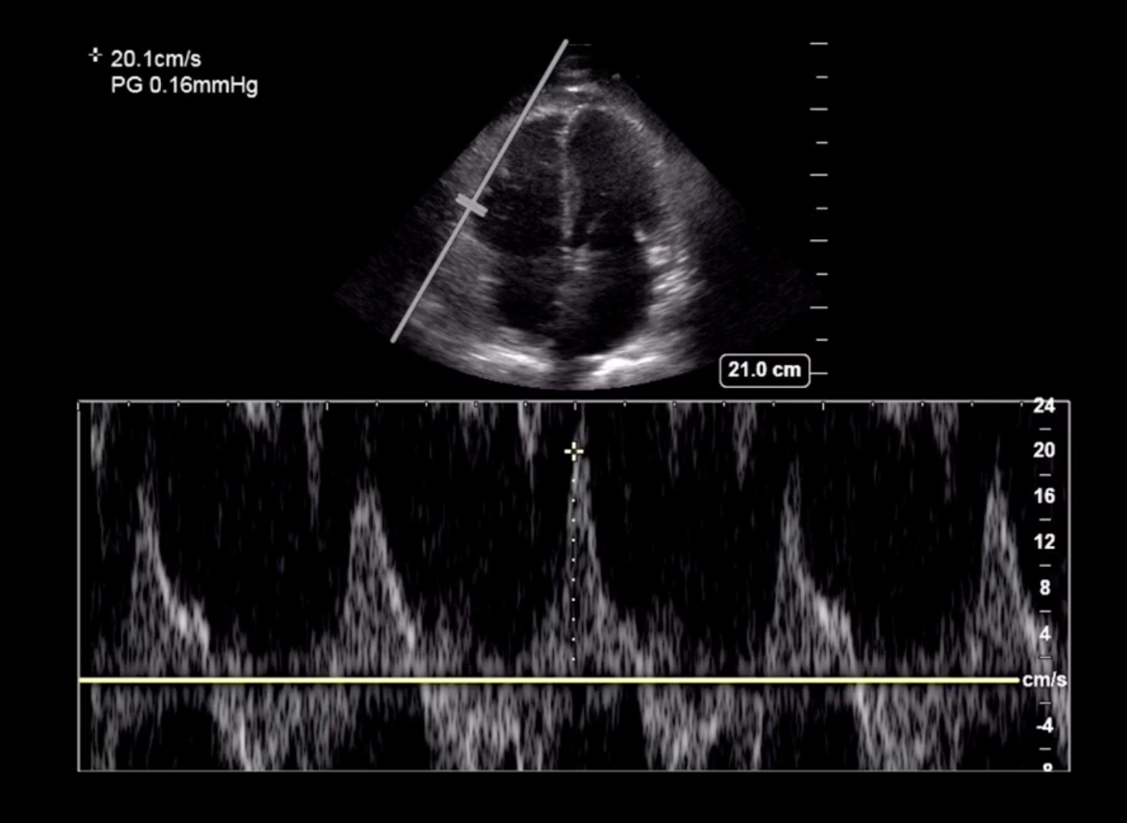
S’ or Systolic Excursion Velocity
TAPSE measures how FAR the annulus moves, S’ measures how FAST the annulus moves
Select Pulse Wave Doppler and then set to Tissue Doppler instead of M-Mode just apically to the Tricuspid Annulus
>10cm/s is considered Normal
Notes:
Systolic Excursion Velocity
https://coreultrasound.com/right-heart-function/

Slide 29
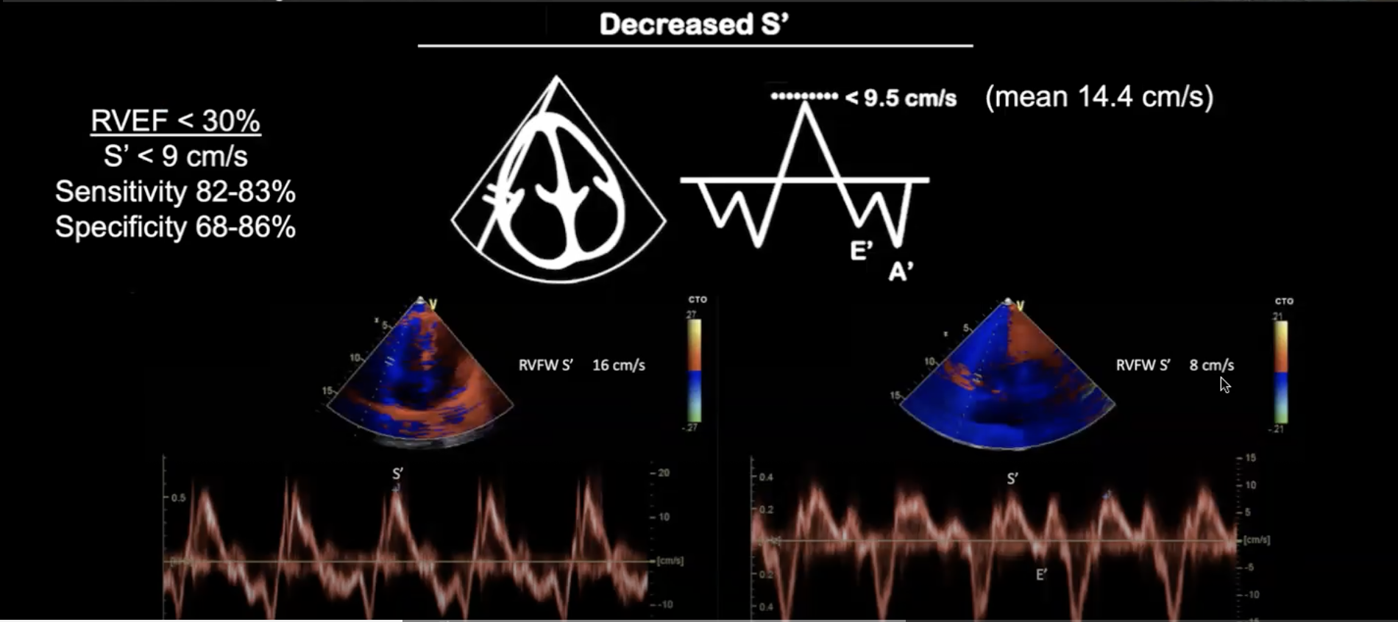
S’
Notes:
Image from AEMUS Alerhand Right Heart Talk
Left image is normal, Right image is abnormal

Slide 30
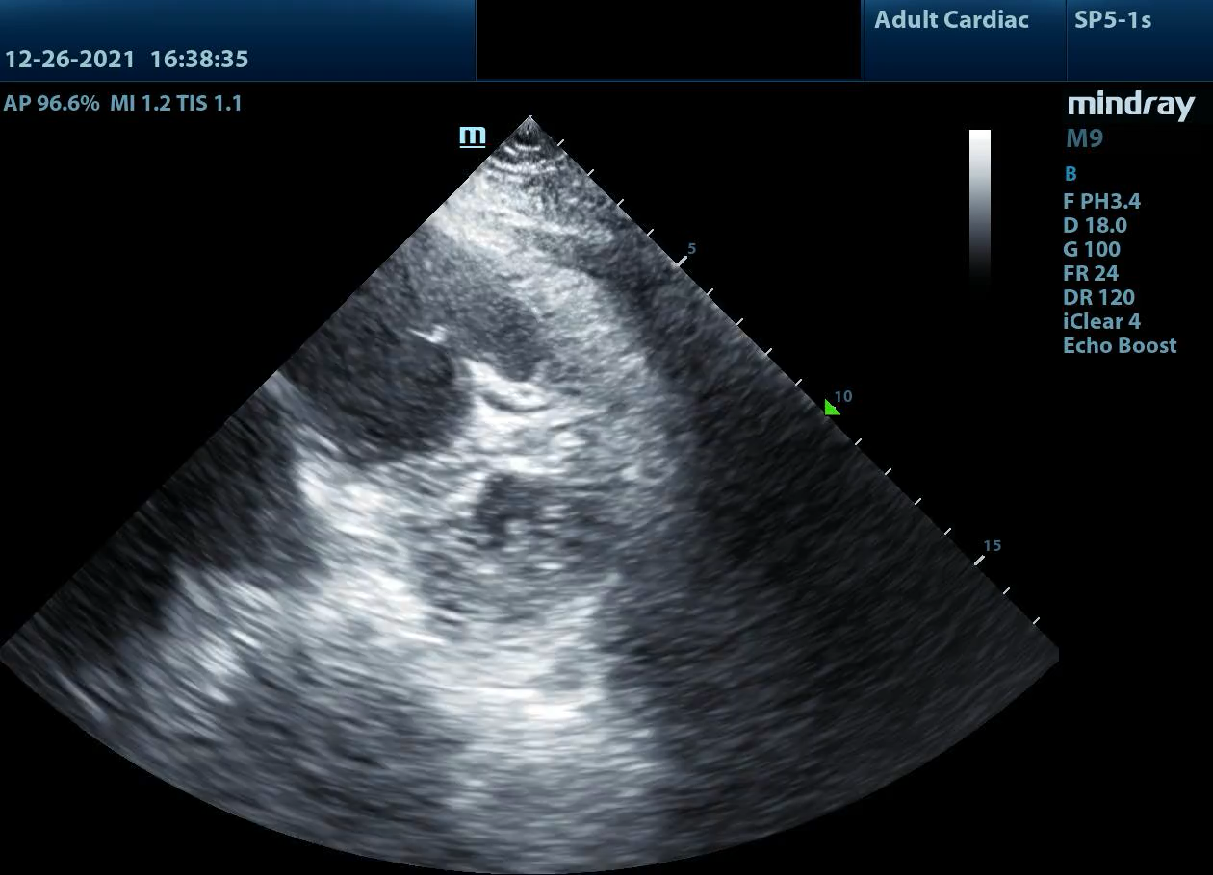
Ventricular Overload
Pressure overload → Systolic Dysfunction
  Pulmonary Embolism
Volume overload → Diastolic Dysfunction
  Massive Fluid Bolus (MTP)
Notes:
The LV should not flatten- septal flattening aka paradoxical septal motion aka septal dyskinesia (intraventricular septum should remain concave with respect to LV during systole and diastole)
ASK: Is this pressure or volume overload in this photo? It’s pressure overload due to a PE (actually had clots in right ventricle, some of which are visible) due to large PE
Volume Overload may look the same as Pressure overload HOWEVER the septal flattening is ONLY at end-diastole unlike pressure overload where it is present throughout. (septum flattens and appears to regain its shape during systole)

Slide 31
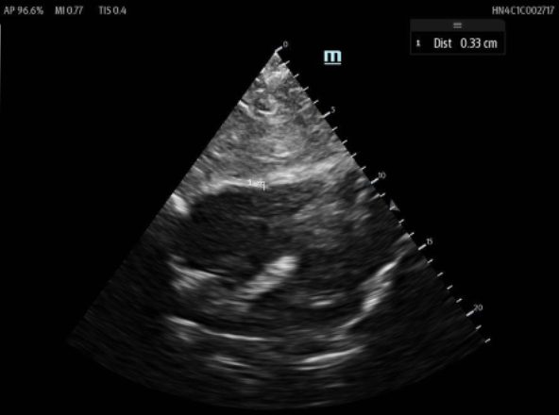
Chronic vs Acute Changes
RV Free Wall Thickness >5mm
  In Diastole from the Subxiphoid View
Hypertrophied trabeculae, moderator band, papillary muscles
Acute on Chronic- Need to compare echos
Notes:
For acute on chronic (e.g. someone who develops a PE but has chronic pulmonary hypertension), need to look at prior imaging for comparison

Slide 32
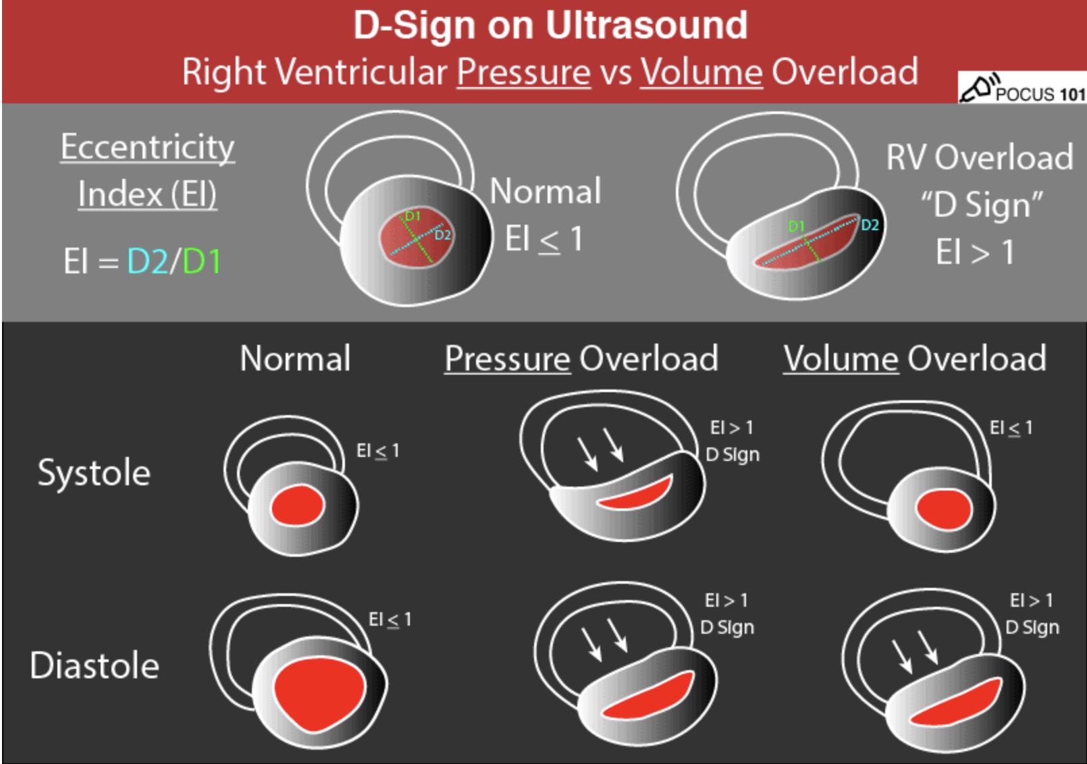
Eccentricity Index
Notes:
https://www.pocus101.com/the-d-sign-right-heart-strain-from-pressure-vs-volume-overload/
Pressure Overload
Bows in during both systole and diastole
Pressures are high during both systole and diastole
Volume Overload
Diastole- Bows in/D Sign when filling, Systole- returns to normal
Volume increase during filling causes septal bowing but that is finished by the time we are in systole so the bowing resolves

Slide 33
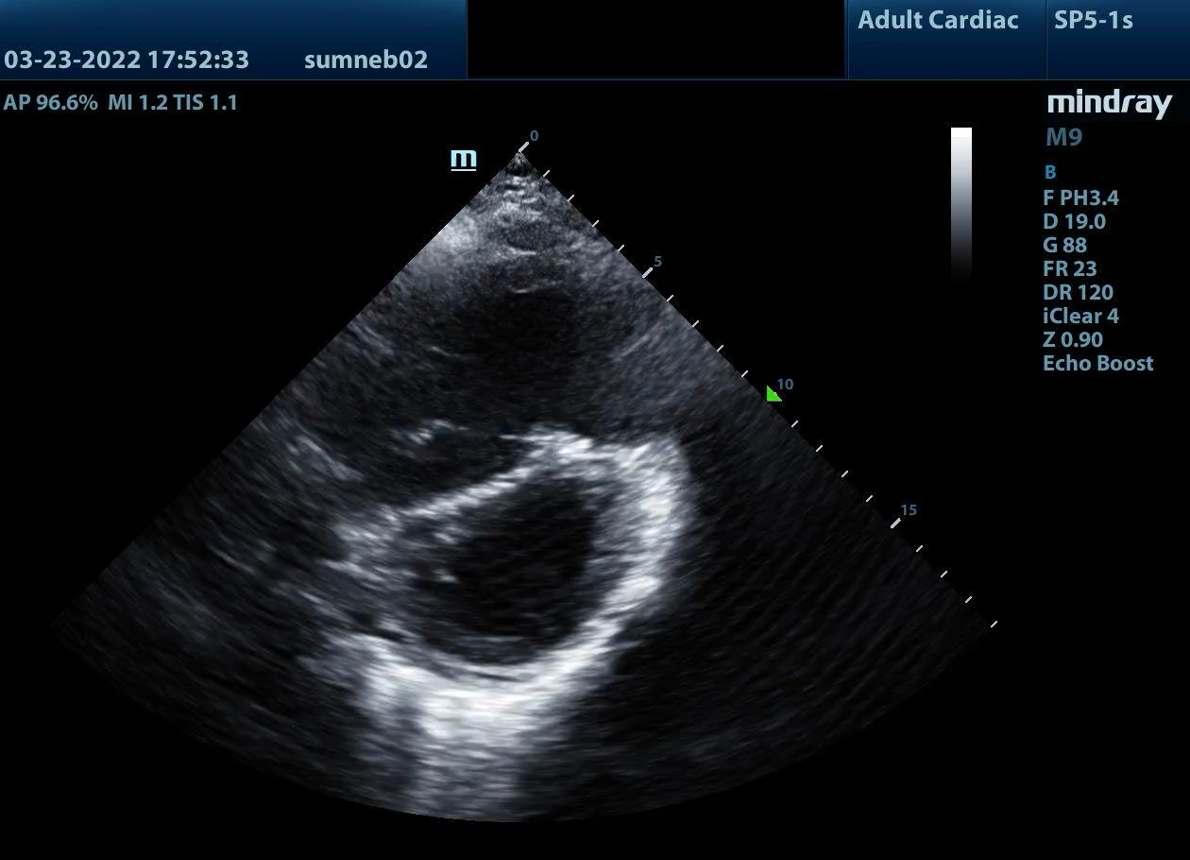
Eccentricity Index
Pressure
Volume

Slide 34
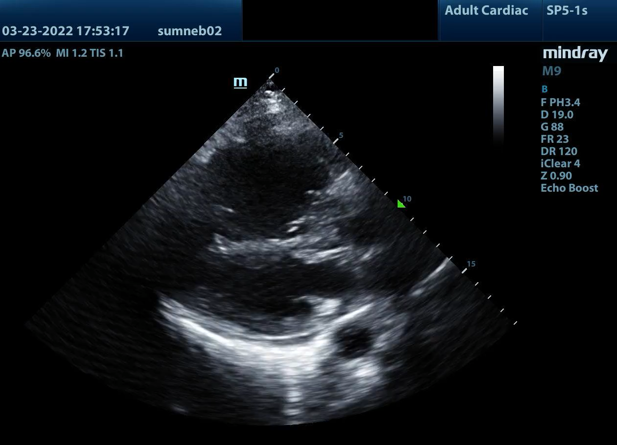
Eccentricity Index
Notes:
Same Patient- PSS, PSSL
Note during Systole (Valves closed), the septum bounces back, more notable in the PSSL

Slide 35
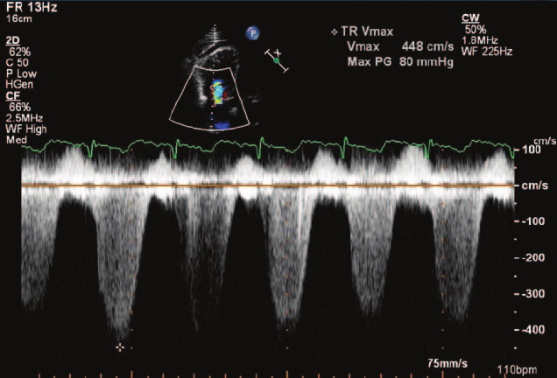
Pulmonary Artery Systolic Pressure (PASP)
Used to diagnose and monitor pulmonary hypertension
Apical 4 Chamber View- Use CW over TR jet for velocity and RV Systolic Pressure (RSVP)
IVC from Subxiphoid View
  Obtain longitudinal view with absolute size measurement & collapsibility
RVSP + RAP = PASP
  Where if you only have velocity available use RSVP = 4v_{max}²
PASP >36mmHG IS ABNORMAL
 | IVC (cm) | Collapse | CVP
Low | <2.1 | >50% | 3 (0-5)
Normal | </> 2.1 | </>50% | 8 (5-10)
High | >2.1 | <50% | 15 (10-20)
Notes:
IVC chart fixed- the one in Dawson & Mallin was wrong
Note that some refer to RSVP also called the Tricuspid Regurgitation Pressure Gradient (TRPG)- Alerhand AEMUS Right Heart Lecture
FIRST
RVSP: Use Color Doppler to look for tricuspid regurgitation (you get tricuspid regurg because of stretching of the annulus/valves due to higher pressures from the PE)
Place Continuous Wave Doppler gate over the largest jet, measure the length of the largest jet (aka peak of the blood flow). Make sure your angle is less than 20 degrees (i.e. line it up with the jet as much as possible). Larger angles means underestimated TRPG aka PASP
Software will calculate the velocity and pressure of the jet
FYI: A TR velocity of <2.8m/s is considered normal and unlike to have pulmonary hypertension
THEN
IVC – Obtain the size and collapse percentage which corresponds with the CVP; OF NOTE, the Core Ultrasound video describes CVP as 3= collapsing, 8= normal, and 15 = plethoric which makes more sense. https://coreultrasound.com/60-60-sign-for-acute-pulmonary-embolism/
RVSP + RAP (from CVP)= PASP
That 4V^2 is the modified Bernoulli Equation
https://www.youtube.com/watch?v=zlLV7gk1RZ8 Echo Lady explanation; A TR velocity of <2.8m/s is considered normal and unlike to have pulmonary hypertension
Image from: Solitary Pulmonary Artery Intima Sarcoma Manifesting as Pulmonary Embolism and Subacute Cor Pulmonale
January 2009
Circulation 120(22):2269-2270

Slide 36
PASP
Limitations
  Cannot locate a tricuspid regurgitation jet
  Lack of acoustic window for the tricuspid valve
  Cannot calculate PASP if there is a RV Outflow Tract Obstruction (pulmonary artery stenosis, extracardiac tumors compressing RV, hypertrophic cardiomyopathy, sinus of valsalva aneurysm, myxoma or PA neoplasm)
  Make sure using a high sweep speed (100m/s) with continuous wave
Notes:
https://www.ncbi.nlm.nih.gov/pmc/articles/PMC8551422/

Slide 37
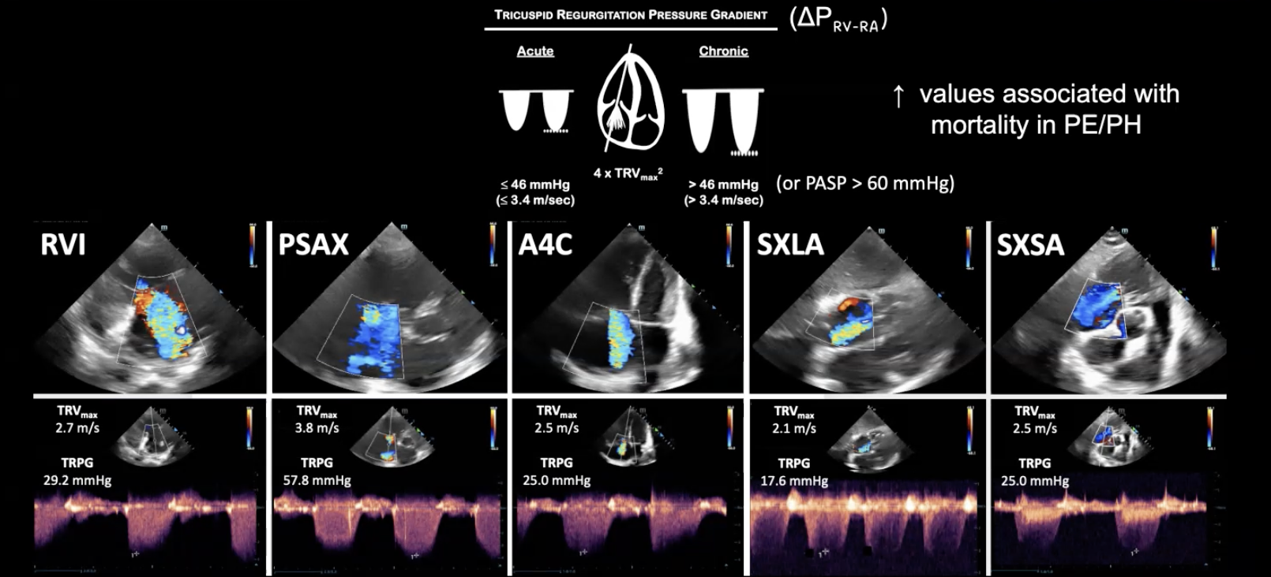
PASP
Notes:
From Alerhands RH Lecture
If you are are looking at PASP in someone with chronic pHTN
If RV hypertrophied, will have higher pressure than RA
If PASP >60mmHG, then it’s chronic and higher values are worse mortality

Slide 38
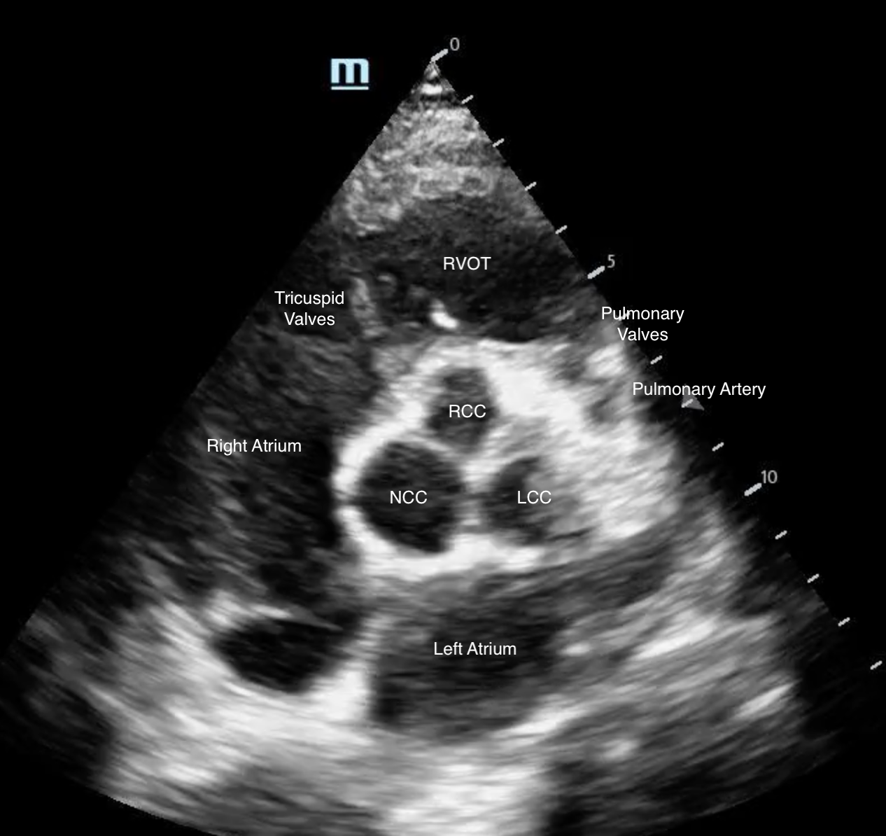
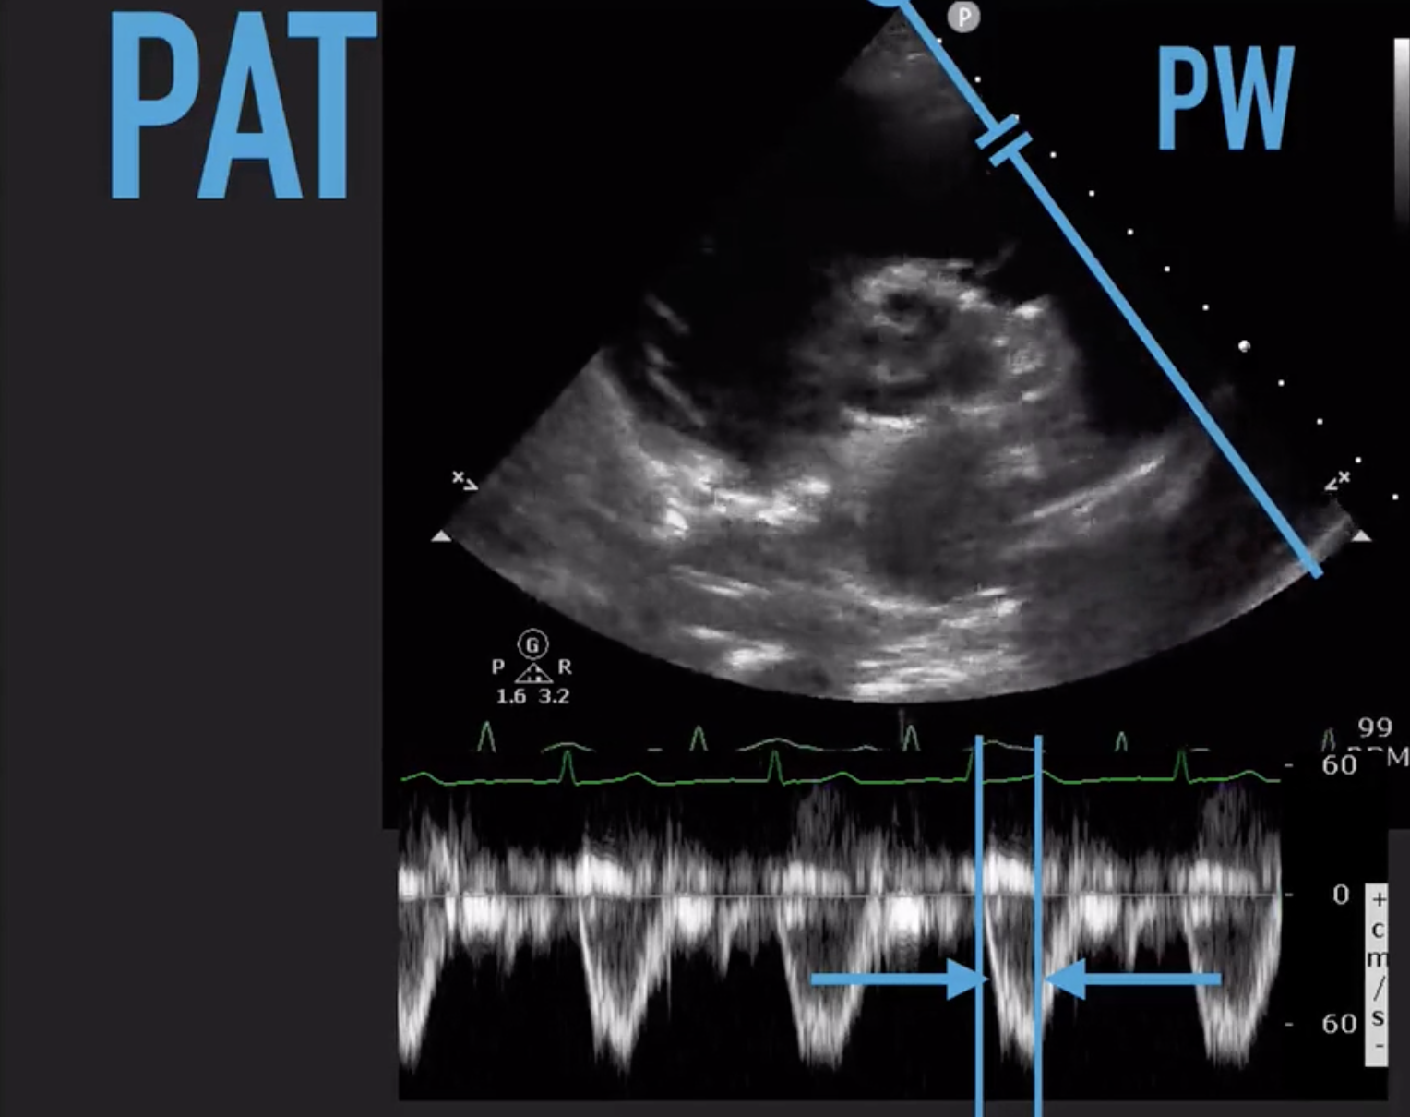
60/60 Sign
PASP <60/ PAT <60
  If your PASP is less than 60mmHG and your PAT is less than 60ms, it’s 94% specific for Pulmonary Embolism
  Calculate your PASP as shown before
Pulmonary Acceleration Time <60s
  Place pulsed wave doppler gate in RVOT just before the pulmonary artery valve
  Measure from start of trough to peak
Notes:
When PASP is very high, it’s actually more consistent with chronic pulmonary hypertension; mild-to-moderately high PASP more acute, perhaps a PE!
https://coreultrasound.com/60-60-sign-for-acute-pulmonary-embolism/
Due to higher pressures, the normally compliant wide waves will be more narrow, indicating a faster acceleration time

Slide 39
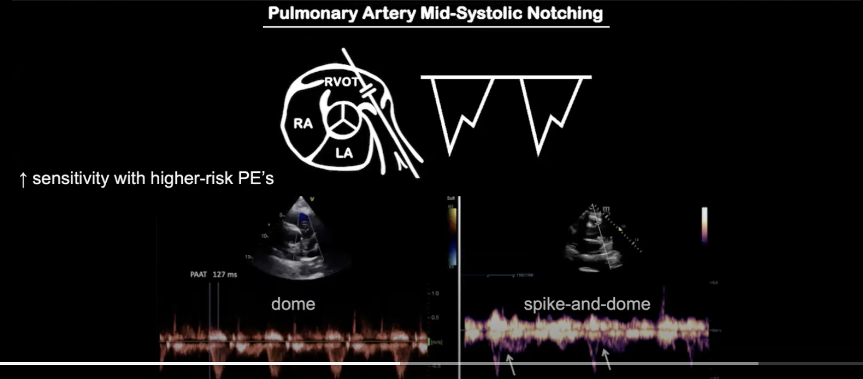
Pulmonary Artery Acceleration Time- MIDSYSTOLIC NOTCHING
Notes:
If rather than the nice smooth dome you know how notching like on the right, that is concerning for higher risk PE. MidSystolic Notching
HOWEVER, if you have EARLY Systolic Notching, it’s even more concerning for a large PE
Alerhand RH AEMUS lecture

Slide 40
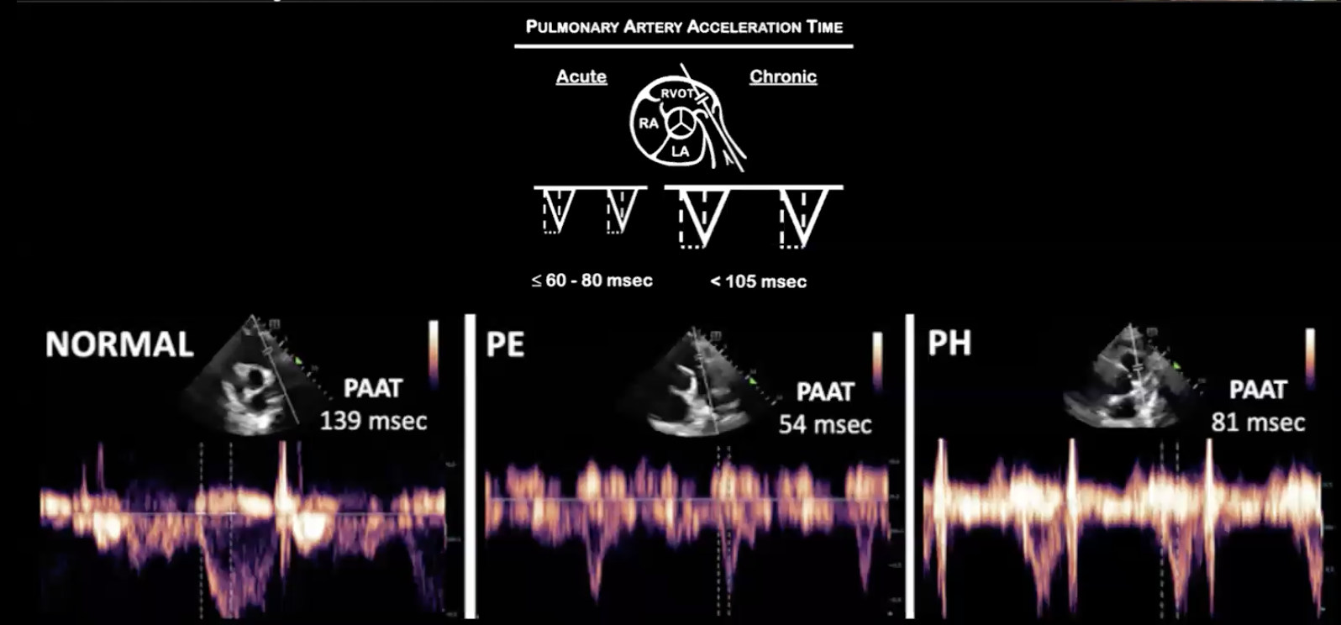
Notes:
PAT in normal vs PE vs PHT

Slide 41
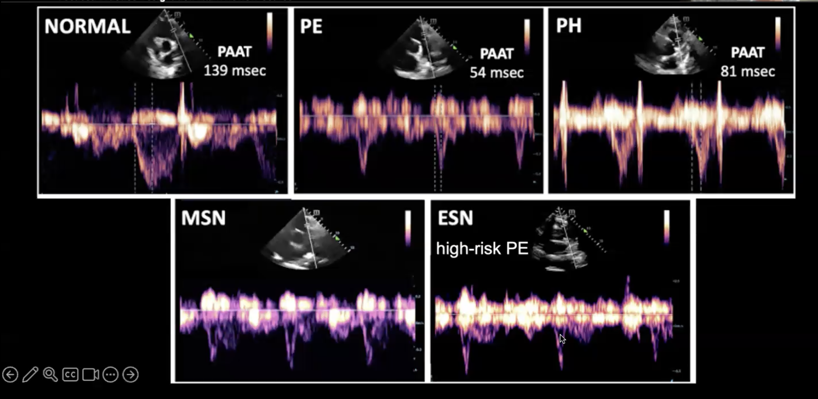
Summary of PAT in Different Diseases
Notes:
Normal has a nice large dome and longer time to acceleration because pulm artery nice and compliant
PE tends to be less than 60 and with spike (i.e. faster acceleration time due to higher pressure from PE)
pulmHTN is spike but chronic so still longer than 60
Mid-systolic notching can be seen in PE or pulm HTN
EARLY systolic notching – less travel time to for your waves to hit your wall (of clot) so higher risk PE

Slide 42
Pathology

Slide 43
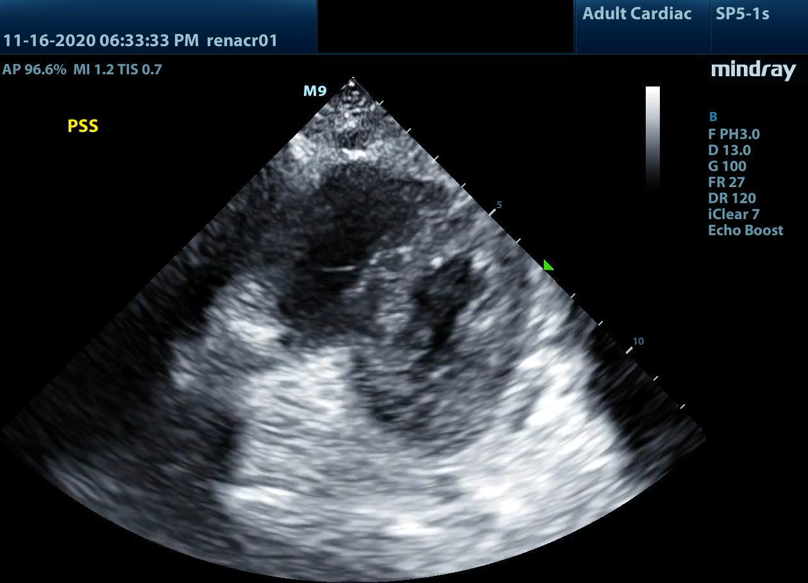
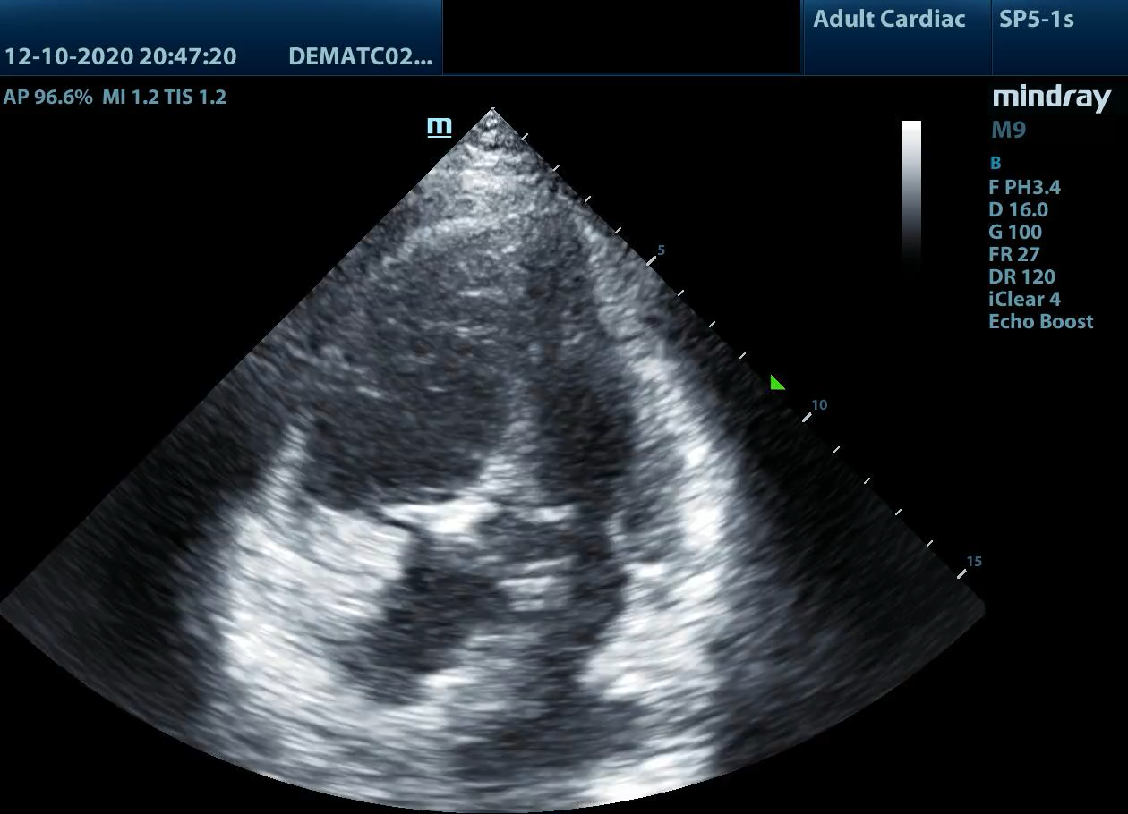
Pulmonary Embolism
McConnell’s Sign no longer considered pathognomonic for PE
  Also see in pHTN, ARDS, RV MI
  But still consider in clinically appropriate cases
  Lack of echo findings =/= no PE
Can use TAPSE, 60/60 Sign, EI
Notes:
McConnell’s Sign- hypokinetic right free wall with normal contraction of apex (appears almost hyperkinetic but it’s just moving normally because supplied by the LAD). Also note the septal bowing!
Acute Right MI may have a McConnell’s sign!
“Casazza F, Bongarzoni A, Capozi A, et al. Regional right ventricular dysfunction in acute pulmonary embolism and right ventricular infarction. Eur J. Echocardiography. 2005 Jan;6(1):11-4.
”
Excerpt From
Introduction to Bedside Ultrasound: Volume 2
Mike Mallin & Matthew Dawson

Slide 44
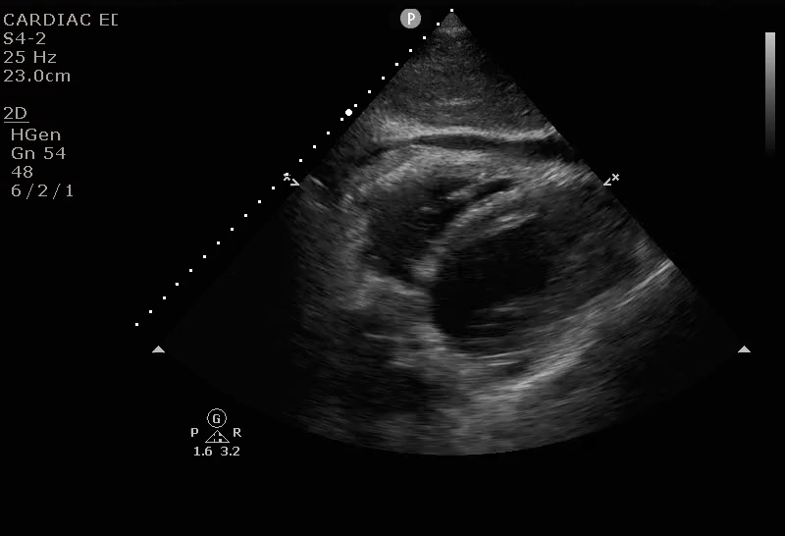
Tamponade
Once intrapericardial pressures are greater than the RA or RV pressures, cardiac filling and output decreases
Use echo to detect early tamponade
  RV Diastolic Collapse (Specific but only 60% Sensitive)
  RA Systolic Collapse (94% Sensitive)
    Best seen on A4C
  Plethoric IVC
Notes:
It is still a clinical diagnosis but we can look for early signs
Subxiphoid with RV systolic collapse

Slide 45
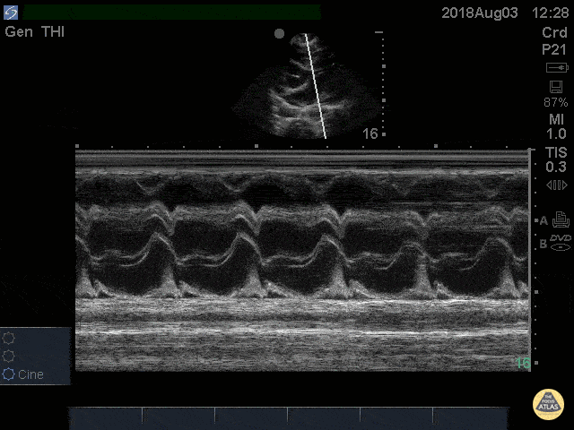
Using M-Mode for Tamponade
Notes:
E wave- early diastole (when the RV collapses), A wave = atrial kick
From POCUS ATLAS: Cardiac Tamponade RV Diastolic Collapse M-mode
41 yo M with history of stage 4 lung cancer presents with AMS and dyspnea, normotensive and tachycardic to 140s.
Parasternal long view showed moderate pericardial effusion with RV collapse. With M mode we are able to see the RV wall collapse (top line) corresponds with the mitral valve opening i.e. it occurs during diastole. Even though the patient was normotensive he was taken to the OR for a pericardial window within the hour given this evidence of echocardiographic tamponade.
Nathan Kabariti MS4, Dr. Charles Murchison, Dr. John Riggins, Dr. Donald Doukas - Kings County Emergency Medicine

Slide 46
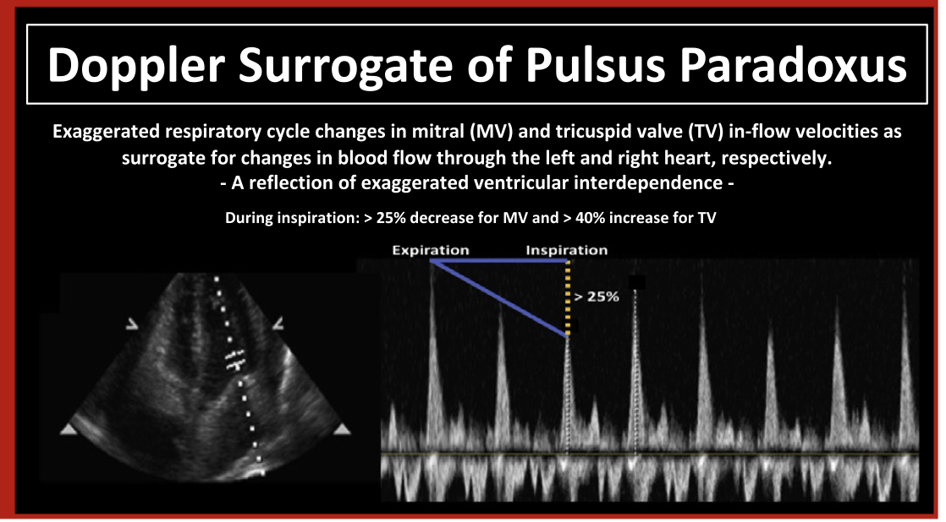
Pulsus Paradoxus
Sensitivity of 82% in Tamponade
Notes:
https://emcrit.org/wp-content/uploads/2020/08/Is-it-tamponad-Alerhand.pdf
Ventricular Interdependence is the basis for pulsus paradoxus which is seen as a palpable diminution of the radial pulse or drop in systolic bp of more than 10mmHg with inspiration.-Chiem EUS board book. During diastole- Breathe in and the RV collapses- blood has no where to go but the RV is getting filled (diastole) so it pushes on the intraventricular septum making it harder for the LV to fill and causing a decrease in cardiac output. The reverse happens during expiration.
Place the Pulse Wave Doppler Gait over the MV when in A4C
As we breathe in, intrathoracic pressure becomes negative as the diaphragm drops/lungs expand. Pulmonary artery pressure decreases and so more blood can flow across the valves. We have increased preload and increased filling. As we breathe out, the left side fills and the pressure increase which is approximately the same as the right side. This is normal. There should be no more than 15-25% variation for the mitral and tricuspid flows respectively.
In the case of tamponade, the intrapericardial pressure is greater than the pressure in the heart, causing RV diastolic or RA systolic collapse. As such, the intraventricular septum bows toward the LV due to pressure gradients (the RV and LV pressures are equalized when normally RV pressure is less). This causes the flow to decrease and you will see a drop of >25% across the mitral valve when comparing expiration to inspiration in someone with tamponade (or 40% across tricuspid)
From Alerhand’s Paper:
Pulsus paradoxus is the exaggeration of the normal respiratory variation in systolic blood pressure (SBP) that can occur with tamponade. During inspiration (negative intrathoracic pressure), air is pulled into the lungs. There is a drop in pulmonary vascular resistance, and blood flow through the right side of the heart (across the TV) increases. The two ventricles, and now the effusion as well, compete for space within the pericardial sac. The increased intrapericardial pressure from the effusion causes the RV and LV end-diastolic pressures to equalize. As a result, with inspiration, the intraventricular septum indents further toward the LV (versus without an effusion) in an exaggeration of ventricular interdependence. Less blood thereby flows through the left side of the heart (across the MV) and leads to a drop in LV stroke volume. This manifests as the abnormally large decrease in SBP > 20 mmHg seen with pulsus paradoxus.”

Slide 47
Extra Views

Slide 48
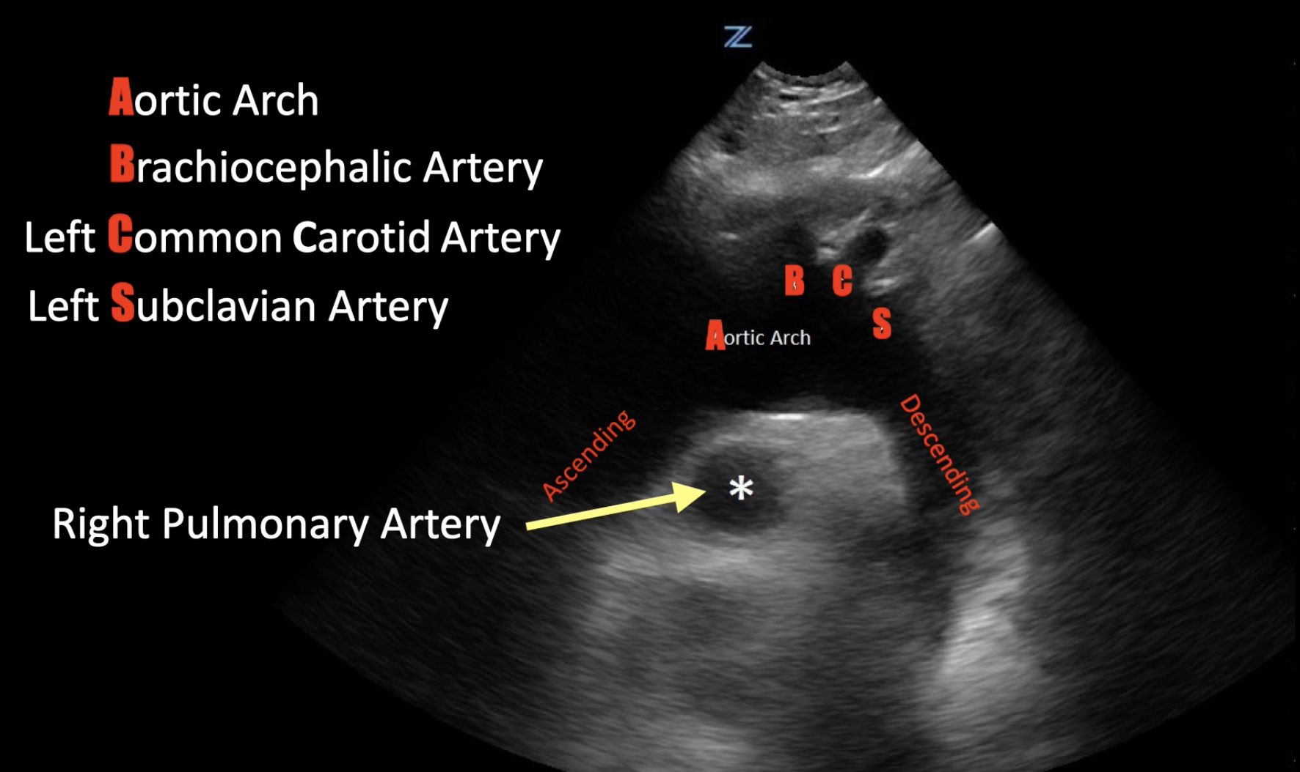
Suprasternal Notch
Good for visualizing the aortic arch
Notes:
https://onlinelibrary.wiley.com/doi/10.1111/echo.14587
Image from Penny Lema AEMUS lecture
https://umem.org/educational_pearls/2359/

Slide 49
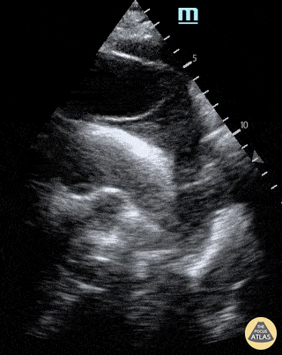
Suprasternal Notch: Dissection

Slide 50
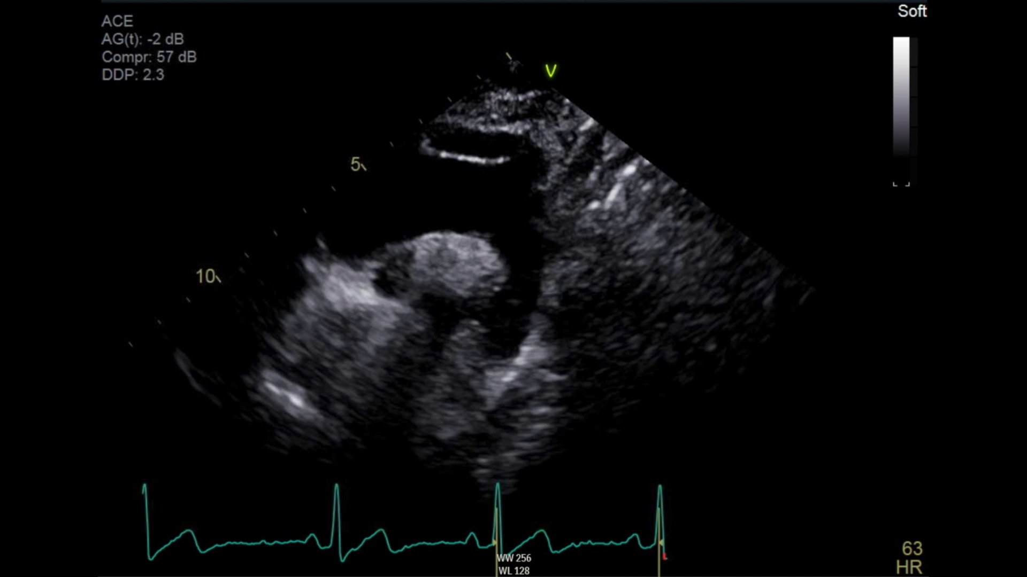
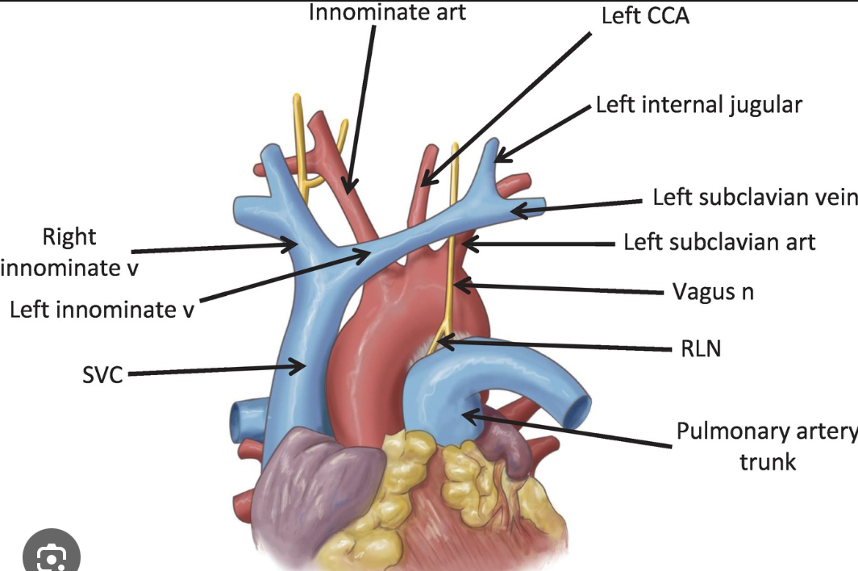
Fake Out: Left Brachiocephalic Vein
Notes:
https://onlinelibrary.wiley.com/doi/10.1111/echo.14587

Slide 51
Apical 2 Chamber
Notes:
The A2C and A3C views allow evaluation of the anterior and inferior LV walls.

Slide 52
Apical 3 Chamber
AKA Apical Long Axis

Slide 53
References
https://www.pocus101.com/measuring-cardiac-output-with-echocardiography-made-easy/#:~:text=The%20LVOT%20VTI%20will%20output,average%20LVOT%20diameter%20is%202cm.
https://www.pocus101.com/the-d-sign-right-heart-strain-from-pressure-vs-volume-overload/
PASP by The Echo Lady https://www.youtube.com/watch?v=zlLV7gk1RZ8
https://emcrit.org/wp-content/uploads/2020/08/Is-it-tamponad-Alerhand.pdf

