Slide 1

Publication Bias
Mathilda Alsen, MPH
Christina Gillezeau, MPH
Emanuela Taioli, MD, PhD

Slide 2
Review
What is one of the biggest drawbacks to doing a meta-analysis?
You are limited to the data that has been published already
Why is this a problem?
- Investigators are more likely to submit papers for publication that report an association over papers reporting no association.
- Similarly, journals are more often willing to accept and publish studies that report an association over papers that report no association
- We cannot know what unpublished studies would have said
What can we do?
Assess our results for publication bias

Slide 3
Publication bias
What is publication bias?
How do we assess it?
How can we avoid it?
How can we deal with it?

Slide 4
Publication Bias
What is publication bias?
- Bias that occurs when results of published studies are systematically different from results of unpublished studies.
- The term dissemination bias is sometimes also used and more all encompassing and include outcome-reporting bias, time lag bias, gray literature bias, citation bias, language bias, full-publication bias , and media-attention bias.

Slide 5
How Can We Assess for Publication Bias?
Statistical Methods
- Rarely used
- Selection models
- Determines which results are published based on the assumption that the study’s p-value affects its probability of publication
- Requires a large number of P-values to avoid strong assumptions about nature of selection mechanism
- Trim and fill
- Duval and Tweedie proposed omitting smaller studies until funnel plot becomes symmetrical
Visual assessment through funnel plots

Slide 6
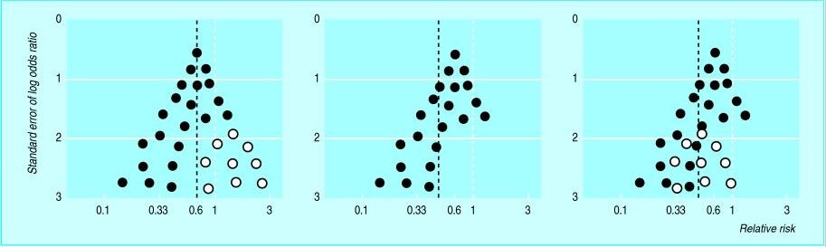
What is a funnel plot?
A scatter plot of the effect estimates from individual studies plotted against a measure of the study’s size or precision
Generally recommended to use standard error of the effect estimate although total sample size was traditionally used
The precision of the estimated effect will increase as the size of the study increases, so there will be more widely scattered small studies a the bottom of the plot and fewer tightly grouped large studies at the top
Ratio measures (eg. odds/risk ratios) should be plotted on a logarithmic scale

Slide 7
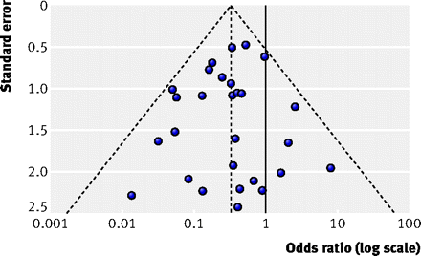
Symmetrical funnel plot
The outer dashed lines indicate the triangular region within which 95% of studies are expected to lie in the absence of both biases and heterogeneity

Slide 8
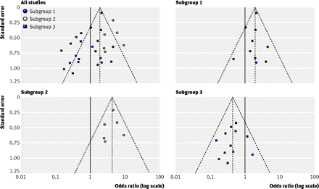
Asymmetrical Funnel Plot

Slide 9
Measures of Funnel Plot Asymmetry
A rank correlation test
This method is based on association between the size of effect estimates and their variance. If publication bias is present, a positive correlation between effect size and variance emerges because the variance of the estimates from smaller studies will be large.

Slide 10
How Can We Avoid Publication Bias?
Look for unpublished literature from reliable sources
  - PhD theses
  - Abstracts and posters
  - Clinical trial registration can be a source to point toward researchers who may be willing to share a summary estimate of their results even if they have not published
Journals can help by changing their publication policies
  - Publish high quality studies even if their results are not novel or exciting
  - Publish protocols
  - Publish full data-sets

Slide 11
How To Deal With Publication Bias
If there is a publication bias, and all studies have positive results. You will find the result more positive than it should be, bias away from null.
Small studies tend to have more publication bias
Limit studies to a certain size. Exclude small studies
If we can see that certain types of studies are more likely to sway our results, providing stratified analysis may help to adjust for publication bias

Slide 12
Stratification
What is stratification?
  - Analysis of subsets of your data separately
Why stratify?
  - Like with regular statistical analysis, you can stratify your results to try to adjust for systematic biases
What types of variables should you stratify on?
  - Variables within the study that might affect the outcome
    Histology, gender, age, treatment, if possible
    You must have a sufficient number of results reported by those variables to be able to stratify
  - You can also stratify by study characteristics
    Study population location
      - For example mesothelioma studies where different countries have different types of asbestos exposure
    Study data collection timing
      - For example before and after a major change in standard of care treatment

Slide 13
Thank you!
Questions?
Mathilda.alsen@mountsinai.org

