Slide 1
8. Meta-analysis Statistical Analysis
Emanuela Taioli, MD, PhD

Slide 2
SOME GENERAL CONCEPTS
The main outcome of the analysis is the overall magnitude of the effect
It's not a simple average of the magnitude in all the studies.
Meta-analysis gives more weight to studies with more precise estimates.
  The weighting factor is 1/(standard error)²

Slide 3
Main magnitude of effects
Descriptive
Mean
Prevalence
Analytical
Additive
Mean difference
Standardized mean difference
Risk, rate or hazard difference
Correlation coefficient
Multiplicative
Odds ratio, Risk, Rate or Hazard Ratio

Slide 4
Statistical concepts
We can combine effects from different studies only when they are expressed in the same units (remember table 1….).
Meta-analysis uses the magnitude of the effect and its precision from each study to produce a weighted mean.
  The weighting factor is 1/(standard error)²

Slide 5
Statistical concepts
Most common approach to Quantitative meta –analysis:
Weighted-sum (the weight given to each study is chosen to be the inverse of the variance of the effect estimate: 1/standard error²).
  Larger studies smaller standard errors more weight

Slide 6
Forest plot
the graphical display of results from individual studies on a common scale is a “Forest plot”.
In the forest plot each study is represented by a black square and a horizontal line (95%CI).The area of the black square reflects the weight of the study in the meta-analysis.
A logarithmic scale is used for plotting the Relative Risk.

Slide 7
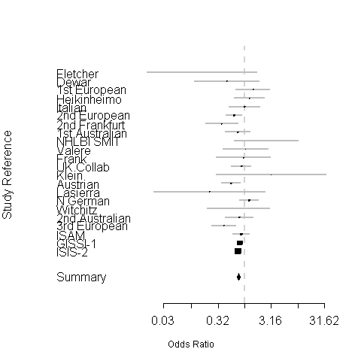
Forest Plot
The dotted vertical line is risk 1.0 (No risk)
The Risk Estimate of each study is lined up, with 95% CI
This diamond is the summary estimate
The two ends of the diamond are 95% CI
The size of each black square box indicates weight of the study

Slide 8
Fixed effect model
In this model, the assumption is that all effect estimates are measuring the same underlying intervention effect, which is referred to variously as a ‘fixed-effect’ assumption, a ‘common-effect’ assumption or an ‘equal-effects’ assumption
All of the observed difference between the studies is due to chance
Each study is a stratum
Random effect model
The “random effect” model assumes a different underlying effect for each study; the different studies are estimating different, yet related, intervention effects
This model leads to relatively more weight being given to smaller studies and to wider confidence intervals than the fixed effects models.
The use of this model has been advocated if there is heterogeneity between study results

Slide 9
Random versus fixed effect models
Neither fixed nor random effect analysis can be considered ideal.
Random effect models has been criticized on grounds that unrealistic distributional assumption have to be made. (very conservative)
Random effect models are consistent with the specific aim of generalization.
Rule of thumb: when there is heterogeneity, use random effect

Slide 10
Source of heterogeneity
Results of studies of similar interventions usually differ to some degree
Differences may be due to:
- inadequate sample size
- different study design
- different treatment protocols
- different patient follow-up
- different statistical analysis
- different reporting
- different patient response

Slide 11
Test of Homogeneity
This tests the hypothesis that observed scatter of study results is consistent with all of them estimating the same underlying effect
Cochran’s Q statistic – distributed like a chi-square (DF: k-1 n of studies)
I² - describes the percentage of variation across studies that is due to heterogeneity rather than chance

Slide 12
Dealing with statistical heterogeneity
The studies must be examined closely to see if the reason for their wide variation is obvious. If it’s found, the analysis can be stratified by that factor.
Subgroup analysis
Sensitivity analysis / Exclusion of study
Choose another scale
Random effect model
Meta-regression
Credibility limits

Slide 13
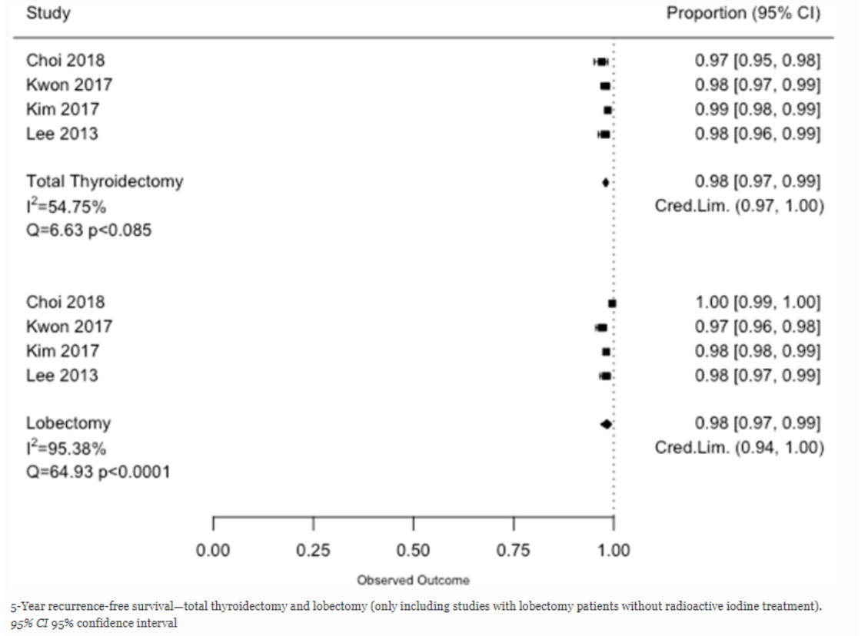
EXAMPLE OF STATISTICAL HETEROGENEITY

Slide 14
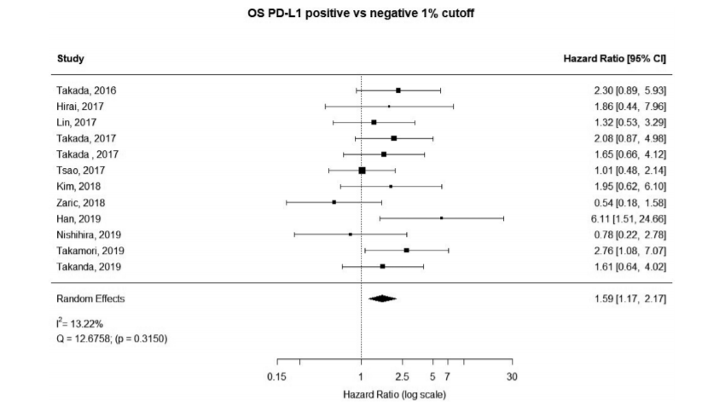
Heterogeneity

Slide 15
Bias In Meta-analysis
English language bias
Database bias
Publication bias
Bias in reporting of data
Citation bias/Multiple publication bias
Sample size

Slide 16
Publication Bias
The results of a meta-analysis may be biased if the included studies are a biased sample of studies in general.
The classic form of this problem is publication bias, a tendency of journals to accept preferentially papers reporting an association over papers reporting no association

Slide 17
HOW TO DEAL WITH PUBLICATION BIAS
If such a bias is operating, a meta-analysis based on only published reports will yield results biased away from the null.
Because small studies tend to display more publication bias, some authors attempt to avoid or minimize the problem by excluding studies below a certain size.

Slide 18
Funnel Plots
Some meta-analyses present the effect magnitude of all the studies as a funnel plot, to address the issue of publication bias.
A plot of 1/(standard error) vs effect magnitude has an inverted funnel shape
Asymmetry in the plot can indicate non-significant studies that weren’t published.

Slide 19
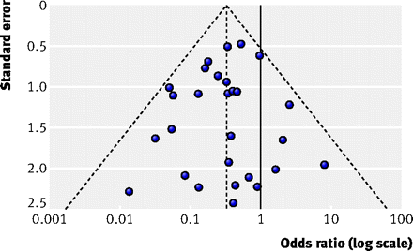
Symmetrical funnel plot
The outer dashed lines indicate the triangular region within which 95% of studies are expected to lie in the absence of both biases and heterogeneity

Slide 20
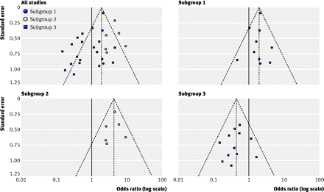
Asymmetrical Funnel Plot

Slide 21
Measures of Funnel Plot Asymmetry
A rank correlation test
This method is based on association between the size of effect estimates and their variance. If publication bias is present, a positive correlation between effect size and variance emerges because the variance of the estimates from smaller studies will be large.

Slide 22
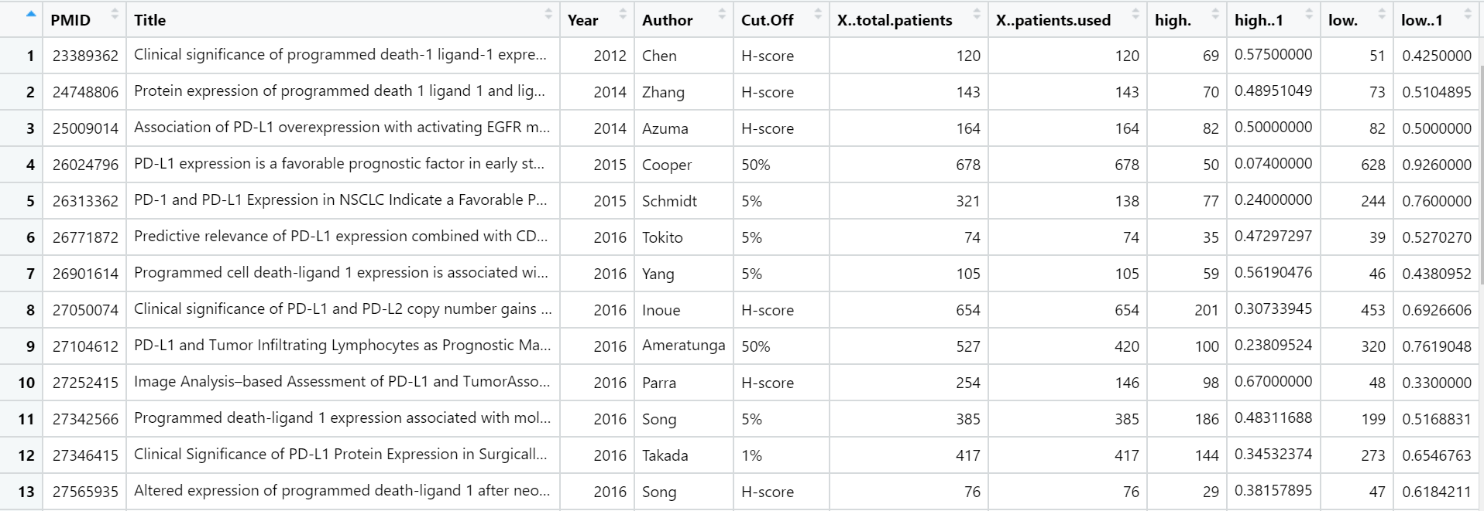
Read in code

