Slide 1

Quality Assessment
Mathilda Alsen, MPH
Christina Gillezeau, MPH

Slide 2
Why Do a Quality Assessment?
An important step to evaluate the quality of studies in the meta-analysis
Distinguish between good and poor quality studies
Not all studies are of the same quality
But judgment of study quality can be subjective
There are several standardized tools that can help provide a clear and objective way to assess study quality
By utilizing a quality assessment tool, you can do a subgroup analysis or adjust for study quality during meta-analysis
The NIH provides a list of resources

Slide 3
Types of Tools for Quality Assessments
Checklists/Scales
Simple yes/no to whether specific attributes are present in the study
Components of quality are scored and combined to give a summary score
Domain-based evaluation
Critical assessments made for assessing risk of bias
Cochrane Collaborative

Slide 4
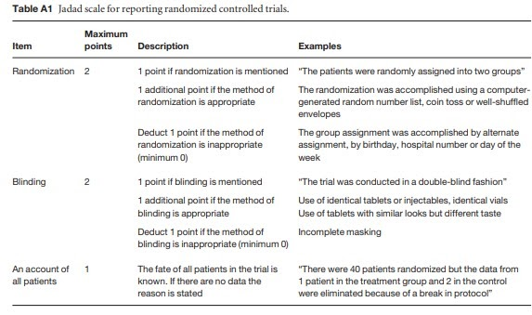
Checklists and Scales
Many types of checklists available
A 1995 study reviewed available scales
- 34 scales and checklists found range of 3-57 questions
- Can take 10-45 minutes per study
Common Examples:
- AMSTAR
- JADAD SCALE for Reporting Randomized
Control Trials
- Newcastle-Ottawa Scale (NOS) for Assessing
the Quality of Nonrandomized Studies
Other examples:
- STROBE
- CASP
Sometimes particular diseases might have
published checklists from other studies

Slide 5
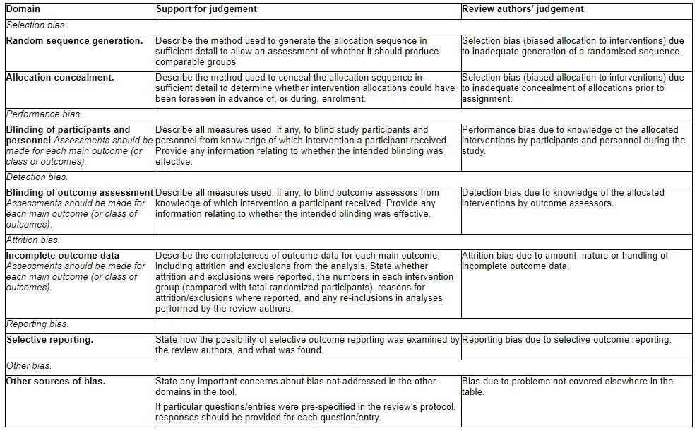
The Cochrane Collaboration
Asks for researcher to evaluate the likelihood of bias in the study
Also describe the specific method used in the study

Slide 6
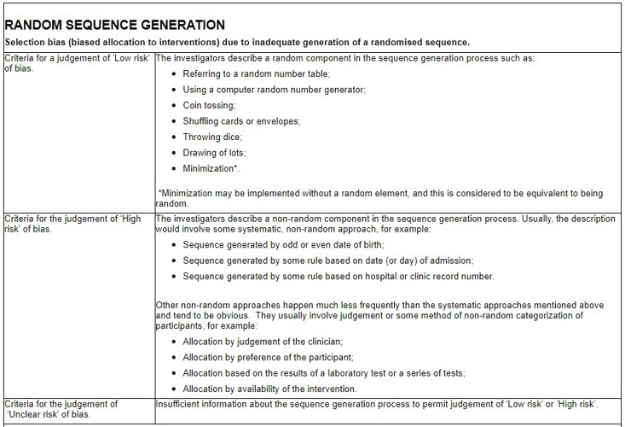
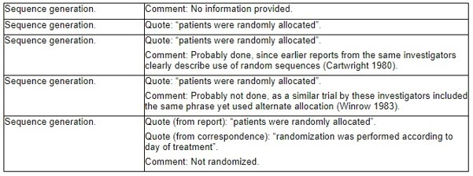
The Cochrane Collaboration

Slide 7
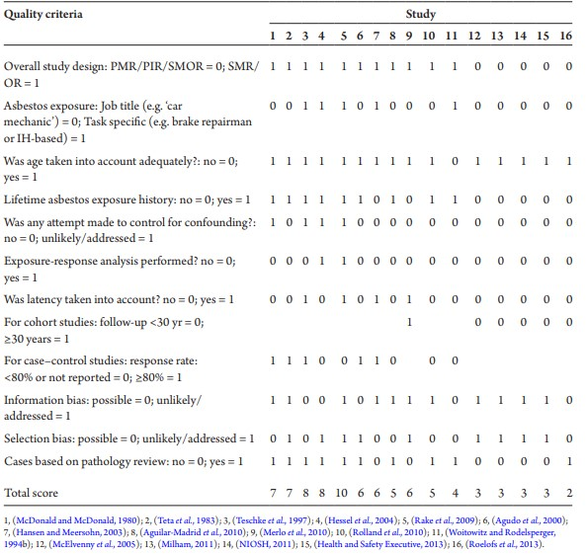
Disease Specific Checklist Example

Slide 8
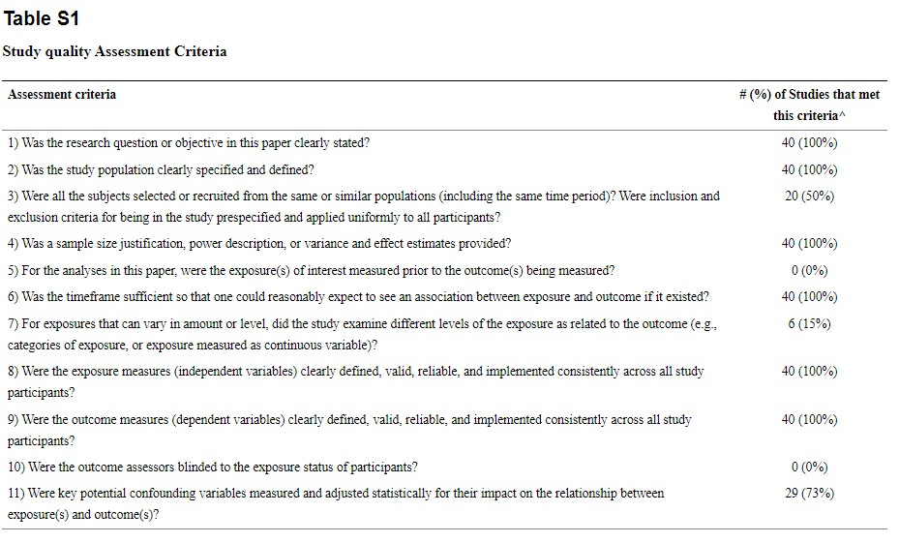
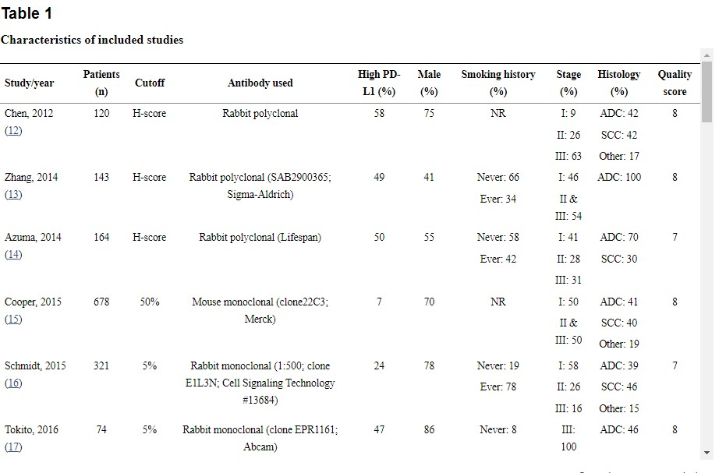
Reporting Article Quality in Manuscripts

Slide 9
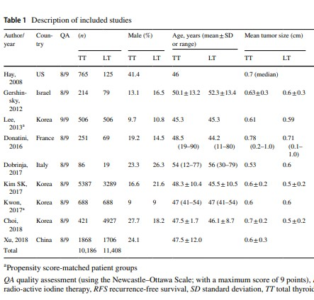
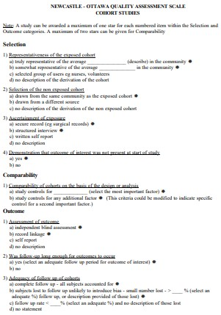
Reporting Article Quality in Manuscripts
Newcastle-Ottawa Scale (NOS) for Assessing the Quality of Nonrandomized Studies

Slide 10
Best Practices
Two researchers will need to review each study and rate it independently
After two researchers have reviewed, they can either discuss discrepancies or have a third reviewer come in and reconcile any differences
Can either be done by overall score or by question
Allows for stratification by quality during the analysis phase

Slide 11
Thank you!
Questions? mathilda.alsen@mountsinai.org

