Slide 1

5.Study Selection:
Workflow and Tools
Gloria Willson, MLIS, MPH
Director, Library Education & Research Services
Levy Library
gloria.willson@mssm.edu

Slide 2
A Typical First-Timer Workflow
Screen
Screen
  Search one database
  Search another database
  Struggle to effectively combine results and ultimately do a sloppy job
  Screen results from first database, manually tracking in Excel
  Screen results from 2nd database
  Inevitably end up screening some results twice
Search
Search
Struggle

Slide 3
Recommended Workflow
Create a de-duplicated library of results *before* you begin screening.
Generate All Search Results
Develop comprehensive search in one database. Translate and execute in additional databases. **Save your searches.**
Export Results
Export search results en masse from all databases , typically to a citation manager (e.g. EndNote).
Upload, Deduplicate and Screen
Upload results to Covidence; utilize its automatic de-duplication feature to generate a de-deuplicated library of citations to screen.

Slide 4
Covidence
With Covidence you can:
Combine and de-duplicate search results from multiple databases
Complete both rounds of study selection independently, meaning reviewer 1 is blinded to reviewer 2’s decisions and vice-versa
Decisions and conflicts are tracked automatically – no need to merge unwieldy spreadsheets.
Conflicts are automatically flagged for a 3rd reviewer to review
Tools for risk of bias assessment and data extraction are also available

Slide 5
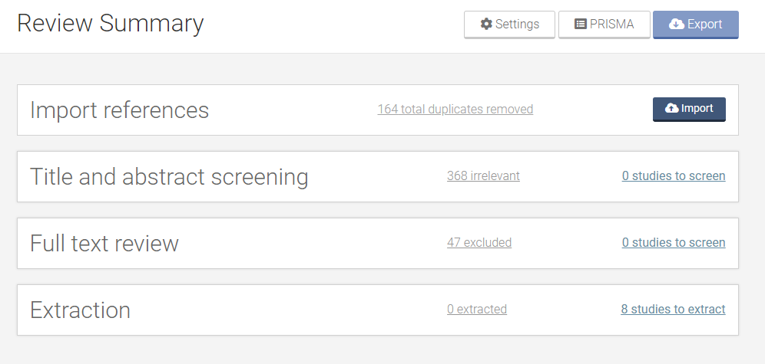
Covidence – Review Summary

Slide 6
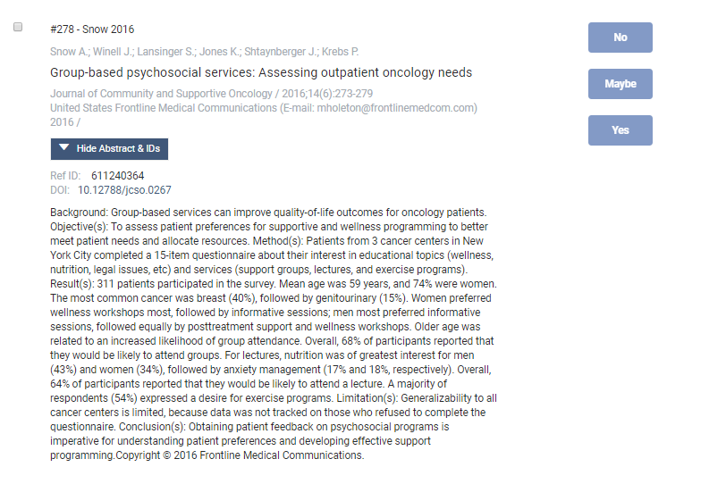
Covidence – Study Selection

Slide 7
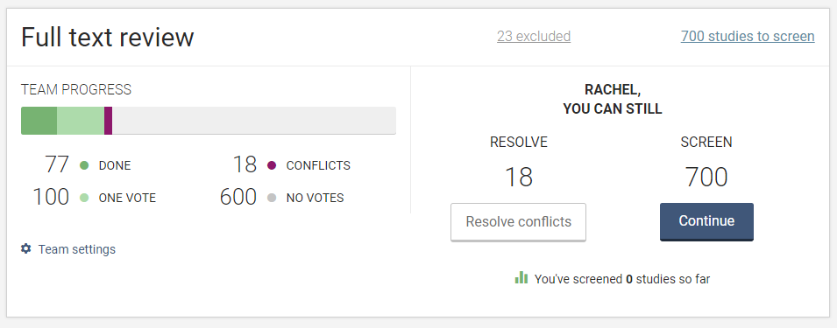
Covidence –Study Selection Tracking

Slide 8
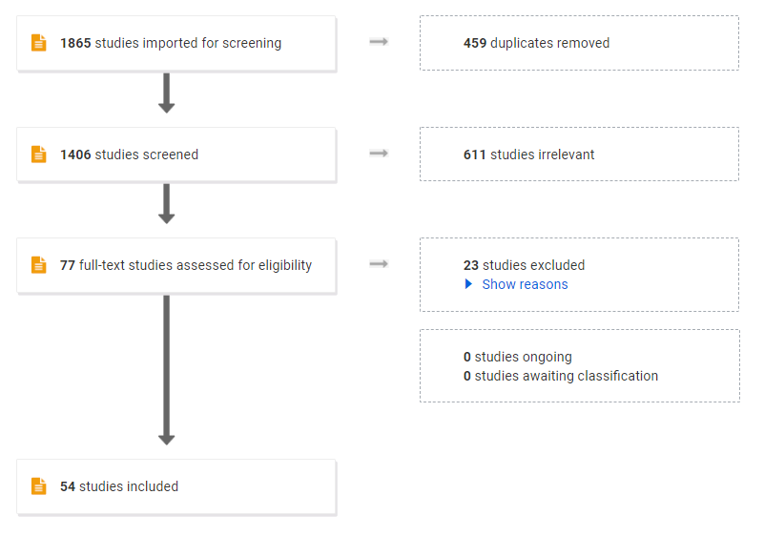
Covidence –Study Selection Tracking

Slide 9
Learn More About Covidence
Trainings - https://support.covidence.org/help/training
Covidence Academy - https://www.covidence.org/covidence-academy/
Covidence Blog – https://www.covidence.org/blog/page/2/
Covidence YouTube Channel - https://www.youtube.com/channel/UCgr_cyJlrKYBjxjyMe2z9mw
Covidence Knowledge Base - https://support.covidence.org/help

