Slide 1

Meta-analysis
Search results and article selection
Maaike van Gerwen, MD PhD
Assistant Professor
Department of Otolaryngology- Head and Neck Surgery
Institute for Translational Epidemiology

Slide 2
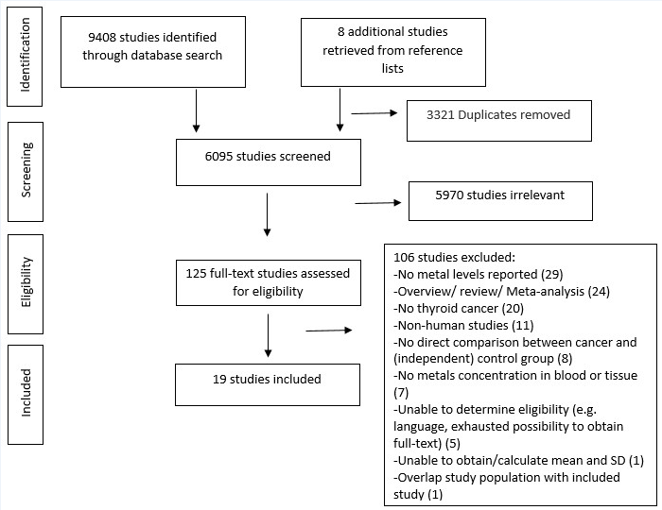
Results literature search
Research question: What is the association between of heavy metals and thyroid cancer?

Slide 3
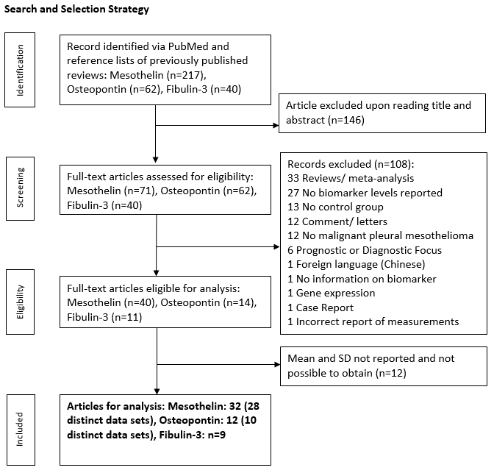
Research question: Are mesothelin, osteopontin and fibulin-3 potential biomarkers for the detection of mesothelioma by comparing biomarker levels in mesothelioma patients with biomarker levels in patients with other cancers, patients with lung disease or healthy individuals?

Slide 4
In- and exclusion criteria
Inclusion criteria
Published in English
At least one comparison group besides the mesothelioma patient group
Levels of biomarker reported in blood or pleural effusion
Exclusion criteria
Meta-analysis/ review
Impossible to calculate mean and standard deviation
Overlapping cohorts

Slide 5
Broad versus more detailed initial search
Research question: Are mesothelin, osteopontin and fibulin-3 potential biomarkers for the detection of mesothelioma by comparing biomarker levels in mesothelioma patients with biomarker levels in patients with other cancers, patients with lung disease or healthy individuals?
Research question: What is the association between of heavy metals and thyroid cancer?

Slide 6
Research question:
Is fibulin-3 a potential biomarker for the detection of mesothelioma by comparing biomarker levels in mesothelioma patients with biomarker levels in patients with other cancers, patients with lung disease or healthy individuals?

Slide 7
Literature search
Literature search yielded 35 articles using the following search terms:
(((fibulin-3) OR fibulin)) AND ((MPM) OR mesothelioma), restricted to English
+ 5 articles retrieved from meta-analysis and reviews
Total: 40 articles
Screening: Review of title and abstract

Slide 8
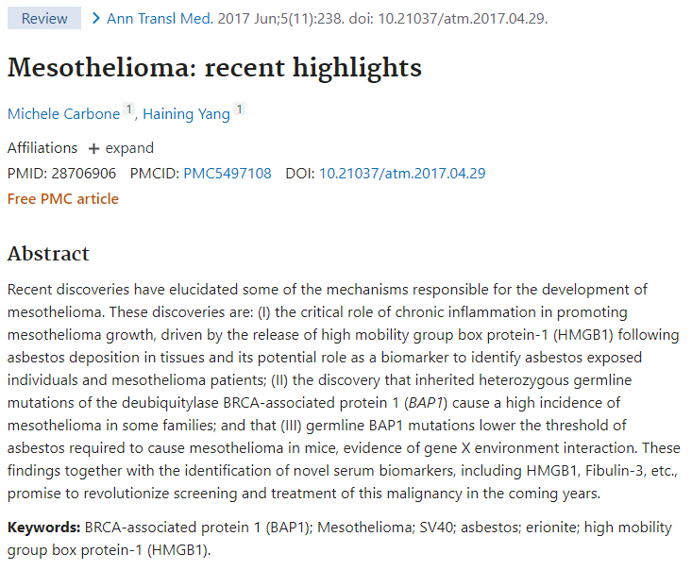
Examples of articles:
In- or excluded?

Slide 9
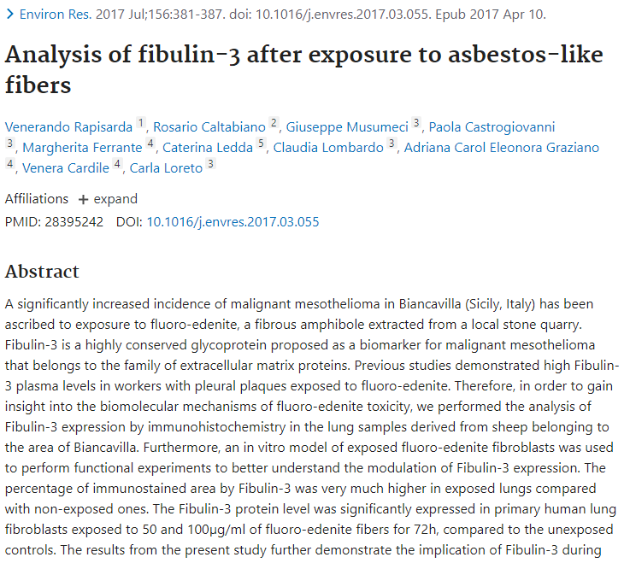
Examples of articles:
In- or excluded?

Slide 10
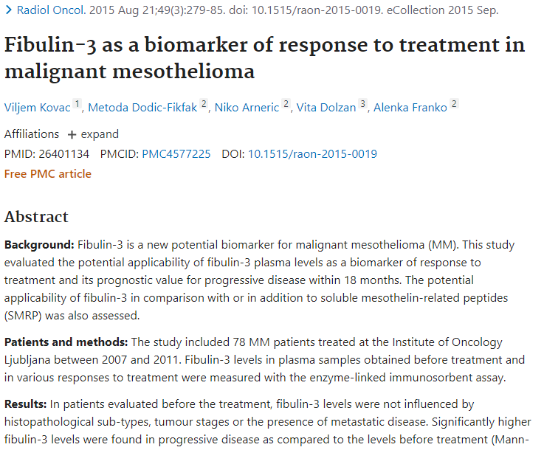
Examples of articles:
In- or excluded?

Slide 11
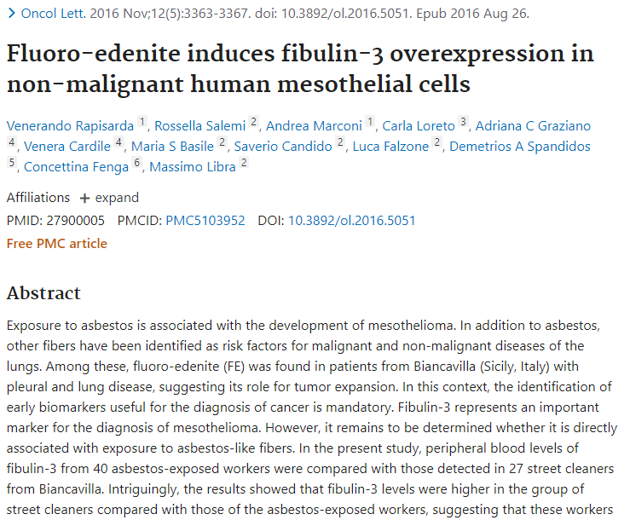
Examples of articles:
In- or excluded?

Slide 12
Eligibility
Screening yielded 11 out of 40 articles for full text review
Eligibility: Full text review

Slide 13
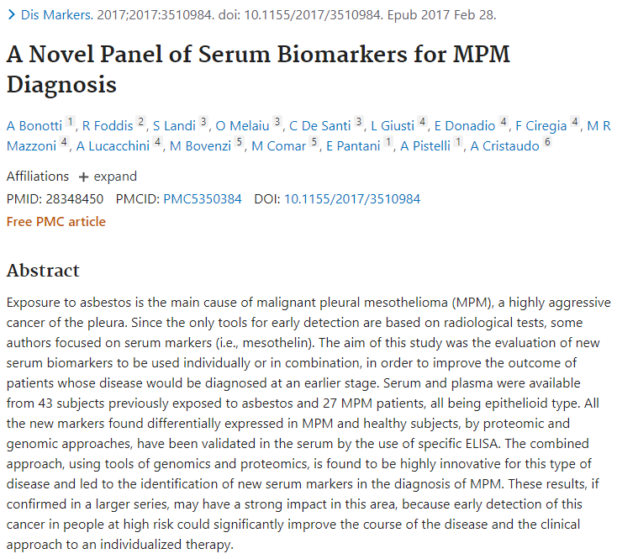
Examples of articles:
In- or excluded?

Slide 14
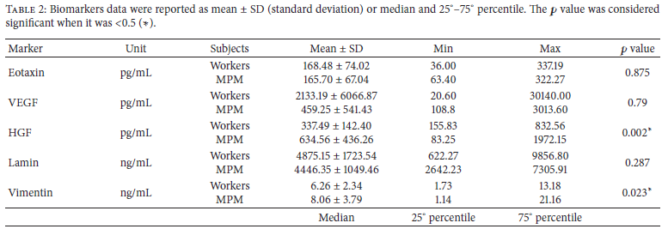
Mean and standard deviation not reported and impossible to obtain

Slide 15
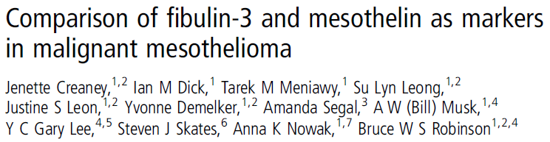

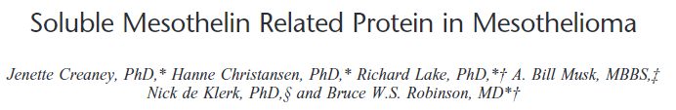
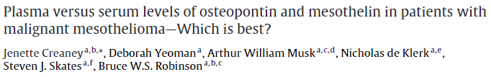
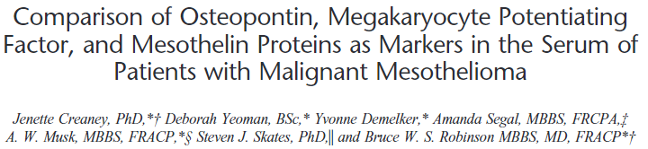
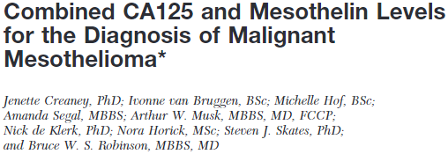

Slide 16
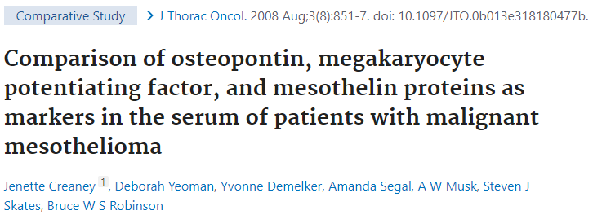
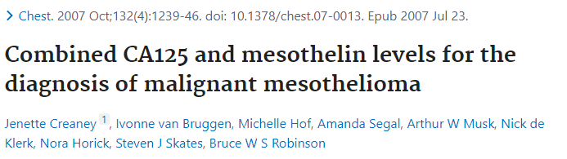

Slide 17
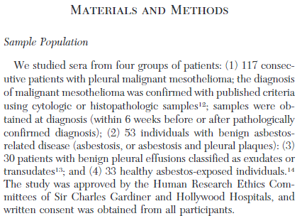
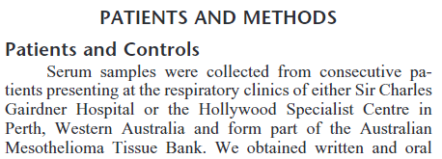
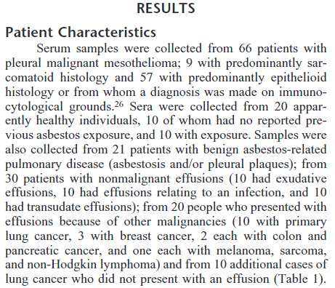
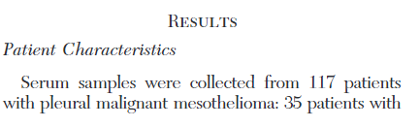
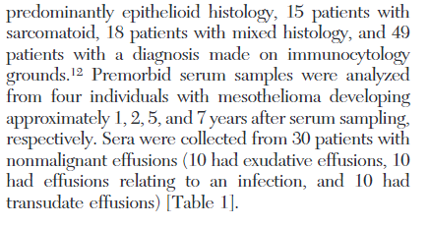
Creaney et al. Chest- 2007
Creaney et al. J Thor Oncol- 2008

