Slide 1

3. How to Perform a Systematic Literature Search
Gloria Willson, MLIS, MPH
Director, Library Education & Research Services
Levy Library
gloria.willson@mssm.edu

Slide 2
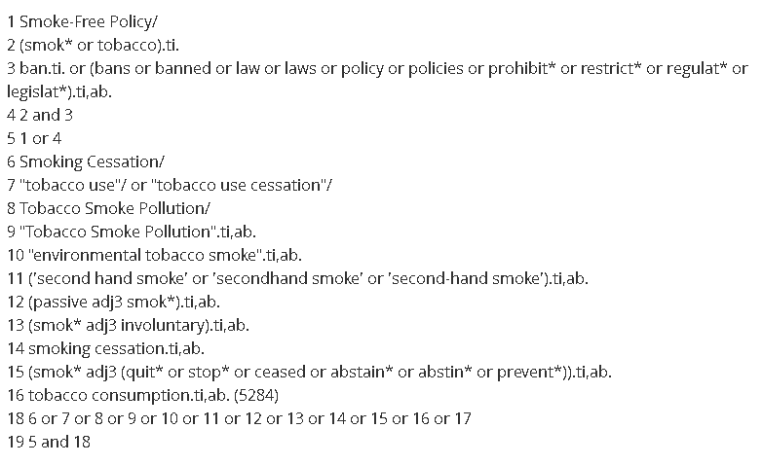
Searching Syntax
Notes:
What we are looking at is the search strategy for a Cochrane Collaboration systematic review and meta-analysis entitled, “Legislative smoking bans for reducing harms from secondhand smoke exposure, smoking prevalence and tobacco consumption.” The asterisks, slashes, dots and numbers you see are all part of the language of advanced search syntax. And it really is like its own language, the language of searchese. My objectives for the next 30 minutes are to help you understand how systematic review searches are different than normal lit searches and to begin understand the search process of designing a comprehensive search.

Slide 3
How Systematic Review Searches are Different
A systematic search query is comprehensive
  Comprehensiveness is defined as the sensitivity of the search query in retrieving a large enough number of results to ensure that as many of the relevant studies are included in the review as possible.
  "Sensitivity" in this context is defined as the proportion of relevant studies retrieved, in contrast with "precision," which is the proportion of retrieved studies that are relevant. According to the Cochrane Handbook for Systematic Reviews of Interventions, searches for reviews “should seek to maximize sensitivity whilst striving for reasonable precision.”
The systematic search query is reproducible
  Reproducibility or replicability ensures that a documented work can be verified, repeated, and reproduced
  Uses Boolean logic (AND, OR, NOT and/or specific database syntax)
Notes:
In a regular lit search, you need to be selective. You use your subject knowledge and judgement to find the most relevant and high quality papers on your topic. In a systematic review search, your job is to be comprehensive. You are purposefully casting a wide net that will allow you to discover ALL potentially relevant papers. To that end, the best practices are:

Slide 4
Systematic Searching Best Practices
Search multiple databases (3 or more)
Use an exhaustive list of index terms AND keywords
Identify all possible synonyms/relevant words
Date limit used only for a specific reason, not arbitrary
Assess quality of the comprehensive search query
  Peer Review of Electronic Search Strategies (PRESS) Guideline Checklist(assessment form filled by a reviewer); reviewer is acknowledged in manuscript
  Can use PRESS checklist for self-assessment
Notes:
In a regular lit search, you need to be selective. You use your subject knowledge and judgement to find the most relevant and high quality papers on your topic. In a systematic review search, your job is to be comprehensive. You are purposefully casting a wide net that will allow you to discover ALL potentially relevant papers. To that end, the best practices are:

Slide 5



Why Search Multiple Databases?
Different databases contain different content:
Different databases offer different features:
  Search functionality (e.g. adjacency searching on Ovid platform – “breast adj3 cancer”)
  Search filters (e.g. Routes of Drug Administration filter in Embase)
  The ability to see which papers have cited others and otherwise analyze published material (Scopus, Web of Science)
PubMed
Scopus
Embase
Notes:
Some databases off specialized content, such as Cochrane CENTRAL, for finding controlled trials, PsycINFO for topics that involve psychology or mental health, and MedEd Portal and ERIC for topics related to education.

Slide 6
The Search Process
Select sources: Decide which databases you will search
Identify “seed” articles: Starting with a basic keyword search, identify 5-7 highly relevant citations
Harvest search terms: Use these citations to begin to generate a list of keywords and index terms relevant to your topic (e.g. PubMed MeSH)
Complete your terms list: Look up the subject headings in each database – see what entry terms (synonyms) are listed in the entry Determine which of the terms are relevant and add to your term list
Build your “buckets”: Starting in one database, begin to build out your search one concept at a time
Translate your search: Modify the search you created in the first database appropriately in the other databases
Don’t forget to save your searches!!!!!!!!!!

Slide 7
Index Terms (controlled vocabulary)
Controlled vocabularies are standardized, organized sets of terms that databases use to describe content in a consistent manner. Many databases have their own, unique controlled vocabulary (see table below).
Database | Controlled Vocabulary Name | Tutorial
CINAHL | CINAHL Subject Headings | Using CINAHL/MeSH Subject Headings
EMBASE | Emtree | Searching in Embase
PsycInfo | Thesaurus | APA Thesaurus of Psychological Index Terms
Pubmed | MeSH | MeSH in MEDLINE/Pubmed: A Tutorial
Notes:
Adjacency – breast adj3 tumor could yield a result such as “support groups for breast, ovarian and cervical cancer patients”

Slide 8
Building Your Search:
The Bucket Method
Do support groups diminish the incidence of anxiety and depressions among breast cancer patients?
P: Breast cancer patients
I: Support group
C: No support group
O: Depression + anxiety (measured by specific scales)
Breast cancer OR breast tumor OR breast neoplasms
Support group OR self-help groups OR peer-led group
Depression or anxiety
AND
AND
Notes:
Bucket method example – but first, let’s make sure we understand our PICO question. As Dr. Taioli and Dr. van Gerwen explained, it’s impossible to do a good meta-analysis without a specific, appropriately scoped question and this is very much true for designing a good search as well.
The research question here is: Do support groups diminish the incidence of anxiety and depressions among breast cancer patients?
Harvest additional terms from preliminary search results…
https://www.ncbi.nlm.nih.gov/sites/myncbi/1HoVigKXK7okL/collections/56538888/public/

Slide 9
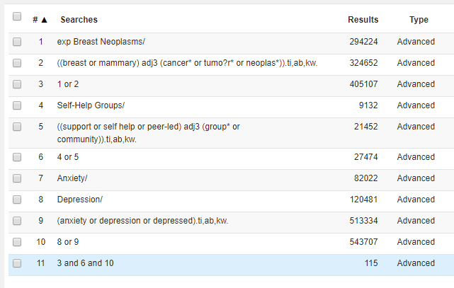
Systematic Search in Practice
Breast Neoplasms, Self-Help Groups, Depression, and Anxiety are MeSH (Medline Index Terms)
Notes:
Adjacency – breast adj3 tumor could yield a result such as “support groups for breast, ovarian and cervical cancer patients”

Slide 10
Library Resources and Tutorials
DEVELOPING SEARCH SKILLS
Levy Library Video Tutorials - https://www.youtube.com/@TheLevyLibrary/videos
PubMed Online Training - https://learn.nlm.nih.gov/documentation/training-packets/T0042010P/
  Using PubMed in Evidence-Based Practice Using PubMed in Evidence-Based Practice develop a clinical question using the PICO framework
  PubMed Essentials - On Demand (self paced, 60 mins.)
  10 short units that include videos, exercises and quizzes
Systematic Searches Tutorials|Harvey Cushing/John Hay Whitney Medical Library (Yale)
https://library.medicine.yale.edu/tutorials/subjects/systematic-searches
Article: A Systemic Approach to Seaching: An Efficient and Complete Method to Develop Literature Searches
For more about translating your search queries, there is this helpful guide from the Cornell University Libraries: A Guide to Evidence Synthesis: 6. Translate Search Strategies
Notes:
As I stated at the outset, my objectives were to help you understand how systematic review searches are different than normal lit searches and to begin to understand the search process. It’s certainly not my expectation that you would be able to independently create and execute a comprehensive search on your own after this short presentation. The good news is, we are here to help!

Slide 11
Library Resources and Tutorials
Evidence Based Medicine & Research Question Development
Levy Library Video Tutorials
Levy Library Evidence Based Medicine LibGuide
Forming Focused Questions with PICO | UNC Health Sciences Library
Systematic Review
Video: So You Want to Do a Systematic Review | Levy Library Youtube Channel
Cochrane Interactive Learning - provides over 15 hours of self-directed learning on conducting a complete systematic review process for both new and experienced review authors
Levy Library Systematic Review Service – Consult with a library expert
  Advisement, training, and/or co-authorship opportunities available
Notes:
As I stated at the outset, my objectives were to help you understand how systematic review searches are different than normal lit searches and to begin to understand the search process. It’s certainly not my expectation that you would be able to independently create and execute a comprehensive search on your own after this short presentation. The good news is, we are here to help!

