Slide 1

2. Meta-analysis
Research protocol
Maaike van Gerwen, MD PhD
Assistant Professor
Department of Otolaryngology- Head and Neck Surgery
Institute for Translational Epidemiology

Slide 2
Literature
Observations
Expert opinions
Research question
Research protocol
Clearly stated objective with pre-defined eligibility criteria

Slide 3
Research Protocol
Definition of eligibility criteria (e.g. study participants, choice of comparators or outcomes)
Systematic approach
Predefine methods and criteria to assess risk of bias in included studies
Key purposes: -Minimize bias in the results of the meta-analysis
-Keep the review process manageable

Slide 4
Research Protocol
Pre-specify criteria for including and excluding studies in the meta-analysis
Determine the elements of the research question
Population, Intervention, Comparator(s), Outcomes (PICO)
and how the intervention produces the expected outcomes to draft a research protocol
Decisions about in-/ exclusion should be documented and justified

Slide 5
Population
Sufficiently broad to include a diversity of studies
Sufficiently narrow to ensure aggregations of the studies’ results in the analysis
Define the disease or condition of interest (diagnostic criteria?)
Define population and setting of interest (age, sex, race, educational status, setting, presence of a particular condition, etc.)
Develop a strategy for dealing with partial eligibility (e.g. age groups)
Subgroup analysis?

Slide 6
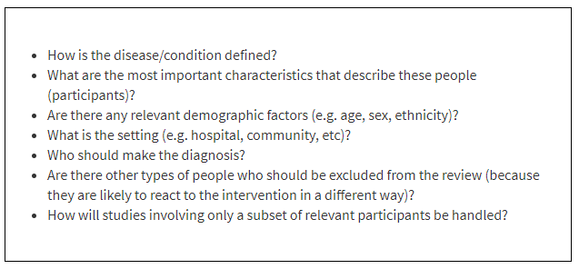
From: Cochrane Handbook, chapter 3

Slide 7
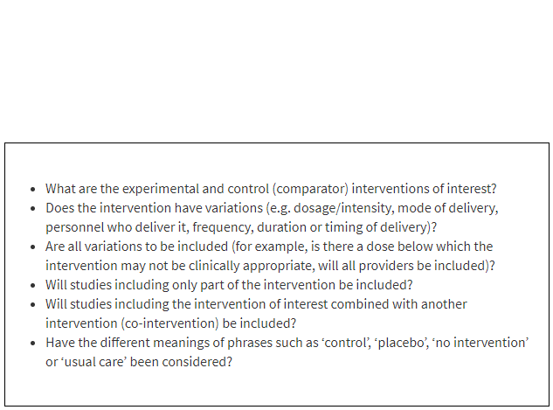
Intervention
What is the intervention of interest?
Are there any restrictions on interventions (e.g. other interventions at the same time, certain delivery method)
From: Cochrane Handbook, chapter 3

Slide 8
Comparison
What is the intervention compared with? (e.g. placebo, another drug/ treatment/ surgical intervention, standard of care, different intensity or dosage, etc.)
What to do if there are additional interventions? (e.g. supplementary treatments) Heterogeneity?

Slide 9
Outcome
Examples: survival, clinical events, level of biomarker, behavioral outcomes, symptoms, adverse events, economic outcomes
Should be a relevant outcome to assess using a meta-analysis

Slide 10
Other factors to consider….
  Which study designs to include? (e.g. experimental, observational, RCT’s etc.)
    Exclude no original studies (such as reviews, commentaries, opinions)
    Exclude large dataset analyses (possibility of overlapping patient populations)
  Publication status
    Different publication sources
    Unpublished/ partially published studies
    Avoid reporting bias (bias due to missing studies)

Slide 11
Other factors to consider….
  Language
    Including foreign language may be resource-intensive
  Certain time frame
    For instance, based on implementation of new treatment strategies, guidelines
  Conflict of interest
    Judgement of “notable concern about conflict of interest”
Be specific in your research protocol
Define before starting your literature search

Slide 12
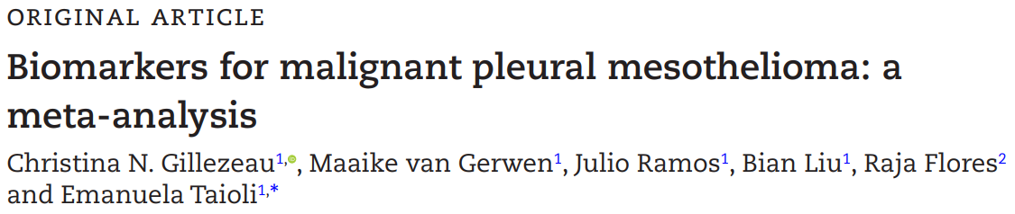
Example
Background information:
Mesothelioma, an aggressive cancer associated with asbestos exposure, has a median survival of < 2 years
Mesothelioma is typically diagnosed late with almost 60% having stage III or IV cancer
Detection of mesothelioma at earlier stage could potentially lead to better survival
Biomarkers: - Screening
- Early detection
Promising biomarker candidates for mesothelioma:
  Mesothelin
  Osteopontin
  Fibulin-3
Research question:
Easy to measure
High specificity and sensitivity

Slide 13
Now, can you formulate a research question?
Research question:
Is fibulin-3 a potential biomarker for the detection of mesothelioma by comparing biomarker levels in mesothelioma patients with biomarker levels in patients with other cancers, patients with lung disease or healthy individuals?

Slide 14
Define the research protocol, in- and exclusion criteria and search terms:
Population:
Intervention:
Patients with malignant pleural mesothelioma
Reported level of fibulin-3 in blood (serum or plasma) or pleural effusion

Slide 15
Define the research protocol, in- and exclusion criteria and search terms:
Comparison:
Outcome:
At least one comparison group:
Patients with other cancers
Patients with an other lung disease
Healthy individuals
Mean level of fibulin-3 per group with standard deviation

Slide 16
Other factors we considered:
Published in English
Excluded if meta-analysis or review
If studies contained overlapping cohorts, the study containing the largest number of subjects was used

Slide 17
Other factors we considered:
Excluded if impossible to calculate the mean and standard deviation based on the provided data
Ways used to obtain the information and to avoid exclusion:
  Contact authors
  Calculate mean from median and range
  For studies with graph, a digitizer tool can be used to estimate range

