Slide 1
1. Overview of meta-analysis
Emaunela Taioli, MD, PhD

Slide 2
Ways to combine evidence in epidemiology
  meta-analyses
  pooled analyses and consortia
  multicenter studies
  Each approach has strengths and limitations, no approach is perfect.

Slide 3
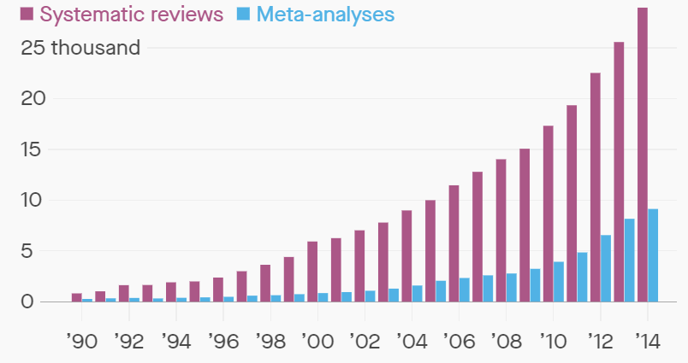
META-ANALYSIS IS VERY POPULAR

Slide 4
Why Meta-analysis Became So Popular
Nowadays epidemiology often deals with low prevalence exposures (asbestos) and with low strength associations (ETS)
Studies are expected to have low potency
We now find ourselves assessing interactions (G x E for example), which requires a lot of power
Heterogeneity of effects

Slide 5
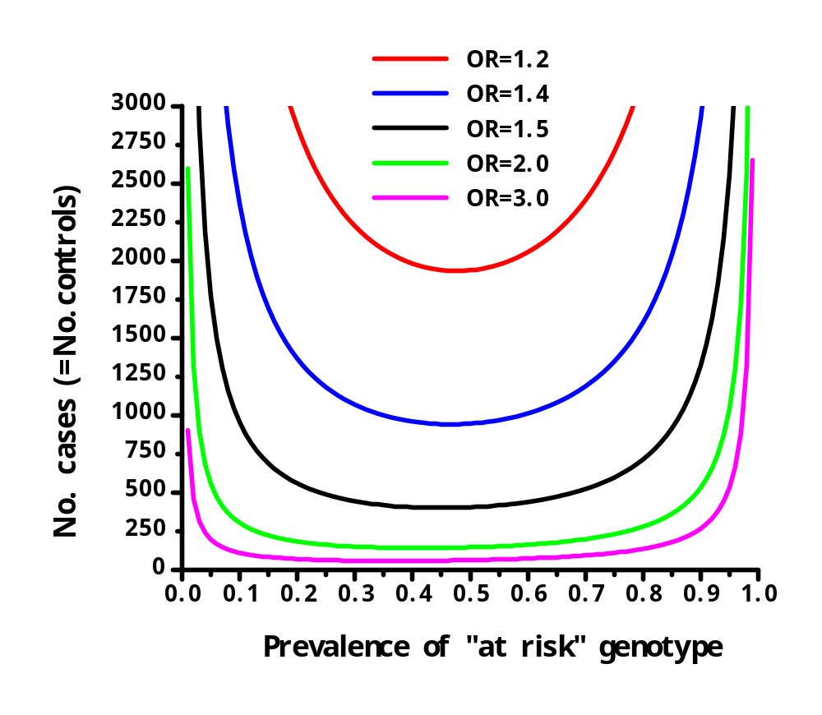
Sample size needs as a function of exposure prevalence and OR for main effects
Prevalence of exposure

Slide 6
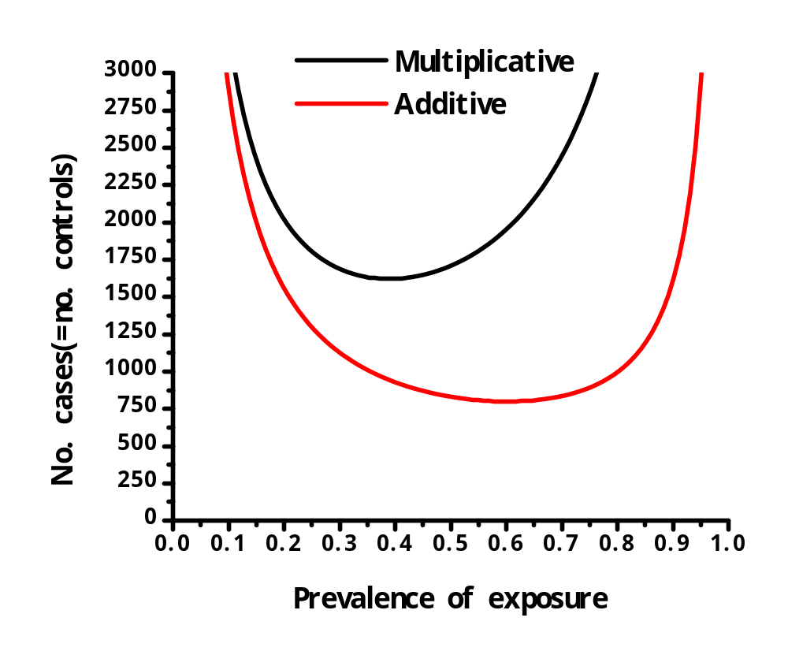
Sample size for 80% power to test for gene-environment interaction
Power = 80%
α-level = 5%
P(G) = 50%
(Marcus et al, 2000)

Slide 7
Meta-analysis
Quantitative approach for systematically combining results of previous research to arrive at conclusions
about the body of research.
(method for combining results from different studies to produce a more stable summary estimate based on large number of patients, identify patterns, sources of disagreement among the study results, or other interesting relationships)

Slide 8
Advantages And Strenghts
Study 1 200 patients
Study 2 37 patients
Study 3 187 patients
Study 4 234 patients
Study……….
Study n…….
COMBINE AND ANALYZE AS ONE SINGLE STUDY CONTAINING (200+37+187+ 234+ n)= 658 or more

Slide 9
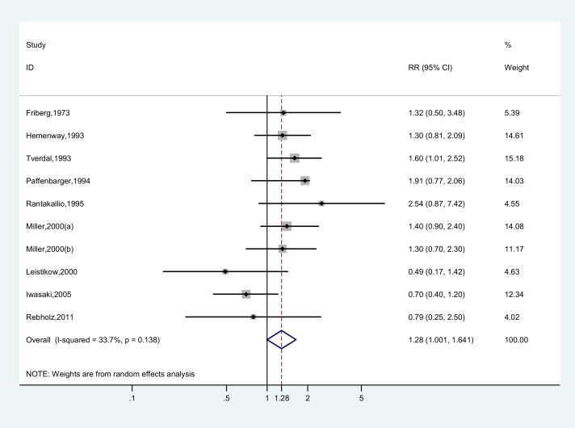
Limitations
If there is bias or confounding in the original studies, the meta-analysis carries and amplifies the issues
Smoking and suicide meta-analysis
(J Psych Res 2012)

Slide 10

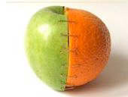
Limitations - Heterogeneity
Evidence that the studies do not belong to the same population
Assess sources of heterogeneity
  effect modifiers
  study design
  quality of studies
If heterogeneity is present, no summary estimate should be calculated

Slide 11
Studies Quality
The validity of a meta-analysis depends on the quality of the studies included, and an assessment of quality is a necessary part of the process
Think of the process as “waste management”, not garbage in, garbage out.
Careful choice of a set of inclusion criteria based on the quality of the study
Limit to certain high quality studies, for example those that use random assignment, or a placebo control. For observational studies, may limit to those where confounders were adequately addressed in the design or analysis.

Slide 12
How To Improve Quality And Reduce Publication Bias
Register your study at PROSPERO
This avoids duplications (COVID-19!!!)
Allows other investigators to inform of their unpublished data
https://www.crd.york.ac.uk/prospero/

Slide 13
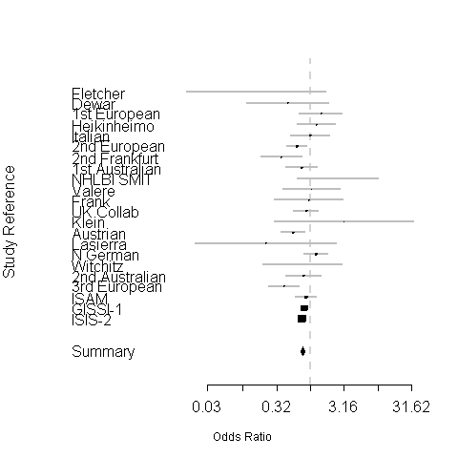
Forest Plot
The dotted vertical line is risk 1.0 (No risk)
The Risk Estimate of each study is lined up, with 95% CI
This diamond is the summary estimate
The two ends of the diamond are 95% CI
The size of each black square box indicates weight of the study

Slide 14
Guidelines For Reporting
Protocols for the reporting of meta-analysis results were developed for RCTs (Quality of Reports of Meta-analysis [QUOROM] and Observational Studies in Epidemiology [MOOSE]
The purpose of QUOROM and MOOSE guidelines is to provide proper procedures for conducting a meta-analysis and to standardize the methods of reporting a meta-analysis.
Kevin C. Chung, MD, Patricia B. Burns, MPH, H. Myra Kim, ScD. “Clinical Perspective: A Practical Guide to Meta-Analysis.” The Journal of Hand Surgery. Vol.31A No.10 December 2006. p. 1672

Slide 15
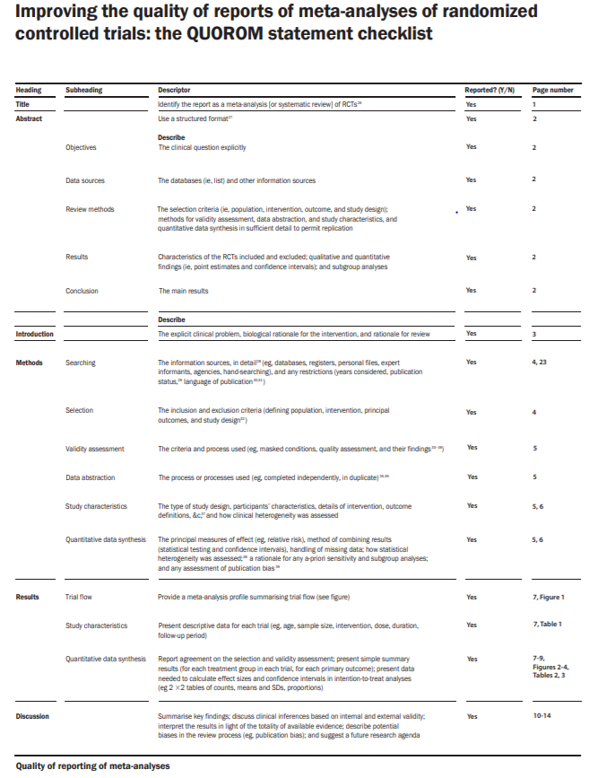

Slide 16
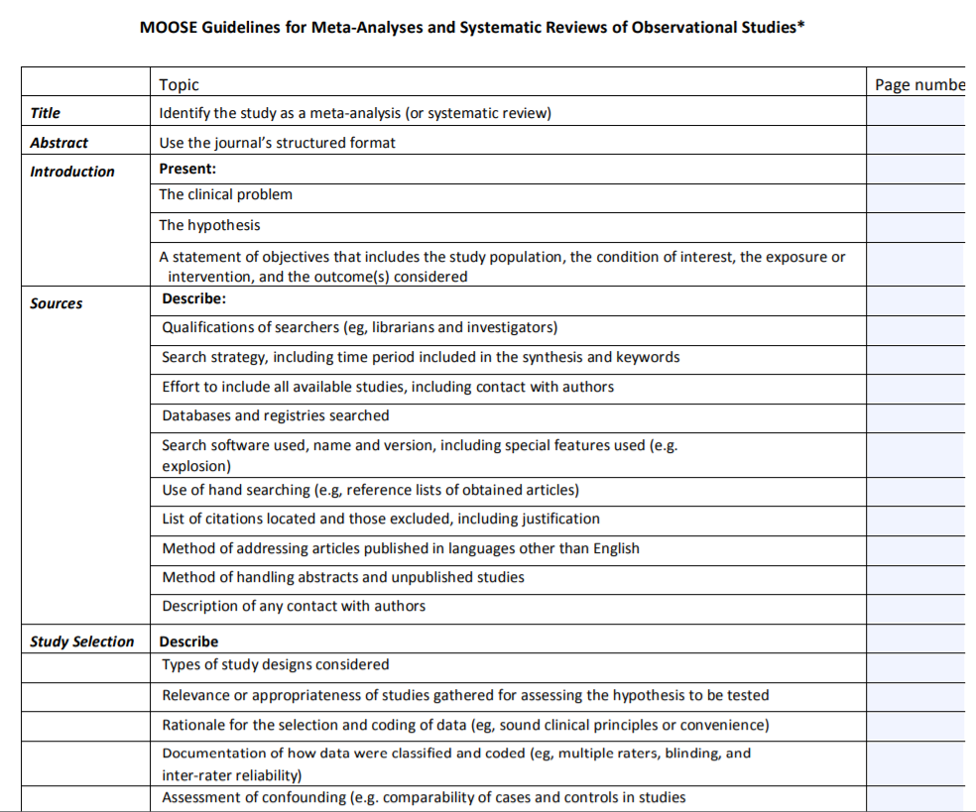

Slide 17
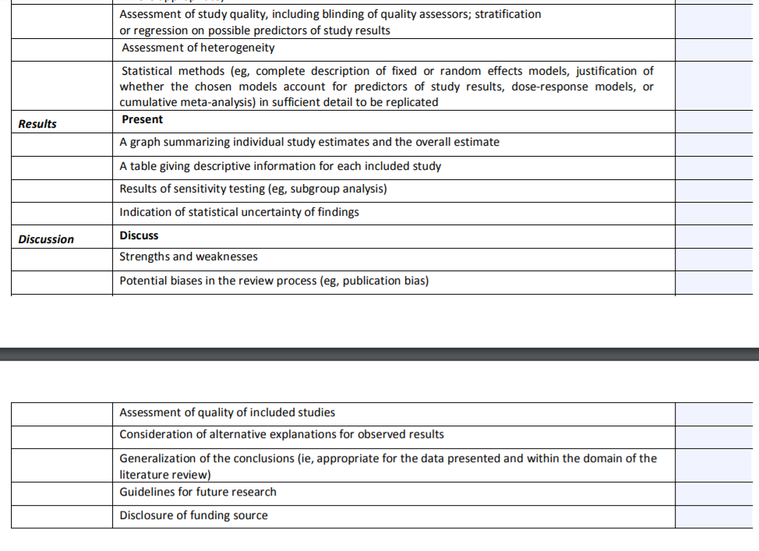

Slide 18
Steps of Meta-analysis
Define the Research Question
Define inclusion-exclusion criteria
Define key word for search
Perform the literature search
Select the studies
Evaluate appropriateness and quality
Extract the data and effect estimates
Analyze the data - Calculation of combined effect
Report the results
Interpretation (heterogeneity; bias)

Slide 19
Further Steps
Need to assess of sources of
  heterogeneity
  Bias
  Sometimes sensitivity analyses help
Interpretation driven by biological rather than statistical consideration

Slide 20
Define A Research Question
Consider four parts of a research question:
  the patient or problem (P);
  the intervention or exposure (I);
  the comparison intervention or exposure (C), if relevant;
  the (clinical) outcome of interest (O).
  Possibly time frame (T)
  This exercise helps to refine the question, and to develop the search terms

Slide 21
Examples Of Questions That Can Be Answered But Are Not Appropriate Anymore
SNP candidate genes and disease associations
  WHY?
  If a SNP is rare, combining studies may reach the critical threshold of statistical significance, but the clinical meaning is limited
  A SNP dosen’t function in a vacuum, but as integral part of the genome
  There is always gene-environmental interaction

Slide 22
EXAMPLE: is lung cancer survival improving because of better surgical options?
P: lung cancer patients have dismal survival
I: limited resection
C: lobectomy (gold standard)
O: mortality
QUESTION:
Does limited resection improve survival/reduce mortality in comparison to lobectomy in lung cancer patients?

Slide 23
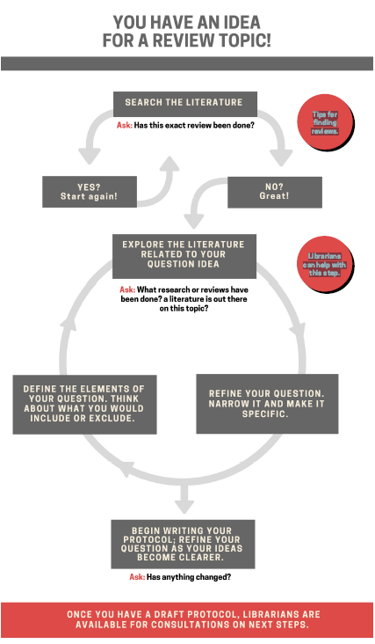
In our example: early stage is a critical determinant of mortality, and is associated with being a candidate to surgery
Refine question and limit to early stage lung cancer

Slide 24
One Last Example: Glyphosate (Round-up)
Very controversial topic (a lot of money involved)
Ubiquitous use on food and plants, we are all exposed
- Defined as 2A carcinogen by IARC, but not by EPA and European Food Safety Authority

Slide 25
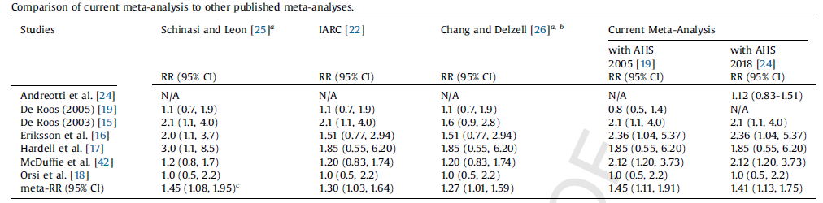
THERE HAS BEEN 4 (Now 5) META- ANALYSES WITH DIFFERENT INCLUSION CRITERIA AND OBJECTIVES
The good news: results are similar
The bad news: there are few studies, only one cohort, none on general population

