Slide 1
When the Belly Beats
Bryan Musmacker
PGY-2

Slide 2
HPI + Vitals
70M pmh CAD, HTN, known AAA (~3.7cm on chart review) presenting with 3 days of atraumatic lower back pain radiating to the abdomen
Vitals: BP 192/110, HR 80, RR 18, Spo2 99%, T98.6

Slide 3
Exam
Neuro: normal
Cardiac: normal
Abdominal: pulsating abdominal mass
MSK: normal

Slide 4
Brief Differential + Workup
Ddx: Ruptured/symptomatic AAA, ACS, MSK, etc.
Workup: CTA?, EKG, all the labs

Slide 5
Brief Differential + Workup
But first,
POCUS
Ddx: Ruptured/symptomatic AAA, ACS, MSK, etc.
Workup: CTA?, EKG, all the labs

Slide 6
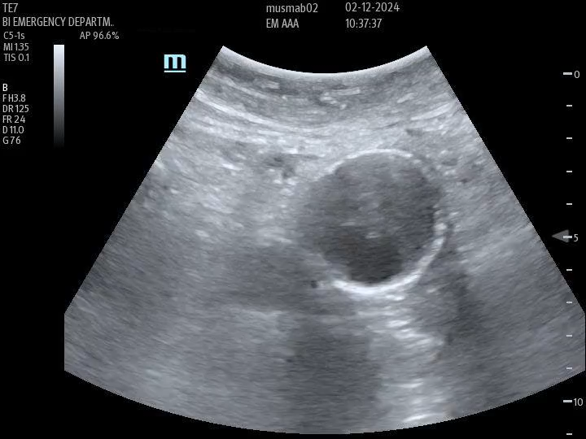
POCUS

Slide 7
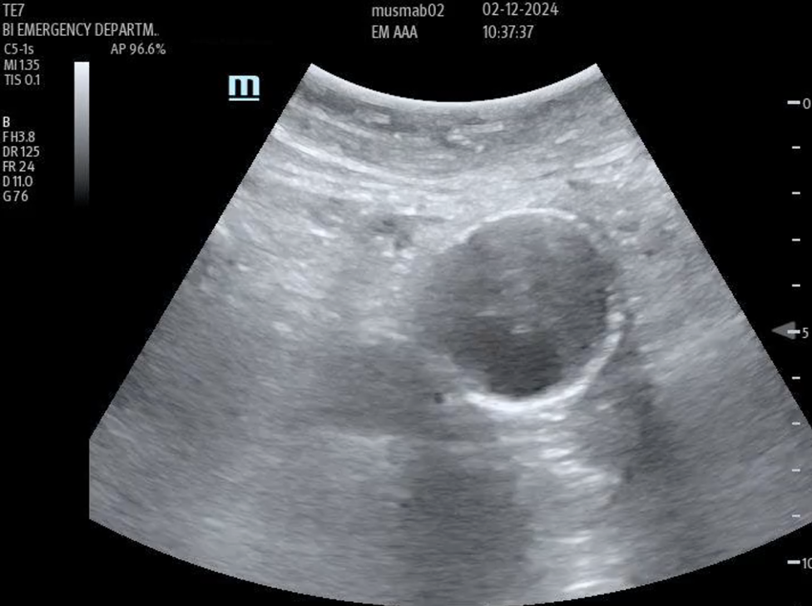

POCUS

Slide 8
POCUS
Outer wall
Thrombus
Inner Wall
Lumen

Slide 9
POCUS - Which measurements do we use?
Outer wall
Thrombus
Inner Wall
Lumen

Slide 10
POCUS
Inner: 2.2cm
Outer: 4.9cm

Slide 11
Normal Aorta on US
Abdominal aorta
  Proximal <3cm – area of celiac trunk
  Middle <3cm – area of SMA and renal arteries
  Distal <3cm – just proximal to iliac arteries
  Iliac <1.5cm
  Sagittal <3cm
Thoracic aorta
  Ascending aorta <4cm

Slide 12
Next Steps for this Patient
CTA CAP reveals 4.8cm aneurysm with intramural thrombus and possible area of external blood collection concerning for unstable or contained rupture of AAA
Vascular consulted
BP/HR controlled with esmolol/clevi
Sent to MSH for EVAR

Slide 13
Management of AAA in ED
POCUS is quick and easy method to evaluate and can reveal if diameter is increased (from known prior aneurysm) but will rarely show evidence of rupture
CTA CAP is gold standard imaging and will evaluate for rupture
Vascular consult on any symptomatic patients, new AAA (especially if >5cm), evidence of rupture
Emergent surgical intervention needed in patients with symptoms attributable to the aneurysm or evidence of rupture
Notes:
See References at end

Slide 14
Question
Ultrasound images are obtained of 4 different patients and aortic diameters are obtained. Based on diameter and location, which of these patients has an aortic aneurysm?
2.5cm distal abdominal aorta
3.2cm ascending aorta
3.5cm proximal abdominal aorta
1.4cm iliac artery

Slide 15
Question
Ultrasound images are obtained of 4 different patients and aortic diameters are obtained. Based on diameter and location, which of these patients has an aortic aneurysm?
2.5cm distal abdominal aorta
3.2cm ascending aorta
3.5cm proximal abdominal aorta
1.4cm iliac artery

Slide 16
References
Chaikof EL, Brewster DC, Dalman RL, Makaroun MS, Illig KA, Sicard GA, Timaran CH, Upchurch GR Jr, Veith FJ; Society for Vascular Surgery. The care of patients with an abdominal aortic aneurysm: the Society for Vascular Surgery practice guidelines. J Vasc Surg. 2009 Oct;50(4 Suppl):S2-49. doi: 10.1016/j.jvs.2009.07.002. PMID: 19786250.
Sullivan CA, Rohrer MJ, Cutler BS. Clinical management of the symptomatic but unruptured abdominal aortic aneurysm. J Vasc Surg. 1990 Jun;11(6):799-803. PMID: 2359191.
Lesperance K, Andersen C, Singh N, Starnes B, Martin MJ. Expanding use of emergency endovascular repair for ruptured abdominal aortic aneurysms: disparities in outcomes from a nationwide perspective. J Vasc Surg. 2008 Jun;47(6):1165-70; discussion 1170-1. doi: 10.1016/j.jvs.2008.01.055. Epub 2008 Apr 3. PMID: 18394857.

