Slide 1
Albumin Stewardship
Pharmacist Inservice
Lance Cho, PharmD, BCPS, BCCCP

Slide 2
Objectives
Review albumin mechanism of action
Discuss indications for albumin
Identify contraindications and safety monitoring for albumin use
Analyze strategies for albumin stewardship

Slide 3
Overview of Albumin
Albumin is a protein found in human plasma that is primarily responsible for regulating blood oncotic pressure.
Exogenous albumin is a large molecular weight colloid used as a plasma volume expander
Albumin increases intravascular oncotic pressure and causes fluid to shift from the interstitial space into the intravascular space, increasing effective plasma volume
Albumin products are available in 5% and 25% concentrations with each formulation containing around 145 mEq/L of sodium
Raofinia R et al. Adv Pharm Bull. 2016 Dec
Notes:
Raoufinia R, Mota A, Keyhanvar N et al. Overview of Albumin and Its Purification Methods. Adv Pharm Bull. 2016 Dec;6(4):495-507.

Slide 4
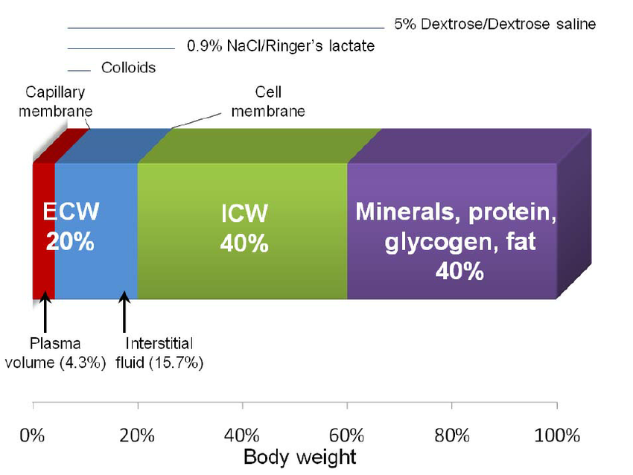
Crystalloid vs Colloid Distribution
Albumin is more effective at plasma volume expansion compared to isotonic crystalloids such as 0.9% sodium chloride
This is due to the distribution of colloids primarily into the intravascular space
5% albumin is considered osmotically equivalent to plasma
  250 ml of 5% albumin will provide an effective plasma volume of 250 ml
25% albumin is osmotically equivalent to 5 times its volume to plasma
  50 ml of 25% albumin will provide an effective plasma volume of 250 ml due to fluid shifts from the interstitial (or "third") space into the intravascular space
Powell-Tuck J et al. NHS. 2011 Mar
Notes:
Powell-Tuck J, Gosling P et al. British Consensus Guidelines on Intravenous Fluid Therapy for Adult Surgical Patients (GIFTASUP). London: NHS National Library of Health.

Slide 5
Albumin Dosing – Grams vs Units
Depending on indication albumin doses will be expressed in either units or grams
Regardless of the concentration (5% vs 25%) 1 unit = 12.5 grams
Round weight-based doses up to the nearest unit
Notes:
Raoufinia R, Mota A, Keyhanvar N, Safari F, Shamekhi S, Abdolalizadeh J. Overview of Albumin and Its Purification Methods. Adv Pharm Bull. 2016 Dec;6(4):495-507. doi: 10.15171/apb.2016.063. Epub 2016 Dec 22. PMID: 28101456; PMCID: PMC5241407.

Slide 6
Albumin Indications
Approved Indications
Not Approved / Contraindicated
Large volume paracentesis
Diagnosis of Hepatorenal Syndrome (HRS)
Treatment of Hepatorenal Syndrome
Spontaneous Bacterial Peritonitis
Intradialytic Hypotension
Plasmapheresis
Traumatic Brain Injury
Acute Respiratory Distress Syndrome
Major Trauma
Hemorrhagic Shock
Severe Nephrotic Syndrome
Distributive/Hypovolemic Shock
Notes:
Raoufinia R, Mota A, Keyhanvar N, Safari F, Shamekhi S, Abdolalizadeh J. Overview of Albumin and Its Purification Methods. Adv Pharm Bull. 2016 Dec;6(4):495-507. doi: 10.15171/apb.2016.063. Epub 2016 Dec 22. PMID: 28101456; PMCID: PMC5241407.

Slide 7
Paracentesis (Approved Indication)
Paracentesis is a procedure performed typically for patients with liver disease in which ascitic fluid is drained from the peritoneal cavity
Diagnostic vs Therapeutic Paracentesis
  Diagnostic paracenteses typically involve smaller volumes of ascitic fluid removal. This fluid is removed and used to test for bacterial peritonitis.
  Therapeutic paracentesis involve large volumes of removal for patients with tense ascites leading to abdominal discomfort, respiratory distress or patients with diuretic-refractory ascites
Diagnostic paracenteses do not typically require albumin therapy
Albumin is used for patients with large-volume paracentesis to prevent acute kidney injury
Notes:
Biggins SW, Angeli P, Garcia-Tsao G, Ginès P, Ling SC, Nadim MK, Wong F, Kim WR. Diagnosis, Evaluation, and Management of Ascites, Spontaneous Bacterial Peritonitis and Hepatorenal Syndrome: 2021 Practice Guidance by the American Association for the Study of Liver Diseases. Hepatology. 2021 Aug;74(2):1014-1048.

Slide 8
Paracentesis (Approved Indication) Cont.
"Large-volume" paracentesis (LVP) is defined as the removal of > 4L of ascitic fluid during paracentesis
  LVP is an indication for albumin replacement
In some cases where less than 4L of fluid is removed, albumin may still be indicated
Patients with acute kidney injury or chronic kidney disease with a serum creatinine (SCr) of > 1.5 mg/dL should receive albumin replacement after paracentesis, even if the volume removed is < 4L
  Albumin may also be considered in patients with hyponatremia or those who are hemodynamically unstable even if the volume removed is < 4L
Paracentesis Albumin Dosing
25% Albumin 6-8g/L of ascitic fluid removed
*If over 5L removed, maximum dose 50g (4 units)
Biggins SW et al. Hepatology. 2021 Aug
Bernardi M et al. Gut. 2020 Jun
Notes:
Biggins SW, Angeli P, Garcia-Tsao G, Ginès P, Ling SC, Nadim MK, Wong F, Kim WR. Diagnosis, Evaluation, and Management of Ascites, Spontaneous Bacterial Peritonitis and Hepatorenal Syndrome: 2021 Practice Guidance by the American Association for the Study of Liver Diseases. Hepatology. 2021 Aug;74(2):1014-1048.

Slide 9
Verification Tips: Albumin for Paracentesis
Confirm that "Other" selection is not being used
Check how much fluid was removed by clicking on the documents tab and looking for a procedure note or calling the provider or nurse to confirm
If the amount of fluid removed was less than 4L, check the patient's chemistry to confirm if the patient meets any of the following criteria:
  Serum sodium < 130 mEq/L
  Systolic blood pressure < 90 mmHg or on vasopressors
  SCr > 1.5 mg/dL
Check that the dose of albumin is within range: 6-8 g per liter of fluid removed
Notes:
Biggins SW, Angeli P, Garcia-Tsao G, Ginès P, Ling SC, Nadim MK, Wong F, Kim WR. Diagnosis, Evaluation, and Management of Ascites, Spontaneous Bacterial Peritonitis and Hepatorenal Syndrome: 2021 Practice Guidance by the American Association for the Study of Liver Diseases. Hepatology. 2021 Aug;74(2):1014-1048.

Slide 10
Hepatorenal Syndrome (Approved Indication)
Hepatorenal syndrome (HRS) refers to acute kidney injury in the setting of end stage liver disease
There are two types of HRS: HRS-AKI and HRS-CKD
HRS is a diagnosis of exclusion, which requires a trial of volume expansion with albumin to rule out pre-renal injury
Portal Hypertension
Splanchnic Vasodilation
Decreased Intravascular Volume
RASS Activation
Renal Vasoconstriction
Flamm SL et al. Clin Gastroenterol Hepatol. 2022 Dec
Notes:
Flamm SL, Wong F, Ahn J, Kamath PS. AGA Clinical Practice Update on the Evaluation and Management of Acute Kidney Injury in Patients With Cirrhosis: Expert Review. Clin Gastroenterol Hepatol. 2022 Dec;20(12):2707-16.

Slide 11
Hepatorenal Syndrome (Approved Indication)
One of the diagnostic criteria for HRS is a lack of response to diuretic discontinuation and volume expansion challenge with albumin
Patients who fail to respond to albumin challenge should receive an additional 72 hours or more of albumin
Hepatorenal Syndrome (Diagnosis) Dosing
Day 1: 1g/kg 25% Albumin (100g max)
Day 2: 1g/kg 25% Albumin (100g max)
Hepatorenal Syndrome (Treatment) Dosing
25% Albumin 25-50g/day for 3 days or longer
Flamm SL et al. Clin Gastroenterol Hepatol. 2022 Dec
Notes:
Raoufinia R, Mota A, Keyhanvar N, Safari F, Shamekhi S, Abdolalizadeh J. Overview of Albumin and Its Purification Methods. Adv Pharm Bull. 2016 Dec;6(4):495-507. doi: 10.15171/apb.2016.063. Epub 2016 Dec 22. PMID: 28101456; PMCID: PMC5241407.

Slide 12
Verification Tips Albumin for HRS
Confirm that "Other" selection is not being used
An easy way to confirm if hepatorenal syndrome is being suspected or treated is to look at the patients orders for other components of HRS treatment
  These include midodrine, octreotide, norepinephrine, terlipressin
Check if the patient has received albumin recently
Check that the dose of albumin does not exceed 100g (for the diagnosis of HRS)
If patient is receiving 1g/kg of albumin for diagnosis of HRS, confirm that all diuretic therapy has been suspended
Notes:
Raoufinia R, Mota A, Keyhanvar N, Safari F, Shamekhi S, Abdolalizadeh J. Overview of Albumin and Its Purification Methods. Adv Pharm Bull. 2016 Dec;6(4):495-507. doi: 10.15171/apb.2016.063. Epub 2016 Dec 22. PMID: 28101456; PMCID: PMC5241407.

Slide 13
Intradialytic Hypotension (Approved Indication)
Intradialytic hypotension (IDH) is common in hospitalized patients with hypoalbuminemia receiving hemodialysis (HD)
There is limited evidence supporting the use of 2-4 units of 25% albumin to prevent IDH in hospitalized patients
Available data indicates that there is likely no benefit to albumin administration in preventing IDH in patients that do not have hypoalbuminemia
Intradialytic Hypotension Prevention Dosing
25% Albumin 2 to 4 units (25 to 50g) Prior to HD
Macedo E et al. Crit Care. 2021 Jan
Notes:
Macedo E, Karl B, Lee E, Mehta RL. A randomized trial of albumin infusion to prevent intradialytic hypotension in hospitalized hypoalbuminemic patients. Crit Care. 2021 Jan 6;25(1):18. doi: 10.1186/s13054-020-03441-0. PMID: 33407747; PMCID: PMC7789619.
=

Slide 14
Verification Tips: Albumin for IDH
Confirm that "Other" selection is not being used
Check patient's serum albumin prior to verification
If albumin is within normal range (> 3.5 g/dL), this may warrant a conversation with the ordering provider
Notes:
Macedo E, Karl B, Lee E, Mehta RL. A randomized trial of albumin infusion to prevent intradialytic hypotension in hospitalized hypoalbuminemic patients. Crit Care. 2021 Jan 6;25(1):18. doi: 10.1186/s13054-020-03441-0. PMID: 33407747; PMCID: PMC7789619.

Slide 15
Spontaneous Bacterial Peritonitis (Approved Indication)
Spontaneous bacterial peritonitis (SBP) refers to an infection of ascitic fluid that occurs primarily in patients with cirrhosis
SBP is thought to occur due to bacterial translocation from the intestinal lumen into the peritoneal cavity
SBP is diagnosed by performing a paracentesis and obtaining a cell count from the ascitic fluid
Albumin administration has been associated with a decreased risk of renal impairment and decreased mortality in hospitalized patients with SBP
Biggins SW et al. Hepatology. 2021 Aug

Slide 16
Spontaneous Bacterial Peritonitis (Approved Indication)
SBP is the presence of > 250 polymorphonuclear neutrophils (PMN) in the ascitic fluid
How to Calculate PMN Count of Ascitic Fluid:
  Total WBC Count x %Neutrophils = PMN Count
Spontaneous Bacterial Peritonitis Dosing
Day 1: 25% Albumin 1.5 g/kg (within 6 hours of diagnosis)
Day 3: 25% Albumin 1 g/kg
Maximum recommended dose (for either dose): 100g
Biggins SW et al. Hepatology. 2021 Aug
Notes:
Sort P, Navasa M, Arroyo V, Aldeguer X, Planas R, Ruiz-del-Arbol L, Castells L, Vargas V, Soriano G, Guevara M, Ginès P, Rodés J. Effect of intravenous albumin on renal impairment and mortality in patients with cirrhosis and spontaneous bacterial peritonitis. N Engl J Med. 1999 Aug 5;341(6):403-9. doi: 10.1056/NEJM199908053410603. PMID: 10432325.

Slide 17
Verification Tips: Albumin for SBP
Confirm that "Other" selection is not being used
Check results for ascitic fluid cell count and calculate PMN count
Confirm what day of treatment (e.g day 1 vs day 3)
Calculate weight-based dose based on day of therapy
Confirm patient is receiving appropriate antibiotics for SBP (e.g ceftriaxone, piperacillin-tazobactam, etc)
Notes:
Macedo E, Karl B, Lee E, Mehta RL. A randomized trial of albumin infusion to prevent intradialytic hypotension in hospitalized hypoalbuminemic patients. Crit Care. 2021 Jan 6;25(1):18. doi: 10.1186/s13054-020-03441-0. PMID: 33407747; PMCID: PMC7789619.

Slide 18
Plasmapheresis (PLEX) (Approved Indication)
May also be referred to as therapeutic apheresis or total plasma exchange
During PLEX, venous blood is passed through an extracorporeal circuit, separating cells and plasma
The purpose of PLEX is to remove harmful substances from the plasma
Albumin is one of many solutions that can be used to replace volume during PLEX
Plasmapheresis Dosing
5% Albumin (dose per New York Blood Bank MD)
Altobeli C et al. Kidney Blood Press Res. 2023
Notes:
Altobelli C, Anastasio P, Cerrone A et al. Therapeutic Plasmapheresis: A Revision of Literature. Kidney Blood Press Res. 2023;48(1):66-78.

Slide 19
Verification Tips: Albumin for PLEX
Confirm that "Other" selection is not being used
Check that 5% and not 25% albumin is ordered for replacement
Ensure that calcium gluconate or calcium chloride is ordered
  Hypocalcemia can occur during PLEX due to sodium citrate being used.
Notes:
Macedo E, Karl B, Lee E, Mehta RL. A randomized trial of albumin infusion to prevent intradialytic hypotension in hospitalized hypoalbuminemic patients. Crit Care. 2021 Jan 6;25(1):18. doi: 10.1186/s13054-020-03441-0. PMID: 33407747; PMCID: PMC7789619.

Slide 20
Nephrotic Syndrome (Approved Indication)
Nephrotic syndrome is defined by severe proteinuria and hypoalbuminemia resulting in edema and many other metabolic consequences
Hypoalbuminemia/plasma protein wasting may decrease the effectiveness of diuretics through many different mechanisms
Diuretic resistance may potentially be overcome by coadministration of albumin with a loop diuretic
Nephrotic Syndrome Dosing
25% Albumin 1-2 units (12.5 to 25 g)
in combination with a loop diuretic
*Diuretic should be used concomitantly or within 30-60 minutes of albumin administration*
Kodner C. Am Fam Physician. 2016 Mar
Duffy et al. Cells 2015 Oct
Sjöström PA et al. Eur J Clin Pharmacol 1989

Slide 21
Verification Tips: Albumin for Nephrotic Syndrome
Confirm that "Other" selection is not being used
Check that 25% albumin is ordered
Ensure that concomitant diuretic therapy is scheduled to be given concomitantly or within 60 minutes of albumin administration
Ensure no contraindications to diuretic therapy, e.g severe electrolyte abnormalities

Slide 22
Hypovolemic or Distributive Shock
Hypovolemic shock is a result of decreased intravascular plasma volume
  Hypovolemic shock may be due to many different reasons including active blood loss and dehydration
  Hypovolemic shock from hemorrhage is NOT an indication for albumin
Distributive shock results in decreased systemic vascular resistance and increased vascular permeability leading to 'leaking' of volume from the intravascular space into the interstitial space
  Septic shock is a type of distributive shock
Albumin may or may not be appropriate for patients with hypovolemic or distributive shock
  In most cases, crystalloids may be sufficient in providing volume for these patients
Notes:
Raoufinia R, Mota A, Keyhanvar N, Safari F, Shamekhi S, Abdolalizadeh J. Overview of Albumin and Its Purification Methods. Adv Pharm Bull. 2016 Dec;6(4):495-507. doi: 10.15171/apb.2016.063. Epub 2016 Dec 22. PMID: 28101456; PMCID: PMC5241407.

Slide 23
Hypovolemic or Distributive Shock
The SAFE and ALBIOS trials demonstrated no difference in mortality in patients receiving albumin compared to crystalloids
However, there is some evidence to suggest that albumin may decrease mortality in patients with cirrhosis and septic shock
The 2021 Surviving Sepsis Guidelines make a weak recommendation for the use of albumin in patients receiving large volumes of crystalloid resuscitation
  'Large volume' is not defined in the guidelines
When albumin is ordered for these patients, cases should be thoroughly reviewed for any contraindications
Finfer S et al. N Engl J Med. 2004 May
Philips CA et al. Hepatol Int. 2021 Aug
Caironi P et al. N Engl J Med. 2014 Apr
Xu JY et Al. Crit Care. 2014 Dec
Evans L et al. Intensive Care Med. 2021 Nov

Slide 24
*Verification Tips* Albumin for Shock
Confirm that "Other" selection is not being used
Confirm what type of shock the patient is in by checking the documents
Ensure that the patient has no contraindications to albumin
  A major example would be patients with hemorrhagic shock or traumatic brain injury

Slide 25
Practice Patient Case

Slide 26
IH is a 42yo M with no known PMH who presented with testicular swelling. Symptoms began ~15 days ago, states that his abdomen and legs have been extremely swollen and have not changed in last 2 weeks. Notes 6/10 testicular pressure on ambulation but no pain otherwise. Pain/swelling have been worsening since onset
Patient was newly diagnosed with cirrhosis, presenting with shortness of breath, and had tense ascites which required a need for paracentesis
Scr increase from 0.86 mg/dL to 1.29 mg/dL
5/8: Underwent paracentesis– large amount of ascites was found and 5.2 L of fluid was removed
5/7: CTAP – Severe abdominal pelvic ascites, cirrhotic changes of liver, bladder distention, diffuse subcutaneous edema

Slide 27
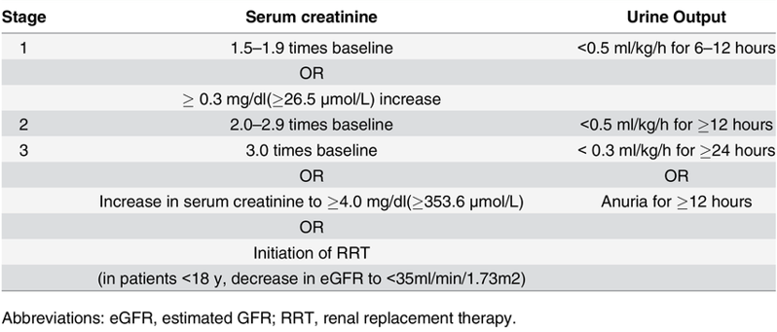
KDIGO AKI Guidelines
Scr increase from 0.86 mg/dL to 1.29 mg/dL

Slide 28


Albumin orders from 5/9

Slide 29



Do you think these orders are ordered correctly?
Yes
No

Slide 30
What albumin dose and indication would you recommend for them?
A) Albumin 25% 12.5g for paracentesis
B) Albumin 5% 12.5g for hepatorenal syndrome
C) Albumin 25% 50g (4 units) for paracentesis
D) Albumin 25% 40g (3 units) for paracentesis
No

Slide 31
What albumin dose and indication would you recommend for them?
A) Albumin 25% 12.5g for paracentesis
B) Albumin 5% 12.5g for hepatorenal syndrome
C) Albumin 25% 50g (4 units) for paracentesis
D) Albumin 25% 40g (3 units) for paracentesis

Slide 32
But wait… there’s more!

Slide 33






What is incorrect about this order?

Slide 34
Paracentesis Albumin Dosing
25% Albumin 6-8g/L of ascitic fluid removed
*If over 5L removed, maximum dose 50g (4 units)

Slide 35
Provider stated GI wants 100g total
GIs note – recommend total of albumin 100g with Lasix 40 mg
Nephrotic Syndrome???

Slide 36
What would be the correct albumin order for nephrotic syndrome?
A) Albumin 25% 40g (3 units) for nephrotic syndrome
B) Albumin 25% 50g (4 units) for nephrotic syndrome
C) Albumin 25% 12.5 to 25g (1-2 units) for nephrotic syndrome

Slide 37
What would be the correct albumin order for nephrotic syndrome?
A) Albumin 25% 40g (3 units) for nephrotic syndrome
B) Albumin 25% 50g (4 units) for nephrotic syndrome
C) Albumin 25% 12.5 to 25g (1-2 units) for nephrotic syndrome

Slide 38
References
Altobelli C, Anastasio P, Cerrone A et al. Therapeutic Plasmapheresis: A Revision of Literature. Kidney Blood Press Res. 2023;48(1):66-78.
Bernardi M, Angeli P, Claria J et al. Albumin in decompensated cirrhosis: new concepts and perspectives. Gut. 2020 Jun;69(6):1127-38.
Biggins SW, Angeli P, Garcia-Tsao G, et al. Diagnosis, Evaluation, and Management of Ascites, Spontaneous Bacterial Peritonitis and Hepatorenal Syndrome: 2021 Practice Guidance by the American Association for the Study of Liver Diseases. Hepatology. 2021 Aug;74(2):1014-48.
Caironi P, Tognoni G, Masson S et al; ALBIOS Study Investigators. Albumin replacement in patients with severe sepsis or septic shock. N Engl J Med. 2014 Apr 10;370(15):1412-21.
Duffy M, Jain S, Harrell N et al. Albumin and Furosemide Combination for Management of Edema in Nephrotic Syndrome: A Review of Clinical Studies. Cells. 2015 Oct 7;4(4):622-30.
Evans L, Rhodes A, Alhazzani W et al. Surviving sepsis campaign: international guidelines for management of sepsis and septic shock 2021. Intensive Care Med. 2021 Nov;47(11):1181-247.
Finfer S, Bellomo R, Boyce N et al; SAFE Study Investigators. A comparison of albumin and saline for fluid resuscitation in the intensive care unit. N Engl J Med. 2004 May 27;350(22):2247-56.
Flamm SL, Wong F, Ahn J et al. AGA Clinical Practice Update on the Evaluation and Management of Acute Kidney Injury in Patients With Cirrhosis: Expert Review. Clin Gastroenterol Hepatol. 2022 Dec;20(12):2707-16.
Kodner C. Diagnosis and Management of Nephrotic Syndrome in Adults. Am Fam Physician. 2016 Mar 15;93(6):479-85.
Macedo E, Karl B, Lee E et al. A randomized trial of albumin infusion to prevent intradialytic hypotension in hospitalized hypoalbuminemic patients. Crit Care. 2021 Jan 6;25(1):18.
Philips CA, Maiwall R, Sharma MK et al. Comparison of 5% human albumin and normal saline for fluid resuscitation in sepsis induced hypotension among patients with cirrhosis (FRISC study): a randomized controlled trial. Hepatol Int. 2021 Aug;15(4):983-994.
Powell-Tuck J, Gosling P et al. British Consensus Guidelines on Intravenous Fluid Therapy for Adult Surgical Patients (GIFTASUP). London: NHS National Library of Health. 2011 Mar.
Raoufinia R, Mota A, Keyhanvar N et al. Overview of Albumin and Its Purification Methods. Adv Pharm Bull. 2016 Dec;6(4):495-507.
Sjöström PA, Odlind BG, Beermann BA et al. Pharmacokinetics and effects of frusemide in patients with the nephrotic syndrome. Eur J Clin Pharmacol.1989;37(2):173-80.
Xu JY, Chen QH, Xie JF et al. Comparison of the effects of albumin and crystalloid on mortality in adult patients with severe sepsis and septic shock: a meta-analysis of randomized clinical trials. Crit Care. 2014 Dec 15;18(6):702.

