Slide 1
Advanced Cardiac Life Support (ACLS) for Pharmacists
PGY-1 Pharmacy Resident Focused Topic Discussion
MSSN PGY-1 Pharmacy Residency Program

Slide 2
Objectives
Review electrocardiogram basics and cardiac arrest rhythms
Review advanced cardiac life support algorithms and pharmacist's roles and responsibilities during a cardiac arrest code
Evaluate available resources and opportunities for pharmacist involvement
Apply management strategies to patient cases

Slide 3
Review of
Overhead Codes

Slide 4
Codes with Potential for Pharmacist Involvement
Stroke Team
Medical Team
  Cardiac arrest patients requiring cardiopulmonary resuscitation.
Rapid Response Team
  Patient in need of immediate medical assistance due to acute change in physiologic and/or mental status.
  Examples include but are not limited to: seizures, acute respiratory distress, altered mental status, chest pain, etc.
Massive Transfusion Protocol
  Patient hemorrhage requiring emergency transfusion.
Trauma Level 1 or 2

Slide 5
Cardiac Arrest Rhythms

Slide 6
Shockable vs Non-Shockable Rhythms
Shockable rhythms refer to cardiac arrest rhythms that may be responsive to defibrillation
  Ventricular Tachycardia (VT)
  Ventricular Fibrillation (VF)
Non-shockable rhythms refer to cardiac arrest rhythms that do not respond to defibrillation
  Asystole
  Pulseless Electrical Activity (PEA)

Slide 7
Ventricular Tachycardia
Wide complex ventricular arrhythmia
Polymorphic vs Monomorphic
  QRS morphology variations
  Polymorphic VT -> Torsades de Pointes
Most commonly due to ischemic heart disease
Pulseless VT requires immediate cardiopulmonary resuscitation (CPR)
VT with a pulse may be treated with cardioversion or antiarrhythmic drugs
Notes:
http://hqmeded-ecg.blogspot.com/2013/10/polymorphic-ventricular-tachycardia.html

Slide 8
Ventricular Fibrillation
Wide complex ventricular arrhythmia
Disorganized and erratic depolarization of the ventricular myocardium
Characterized by ventricular complexes on ECG that are changing in amplitude, frequency and contour
Requires immediate CPR and ACLS management
Similar to VT, VF is commonly due to ischemic or structural heart disease

Slide 9
Asystole and Pulseless Electrical Activity
Asystole is defined as the complete absence of electrical and mechanical activity of the heart
Pulseless electrical activity (PEA) is the absence of a palpable pulse in the presence of electrical activity
Asystole represents a terminal rhythm and can be due to prolonged cardiac arrest
Patients in asystole/PEA should immediately receive CRP and ACLS protocol
Reversible causes of asystole/PEA should be identified and treated during resuscitation
  H's and T's

Slide 10
ACLS Algorithms

Slide 11
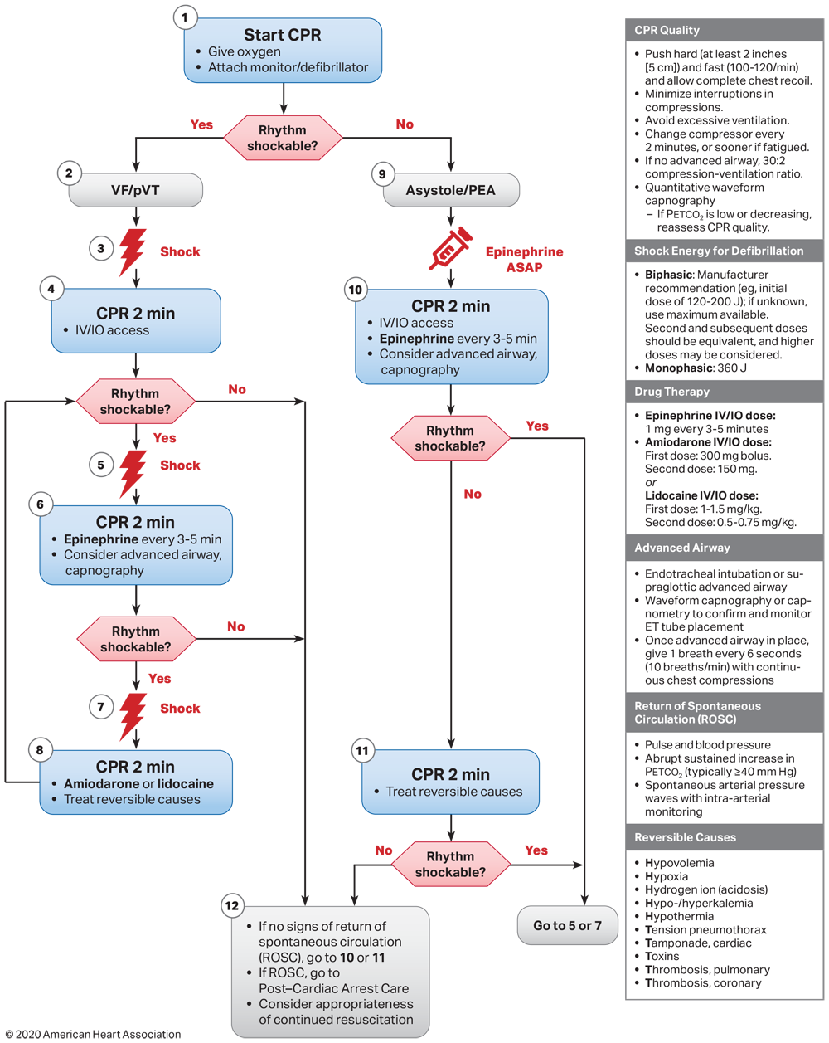
Cardiac Arrest Algorithm
Notes:
American Heart Association. Advanced Cardiovascular Life Support : Provider Manual. American Heart Association; 2020.

Slide 12
H's and T's – Reversible Causes of Cardiac Arrest
In addition to following the ACLS algorithm for PEA/asystole, reversible causes must be identified and treated
H's
  Hypovolemia
  Hypoxia/hypoxemia
  Hydrogen Ion Excess (Acidosis)
  Hypo/hyperkalemia
  Hypothermia
T's
  Tamponade
  Toxins
  Tension Pneumothorax
  Thrombosis (Pulmonary Embolism, Coronary)

Slide 13
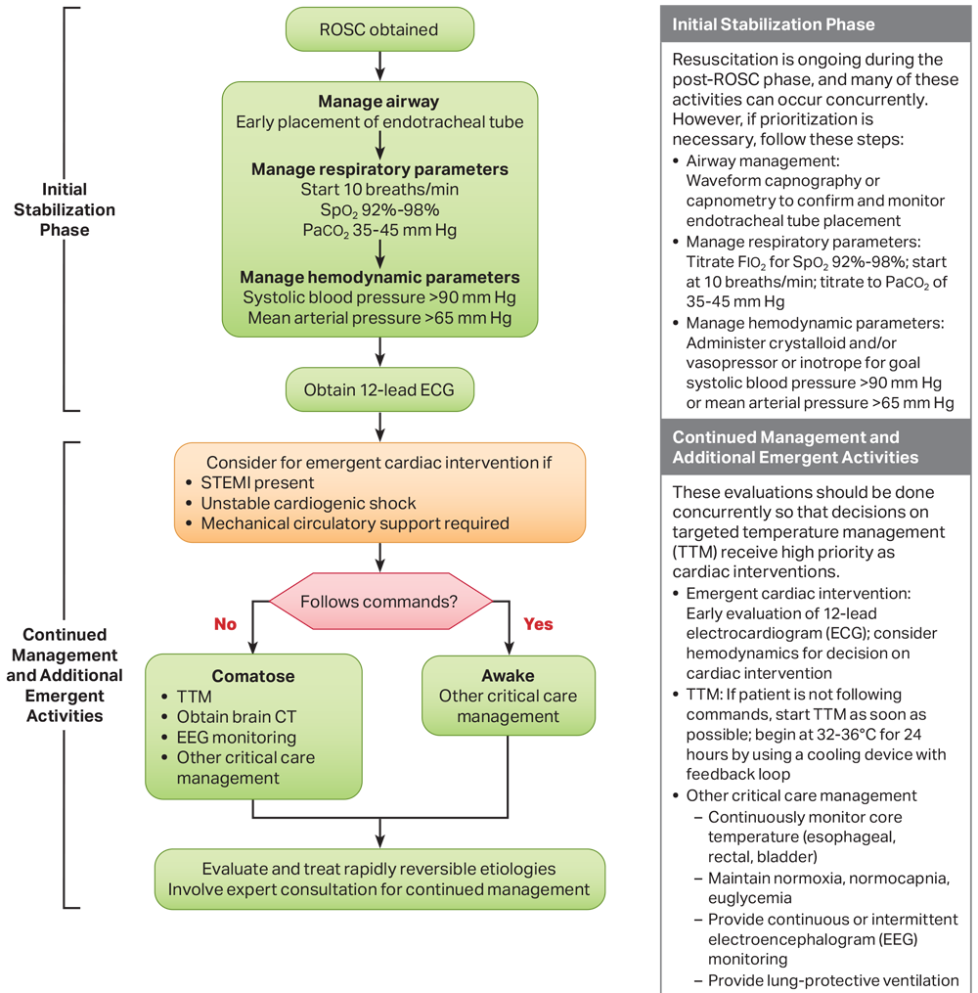
Post Cardiac Arrest Care
Notes:
American Heart Association. Advanced Cardiovascular Life Support : Provider Manual. American Heart Association; 2020.

Slide 14
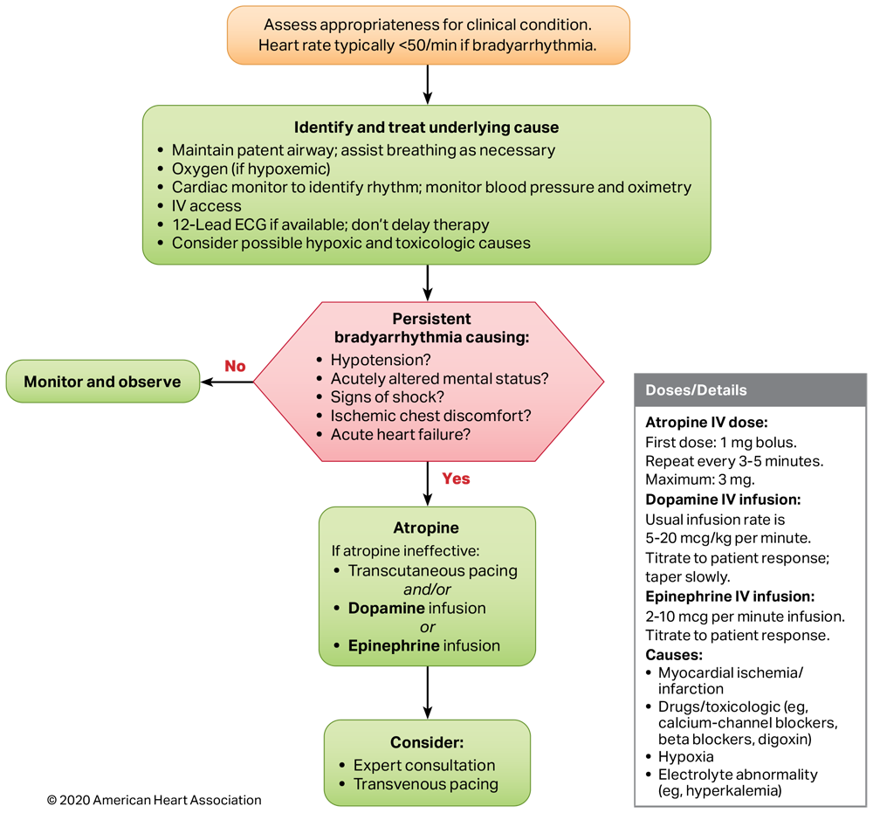
Adult Bradycardia Algorithm
Notes:
American Heart Association. Advanced Cardiovascular Life Support : Provider Manual. American Heart Association; 2020.

Slide 15
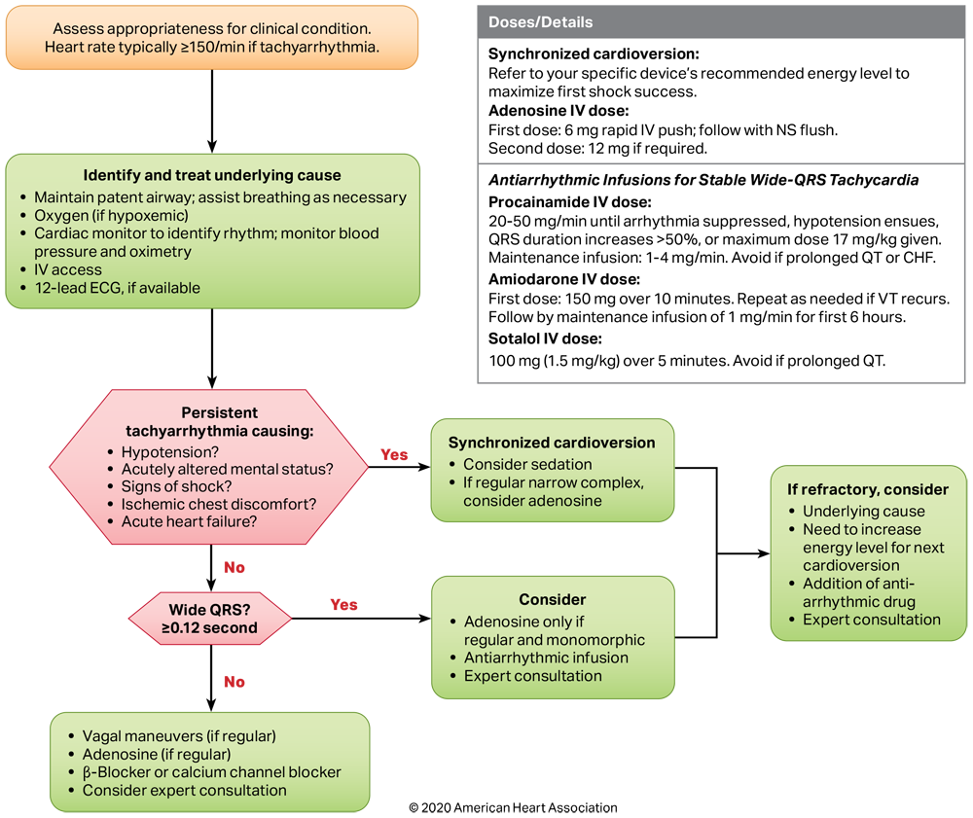
Adult Tachycardia Algorithm
Notes:
American Heart Association. Advanced Cardiovascular Life Support : Provider Manual. American Heart Association; 2020.

Slide 16
Medical Team

Slide 17
Medical Team Overview
Response team typically consists of:
  Critical Care APP and/or Attending Physician
  Internal Medicine or Family Medicine Resident Physicians
  Rapid Response or Critical Care Nurse
  Respiratory Therapist
  Pharmacist
Every member of the code team has set roles and responsibilities
  As pharmacists, you will be primarily responsible for the preparation of medications and recommendations to aid in resuscitation
Medical residents typically serve as code leaders unless there is an attending present
Mount Sinai South Nassau Pharmacy Residency/ ACLS for Pharmacists/ 2023

Slide 18
Crash Cart
Medication Tray

Slide 19
MSSN Crash Cart Contents
Medication | Qty | Medication | Qty
Adenosine 6 mg/2ml Vial | 3 | Lidocaine 100 mg Syringe | 2
Amiodarone 150 mg/3 ml Amp | 4 | Magnesium sulfate 5 g/10 ml Syringe | 1
Atropine 1 mg Syringe | 2 | Naloxone 0.4 mg/ml Vial | 2
Calcium Chloride 1 g Syringe | 1 | Naloxone 2 mg/2 ml Syringe | 1
Dextrose 50% 25g Syringe | 1 | Norepinephrine 4 mg/4 ml Vial | 2
Epinephrine 1 mg/ml Vial | 4 | Sodium Bicarbonate 50 mEq Syringe | 4
Epinephrine 1 mg/10 ml Syringe | 8

Slide 20
Patient Case

Slide 21
Patient Case #1
AP is a 64-year-old female with a PMH of HTN, CKD 3a, class III obesity that presented to the ED yesterday with a 4-day history of shortness of breath and RLE pain/swelling.
Chest X-Ray done in the ED was negative for acute pulmonary pathology.
Initial EKG showed sinus tachycardia with a heart rate of 125.
Labs on admission were significant for an elevated BUN, SCr and potassium.
Patient was admitted to the general medical floor for presumed exacerbation of undiagnosed COPD.
This morning, patient was found unresponsive and a medical team is called.
PMH: past medical history, HTN: hypertension, CKD: chronic kidney disease, ED: emergency department, BUN: blood urea nitrogen, SCr: serum creatinine, EKG: electrocardiogram, COPD: chronic obstructive pulmonary disease, RLE: right lower extremity

Slide 22
Patient Case #1 Continued
Upon arrival to the bedside, you find the patient unresponsive and chest compressions are being performed by the nurse.
The initial rhythm on the monitor is PEA and epinephrine 1 mg IV push has been administered.
The medical resident at bedside asks for your recommendations.

Slide 23
Patient Case #1 Continued
After 15 minutes of ACLS protocol the patient regains a pulse.
Patient was endotracheally intubated peri-arrest and is unresponsive.
The team decides to initiate therapeutic hypothermia.
Patient is tachycardic with a heart rate of 150 bpm and is hypotensive with a mean arterial pressure (MAP) of 55 mmHg.
What would you recommend to manage this patient?
BPM: beats per minute

Slide 24
Patient Case #1 Continued
Patient converts to a sinus rhythm after synchronized cardioversion.
An hour later, you are called to bedside by the medical resident.
The patient is tachycardic again with heart rates ranging from 150-180 bpm, but is hemodynamically stable.
Patient remains unresponsive and decision is made to obtain an EKG.
EKG shows wide complex, monomorphic ventricular tachycardia.
The resident asks for your recommendations. What do you recommend?

Slide 25
Patient Case #1 Continued
Amiodarone 150 mg IV bolus over 10 minutes is given and patient converts to sinus rhythm.
Therapeutic hypothermia is initiated with a target of 33°C.
A few hours later, you are called to bedside and find the patient being actively cooled to target temperature.
The monitor shows a heart rate of 32 bpm and a MAP of 57 mmHg.
What would you recommend for this patient?

Slide 26
Patient Case #1 Continued
Therapeutic hypothermia is stopped due to symptomatic bradycardia and patient is hemodynamically stable after 2 doses of atropine 1 mg IV push and initiation of epinephrine infusion at 2 mcg/min.
Lower extremity doppler imaging shows a non-occlusive femoral vein thrombus in the right lower extremity with multiple additional thrombi in the greater saphenous vein.
Patient is too unstable to go to CT for further imaging.
Suddenly, she becomes hypoxic with increasing oxygen requirements.
There is no palpable pulse and ACLS protocol is initiated.
The initial rhythm is PEA.
The resident asks you to help them identify a reversible cause of cardiac arrest.

Slide 27
Patient Case #1 Continued
Alteplase 50 mg IV push is administered for a suspected pulmonary embolism and ACLS protocol is continued for an additional 6 minutes.
After 2 additional doses of epinephrine, ROSC is achieved.
The medical team is concerned about a possible pulmonary embolism and asks for recommendations regarding initiation of anticoagulation after alteplase administration.

Slide 28
Patient Case #2
CD is a 47-year-old male with no past medical history who has not been seen by a physician in 30 years. CD presents to the emergency department with acute onset chest pain with radiation to the jaw, back and left arm.
Initial labs were significant for elevated BUN, SCr and a troponin-i of 7
While being placed on the monitor, CD suddenly becomes unresponsive and has no palpable pulse.
Medical team is called and ACLS protocol is initiated immediately.
You are called to bedside to assist.
What cardiac arrest rhythm do you suspect the patient is in?

Slide 29
Patient Case #2 Continued
CD is given epinephrine 1 mg IV push.
CD remains pulseless and the monitor shows ventricular tachycardia.
Pads are already in place and the team prepares to shock the patient.
What medications should you be thinking about preparing?

Slide 30
Patient Case #2 Continued
ROSC is achieved after 3 defibrillations and lidocaine 100 mg IV push.
Post-arrest EKG shows ST elevations in the inferiolateral leads.
Patient is immediately taken to the cath lab for revascularization.
Coronary angiography shows a 100% occlusion of the right coronary artery which his treated with balloon angioplasty and placement of a drug eluting stent.
Patient is responsive and following commands post procedure and is admitted to the intensive care unit for monitoring.

Slide 31
References
American Heart Association. Advanced Cardiovascular Life Support : Provider Manual. American Heart Association; 2020.
Prepared By: Lance Cho, PharmD, BCPS, BCCCP
Last Updated: 20 June 2023
Notes:
Kraft MD et al. Am J Health-Syst Pharm. 2005.
Dickerson RN et al. Hosp Pharm. 2001.
Veltassa® Prescribing Information. 2015.
Kayexalate® Prescribing Information. 2017.
Lokelma® Prescribing Information. 2018

